Slide 1
Creating employment opportunities for students with disabilities in small town America
Timber Lake School District
2019 Transition Summer Institute

Slide 2
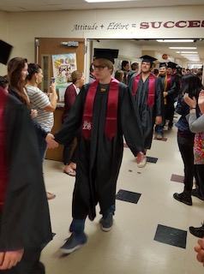
Meet Cody…
A successful young man from Isabel, SD
Currently 19 years old
Attends school in Timber Lake
Diagnosed with autism at age 3
Has a very loving and supportive family
was included in the general education environment to the greatest extent possible
Is a valued member of his graduating class and taught his peers & teachers many life lessons
Participated in graduation -may, 2018
Currently Has a rigorous work schedule

Slide 3
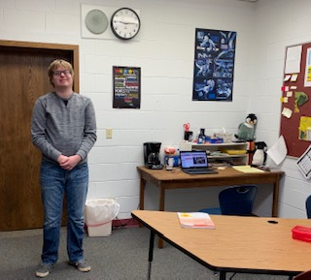
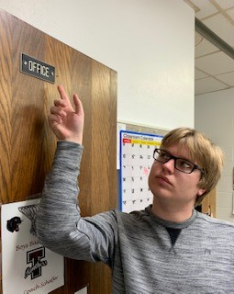
This year Cody moved from the classroom to an office space of his own
Graduation triggered some important changes for this young adult!

Slide 4
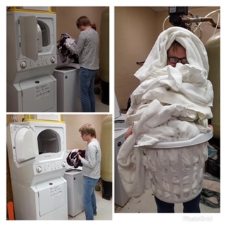
A true “team” Player!
Cody does laundry for the athletic department and the coaches sure appreciate his help!

Slide 5
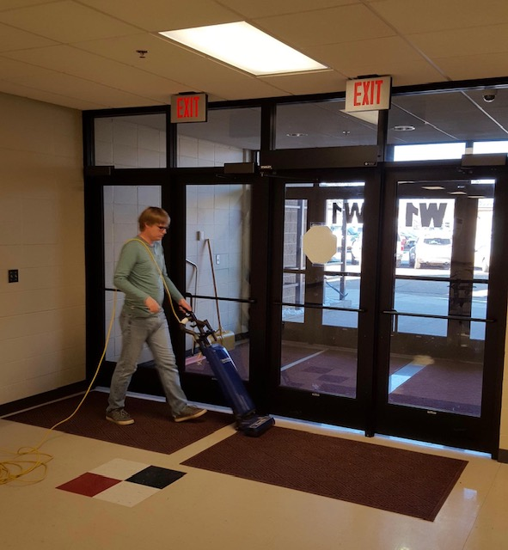
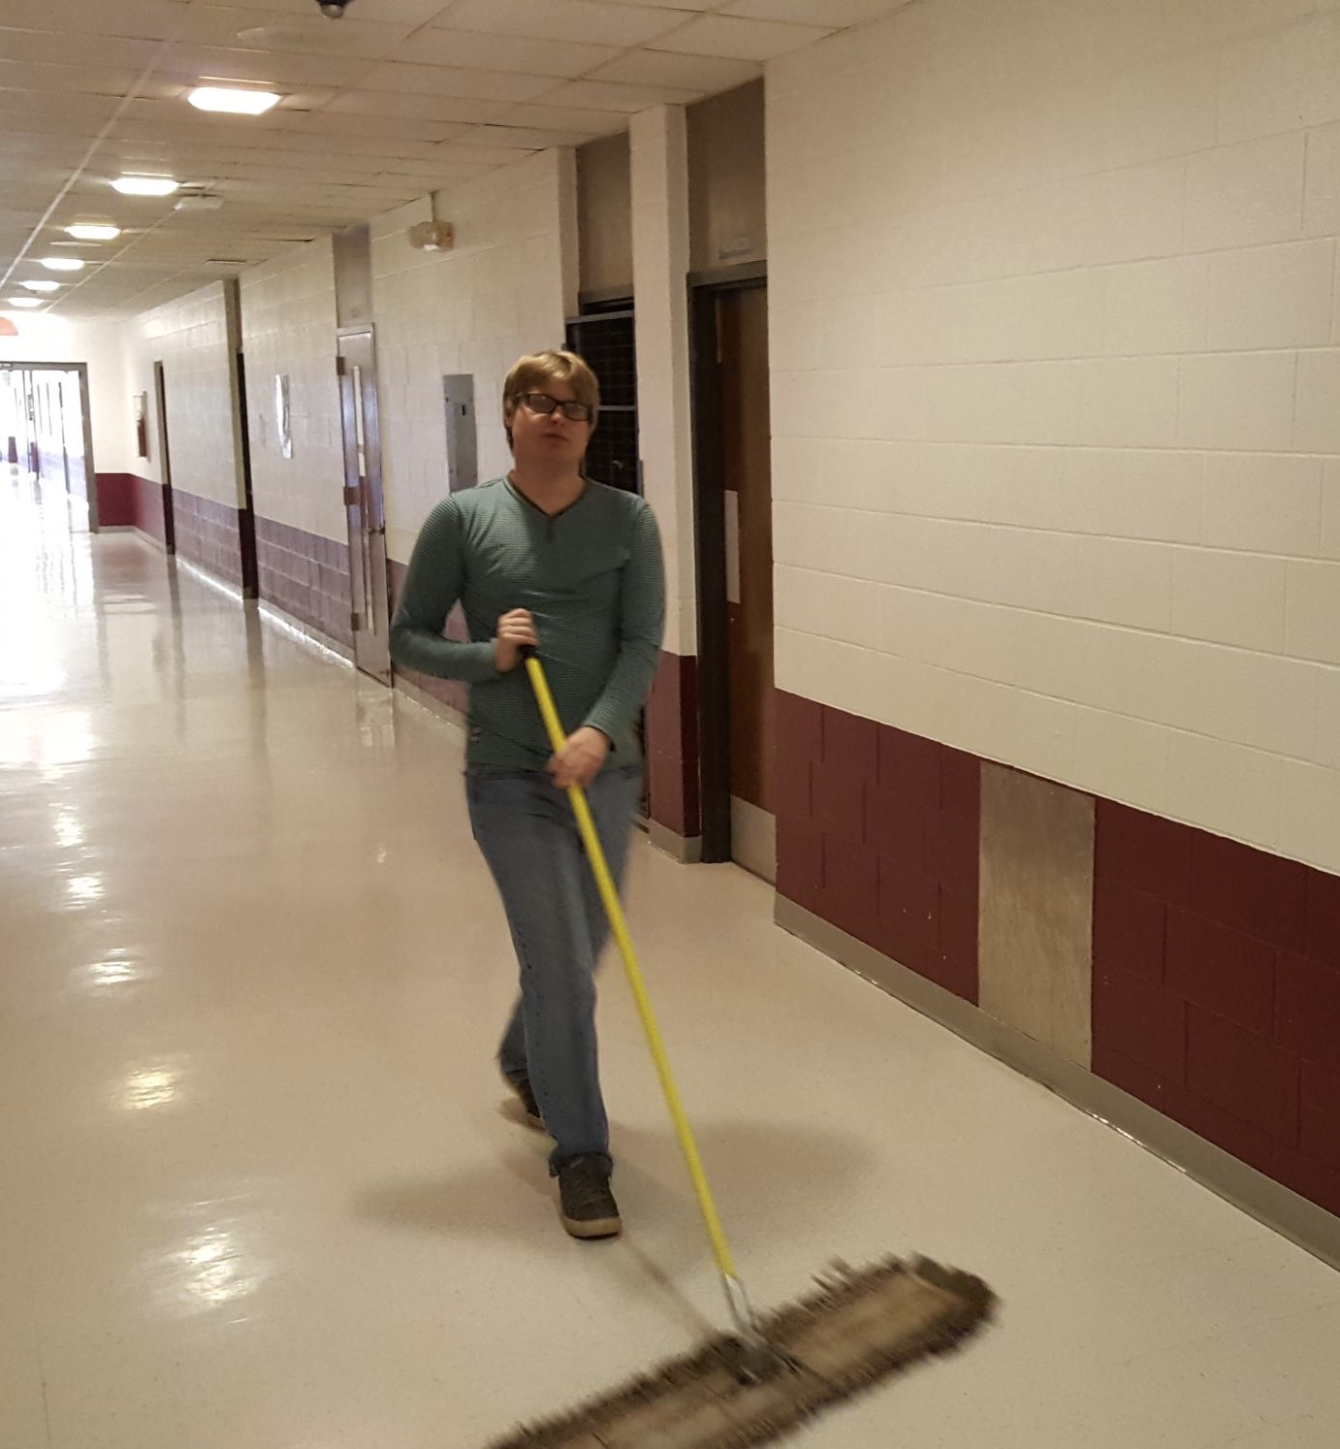
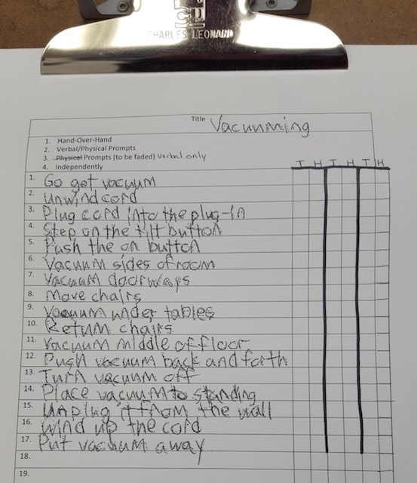
Keeping our school in tip top shape!

Slide 6
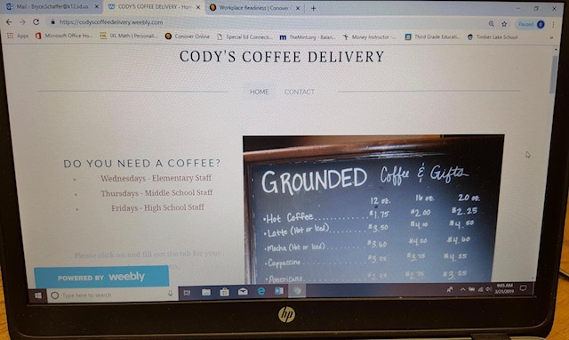
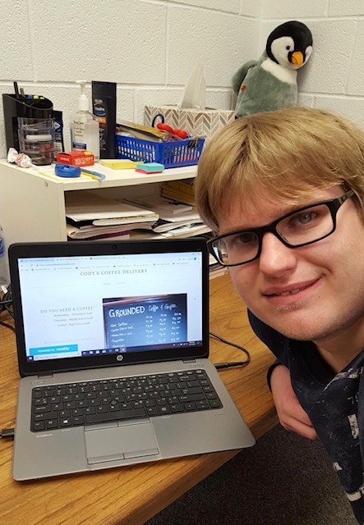
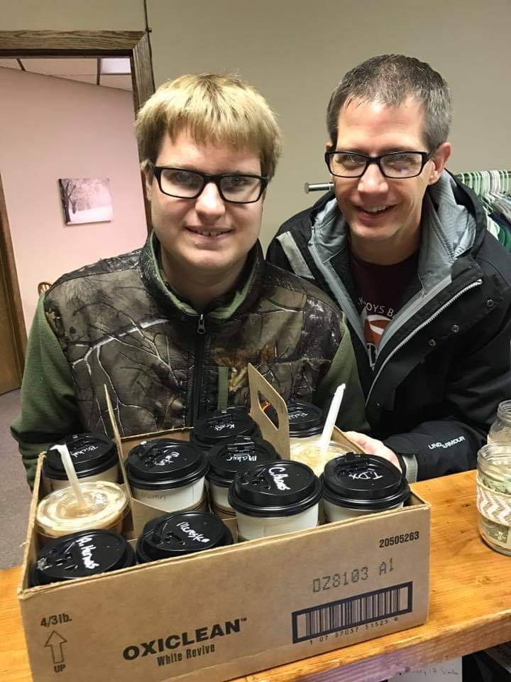
Cody’s coffee delivery service
Entrepreneurship at its finest!
Cody has teamed up with our local coffee shop to provide delivery services to Timber Lake School District Staff. Teachers submit their coffee orders electronically and Cody picks up the order and delivers directly to the classrooms. This is another reason our staff appreciates him so much!
Tips are accepted!

Slide 7
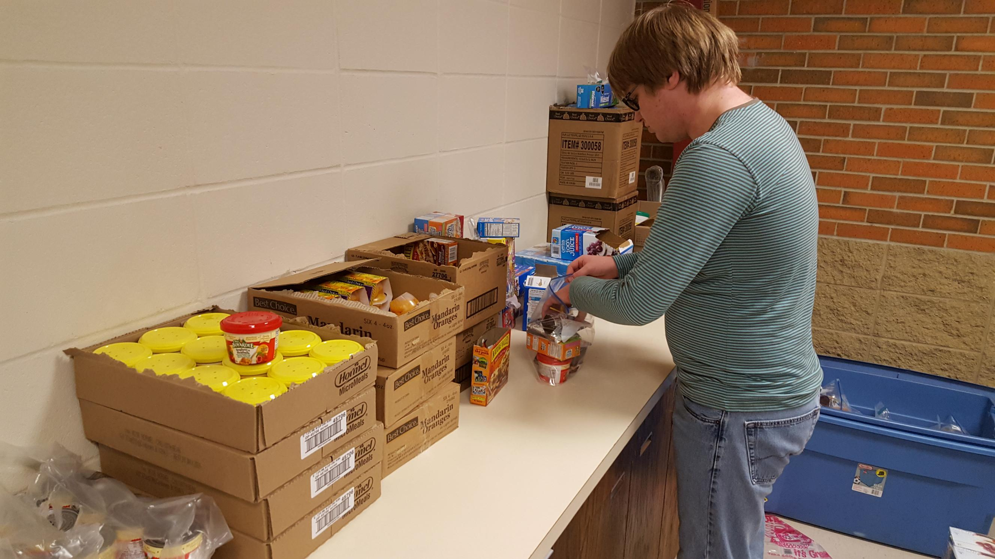
Timber Lake School’s Backpack program
…and The man behind the scenes
With Cody’s help, our school is able to send food home with students each Friday so they have something good to eat over the weekend.
Cody filling Ziploc baggies with food for our Backpack Program.

Slide 8
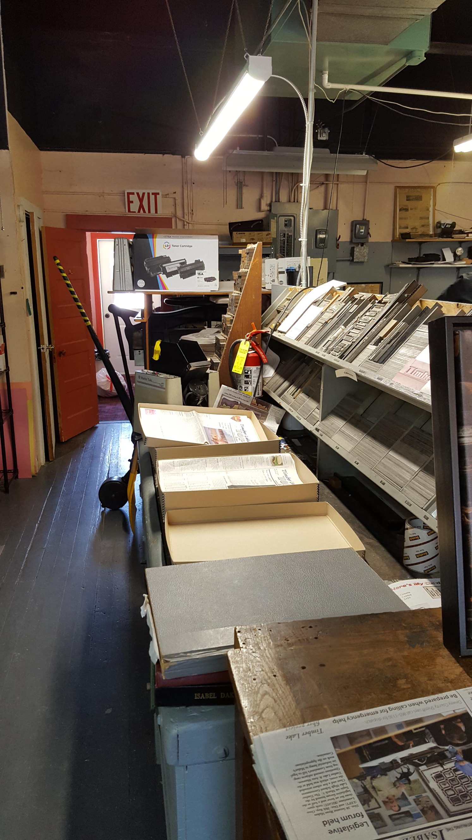
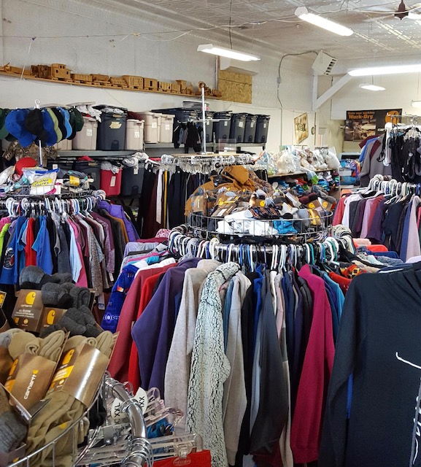
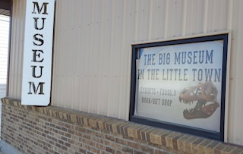
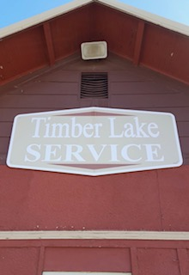
Cody started Project skills in 2016
He had a different job experience each quarter of the school year
Cody stuffed newspapers with the weekly flyer and did odd jobs for the Timber Lake Topic
He counted and folded shirts at Dakota Silkscreen
Cody did sorting, counting, vacuuming, and other odd jobs at the TL Museum
He filled the coolers
With pop and juice
at TL Service

Slide 9
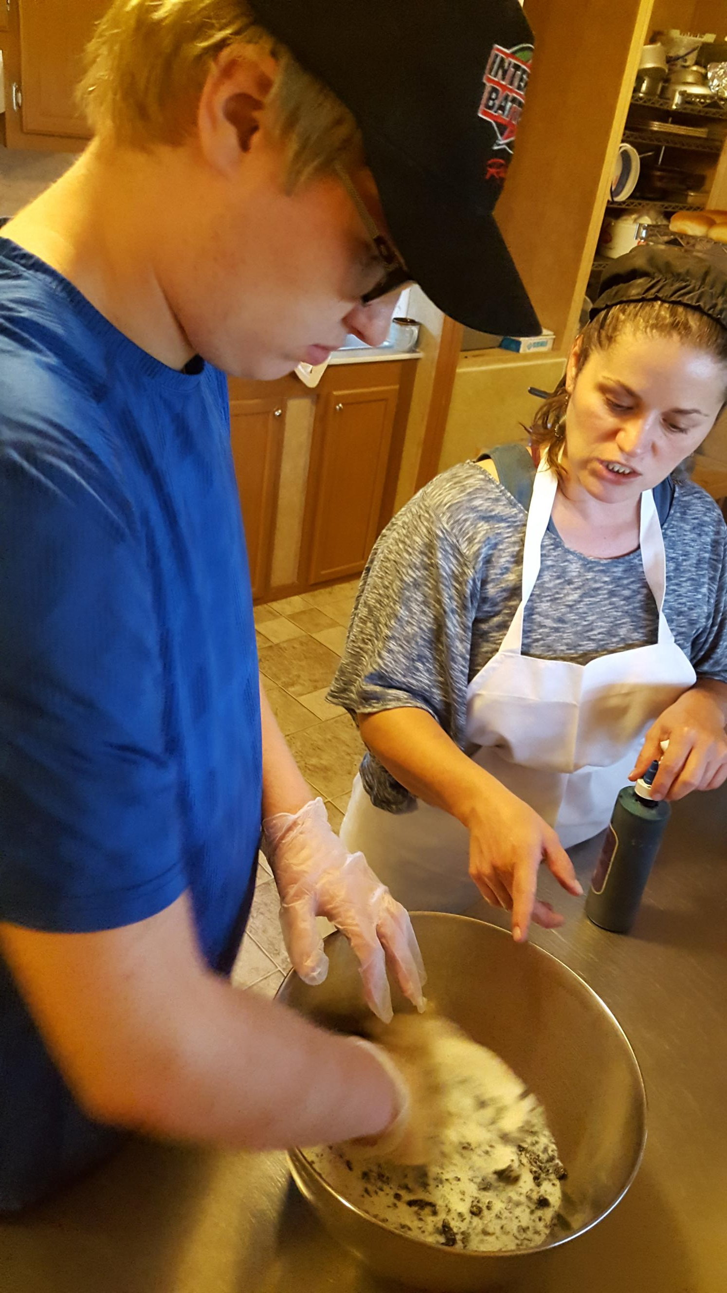
Helping out at a home based business
At Daily Bread Bakery, Cody mixed cake flour and color for frosting, put away product, made puddings, swept floors, folded boxes and towels, and placed product stickers on items.
Being able to mix the dough with his hands was a great sensory accomplishment for Cody!

Slide 10
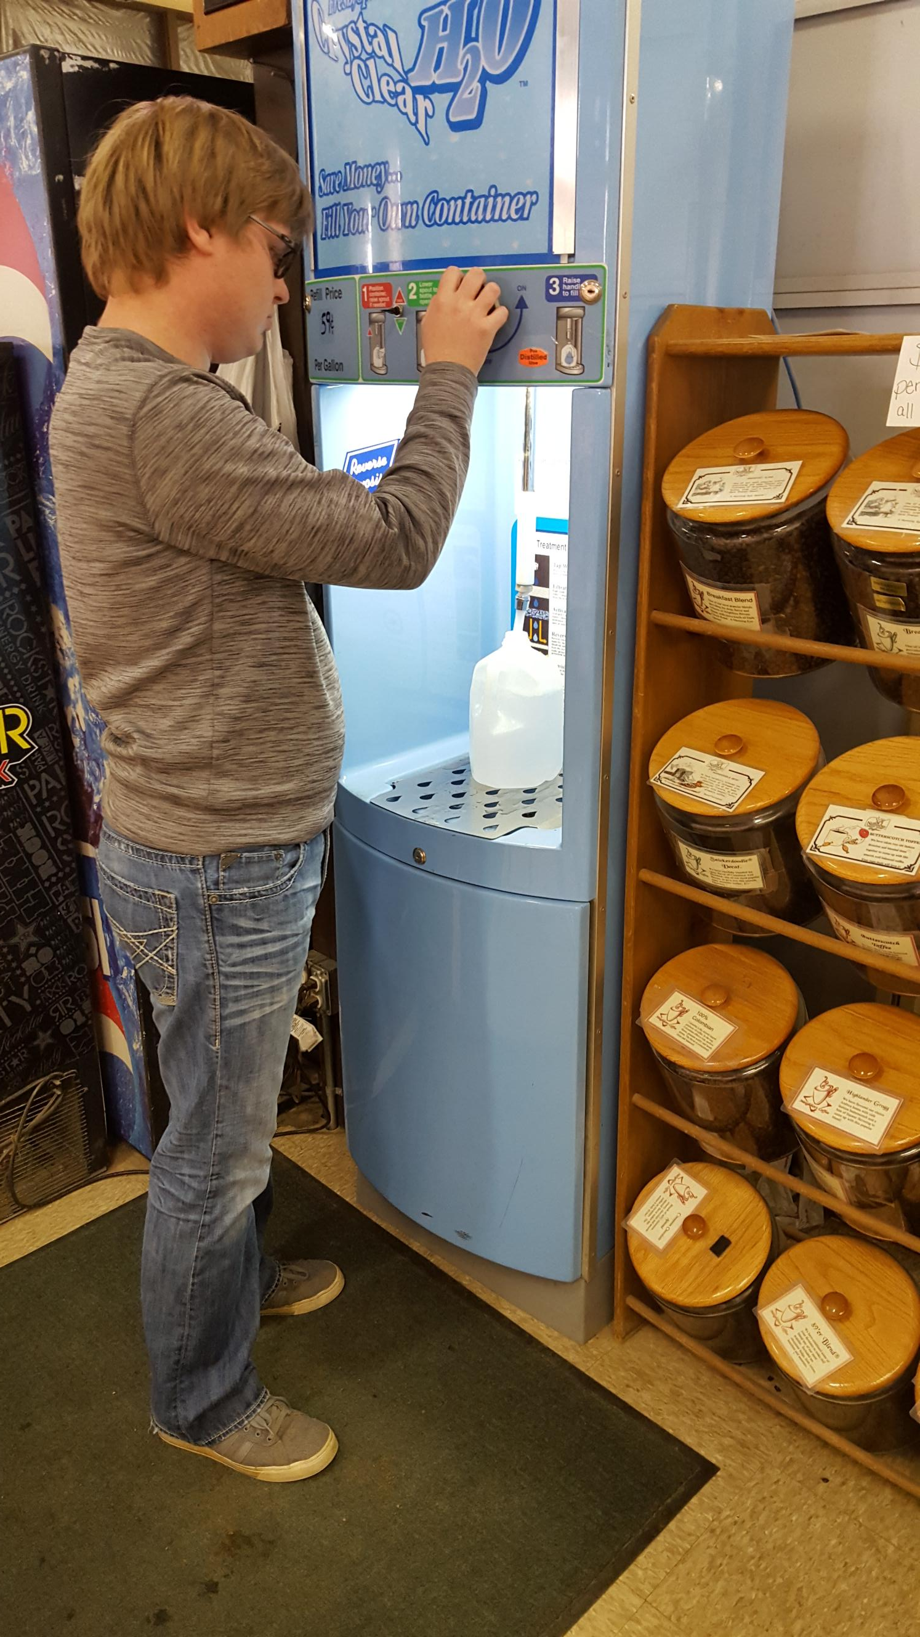
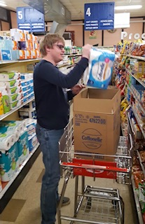
Country Market
Cody started working at Country Market on a regular basis during his Junior year. He fills water jugs and stocks shelves. Country Market is a great place to work and spend the tips he earns from his coffee delivery service!

Slide 11
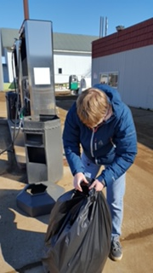
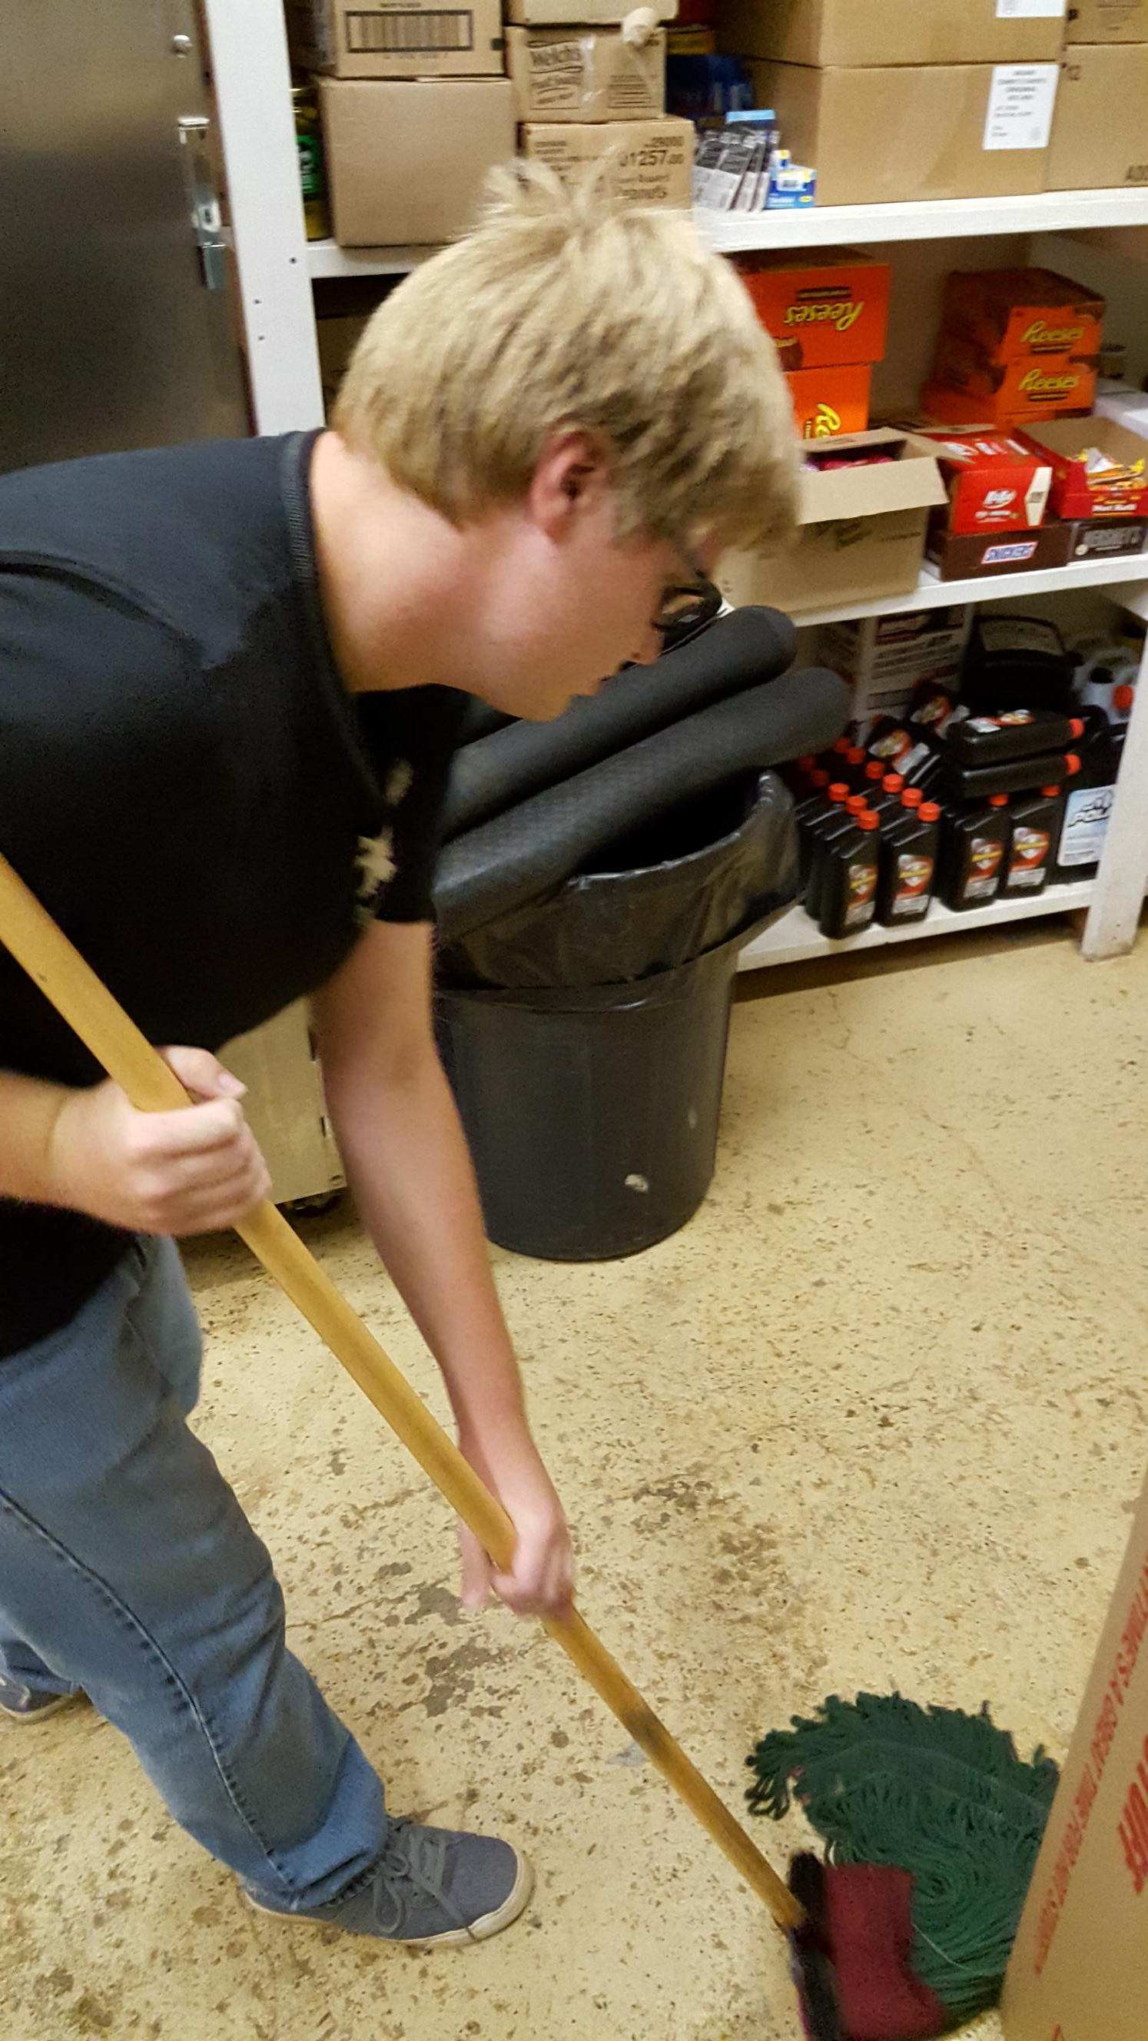
On the job at Locken Oil
At Locken Oil, Cody sweeps, vacuums, mops the back room, deals with the outside trash, folds down boxes and helps stock the pop cooler.

Slide 12
"My favorite job is mopping, because I can make the floor clean.”
~ Cody

Slide 13
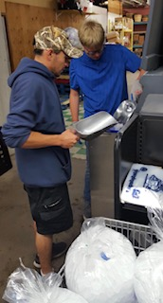
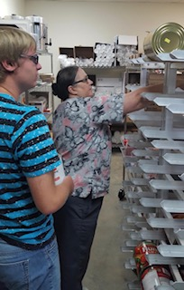
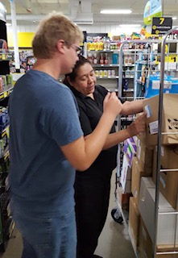
Job shadowing Experiences in Mobridge for esy-Summer 2018
Mobridge Regional Hospital
Food Service
Dollar General
Payless Foods Grocery Store

Slide 14
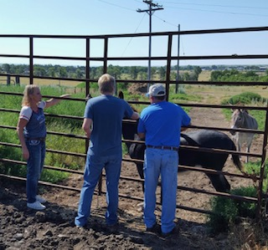
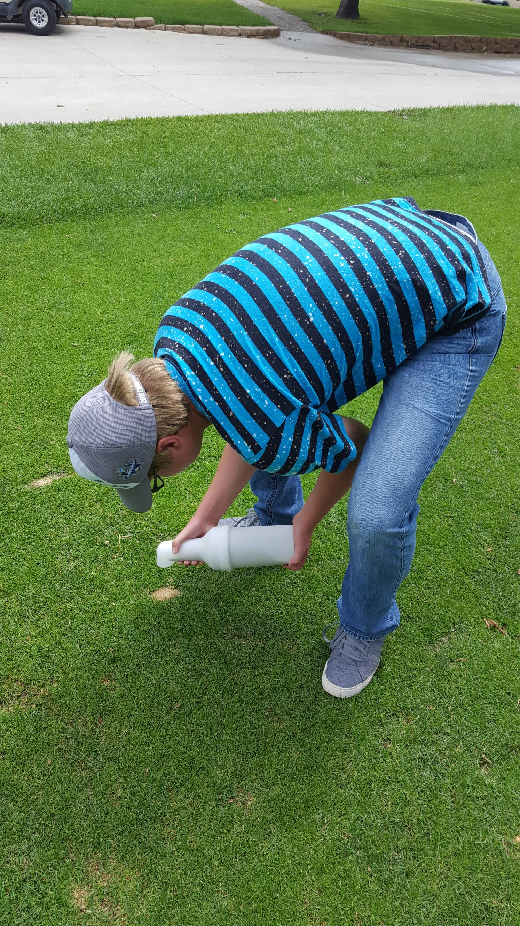
More Job Shadowing experiences
Oahe Vet Clinic in Mobridge Summer 2018 * A Favorite!
Oahe Country Club Golf Course
Summer 2018

Slide 15
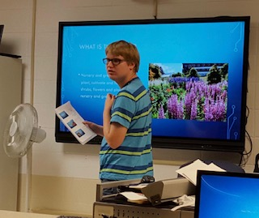
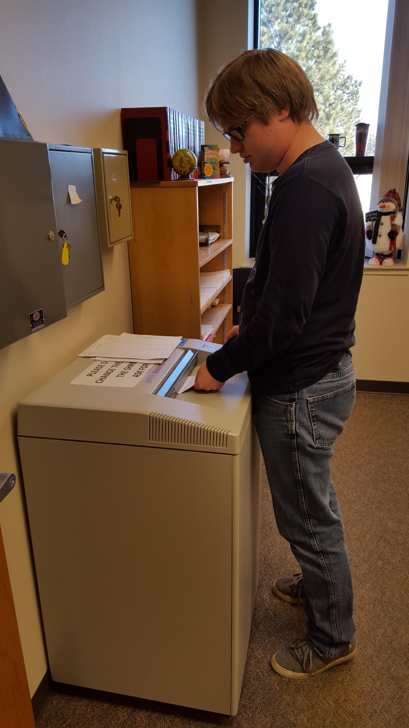
A peek at Cody in the classroom and helping out at school
Cody giving a report to his peers in the general education Computer Applications class.

Slide 16
“Aging Out” is right around the corner
…and we have a unique situation on our hands
Throughout high school Cody was included in the general education setting with his Non-disabled peers to the greatest extent possible. He did not have opportunities to socialize with or work among other students with similar disabilities. How would Cody adjust if he transitioned to a post-secondary program such as NHTC or BHSS?
When thinking about Cody’s transition to an adult program, the iep team knew it was important to create opportunities for him to socialize with same age peers of similar ability
August 2018-Arrangments were made for Cody to visit Oahe, Inc. in Mobridge on a regular basis so he could be introduced to a variety of social experiences with his peers. They have been great about including Cody when he visits!
    Leisure activities such as playing pool and board games
    Lunch at dairy queen
    Swimming

Slide 17
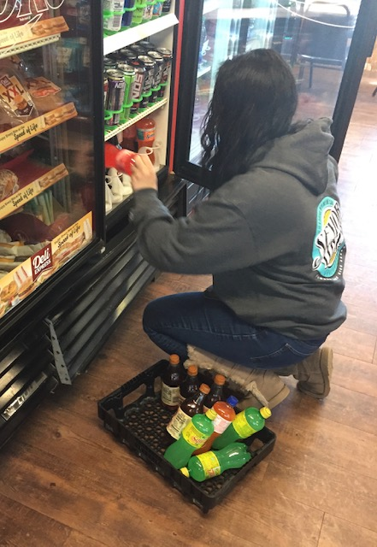
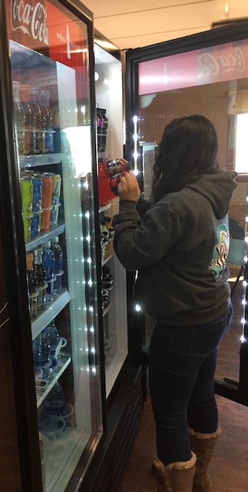
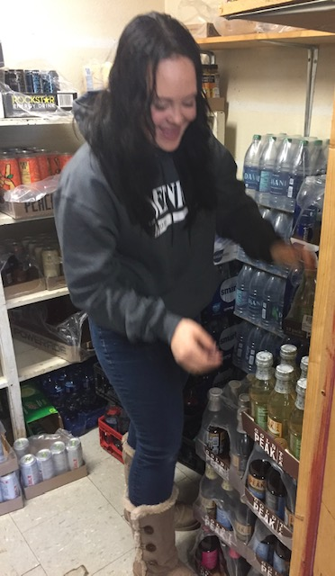
Senior spotlight – Mayson
Mayson is another hard
working student from Timber Lake. She does a
great job organizing the shelves and keeping the coolers stocked at Timber Lake Service.
Mayson’s favorite part of her job is stocking the coolers and getting to meet new people.

Slide 18
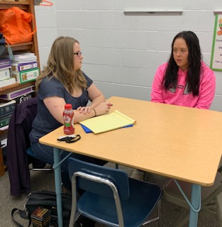
~Career Counseling with Jessica~
Vocational Rehabilitation Counselor
“Jessica is nice and very helpful. She talks to me about how school is going, what my future goals are, and how I am doing at work. She and my teacher, Mrs. Holzer, encouraged me to try a different job so I would get an idea of what working at a different job might be like.”
Mayson

Slide 19
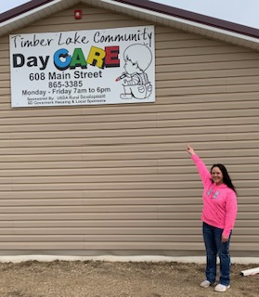
Mayson’s first Project skills work Experience
Timber Lake Day Care
“I really liked working at the day care. My favorite thing was seeing the Kids’ faces light up when they saw me. I also liked giving them snacks and helping them when they needed it.”
Mayson

Slide 20
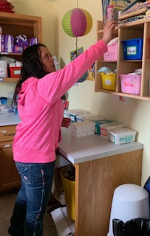
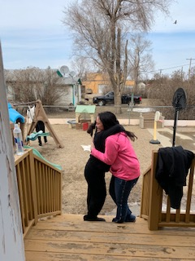
A warm welcome back…
Although Mayson
is now working at
TL Service, she
stopped by the
day care to say
hello and lend a
helping hand.
Someone sure missed Mayson!
Organizing the changing room

Slide 21
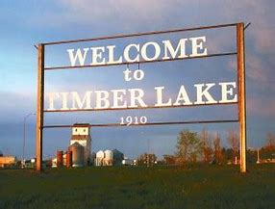
Big things can happen in small places!
Isabel
Cody’s home town is 20 miles from Timber Lake and has a population of 152.
Population 489

Slide 22
Thinking outside of the Box…
It is what small school districts must do

Slide 23
Teamwork Makes the Dream Work!
How one rural Wyoming school district was able to create employment opportunities for students with disabilities
Shoshoni School District created a partnership with Vocational Rehabilitation and WY Workforce Services to start a summer work program for students with disabilities…
And it all started with two telephone conversations!

Slide 24
Getting Started and growing the Project
The shop teacher and technology coordinator were hired to teach and supervise the summer project. Students were paid through Vocational Rehabilitation and WY workforce services
CWC, a community college 22 miles away, heard about the project and wanted to get in on the action. Students were bussed to cwc each Friday afternoon to attend an employability class that was specially designed for them. They were able to earn one college credit per summer. **all tuition was waived**
By the second year, WY workforce services discovered a clause in their eligibility criteria that would allow non-disabled students to participate in the summer program due to the district’s remoteness. By the 3rd summer, we had a work crew of 15 students with and without disabilities working alongside one another

Slide 25
A Grass roots Summer work program
Technology support
Community-based projects & construction
Shipping & purchase orders
Installed updates on all laptop computers
Re-imaged computers
Made basic computer repairs
Cleaned computers for the following school year
Learned trouble shooting techniques to use at the technology help desk
Remodeled bathrooms in the wood shop
Built wheelchair ramps for senior citizens
Assembled new playground equipment at the city park
Took requests from community members to build and/or repair decks, steps, fences, etc. *This was a big hit!
Sorted teacher/department orders as they came in
Delivered orders to classrooms
Assisted with other deliveries made to the the business office
Organized the supply closets
Helped the custodial staff move furniture

Slide 26
Meet Michael and Michelle
Michael was in the 8th grade and Michelle was in the 7th grade when they Transferred from Los Alamos, NM where they had been educated in a self-Contained special education classroom. They spoke very little, lacked confidence, and were uncomfortable in large group settings.
Transfer records indicated that they were not able to engage in the general education curriculum
When they enrolled in our small school district, They did not want to go to regular classes-primarily due to a lack of experience, fear, and confidence. We compromised by giving them two study skills classes in the resource room during their first quarter.
Both ended up being successful students who needed little inclusion support. They definitely did not need an alternative curriculum or two class periods a day in the resource room!
Both went on to graduate from post secondary programs with help from Vocational Rehabilitation
They are a great example of why we must presume competence!

Slide 27
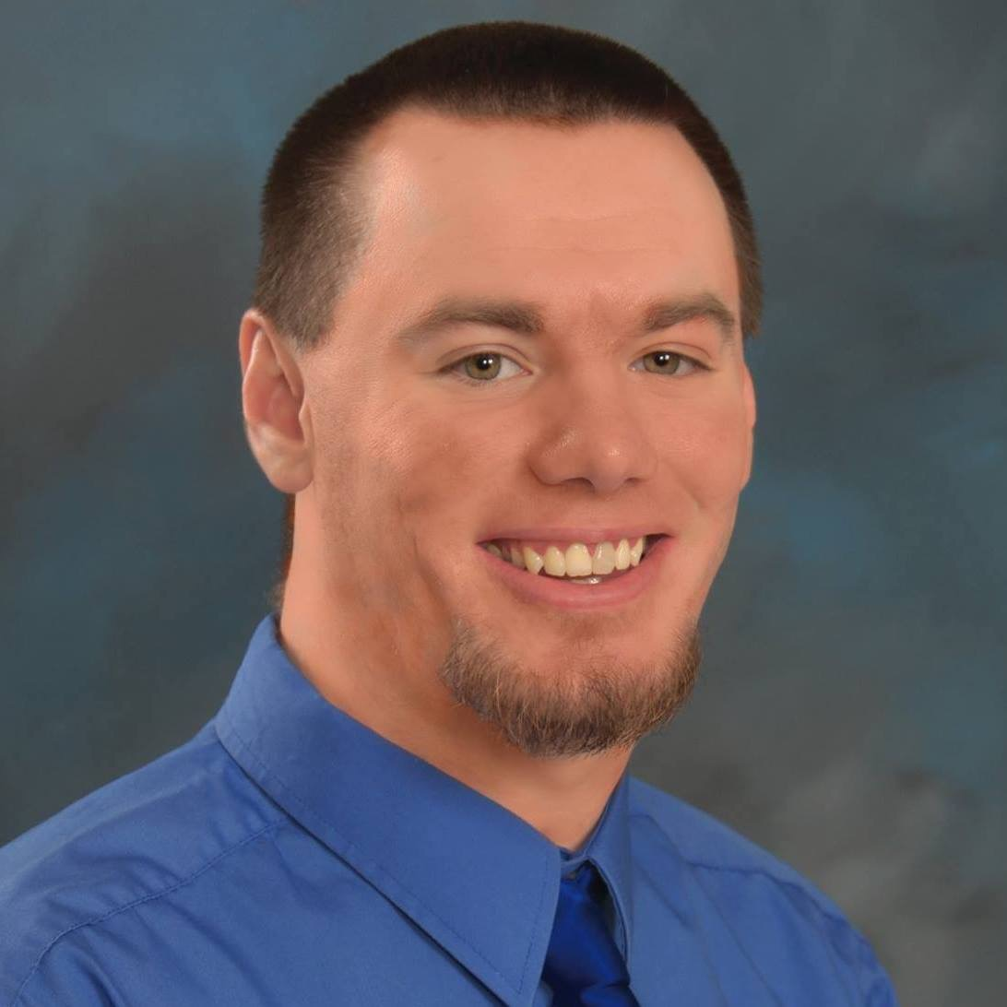
Michael’s story
Even though Michael didn’t talk much, we soon discovered he had an aptitude for technology
During his Sophomore year, he was Trained to work at the high school technology “help Desk”. That is when he found his voice and we learned that he had much to say!
during the Summers between 10th, 11th, and 12th Grade, he gained work experience and college credit through a pilot partnership between the school district, Vocational Rehabilitation, WY Workforce Services, and Central Wy College
Michael Went on to attend CWC in Riverton and earned a degree in The field of technology

Slide 28
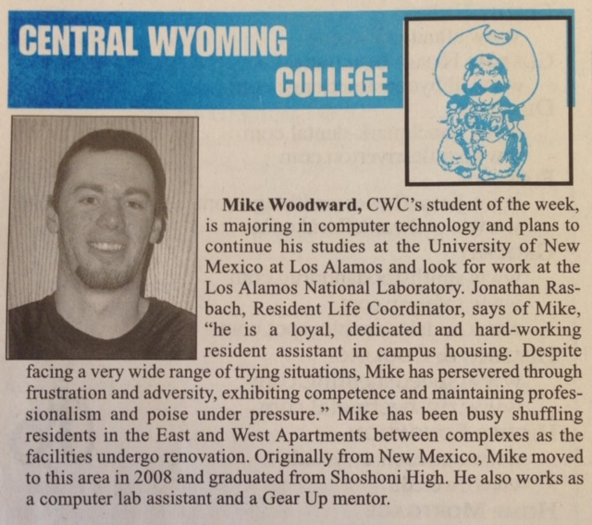
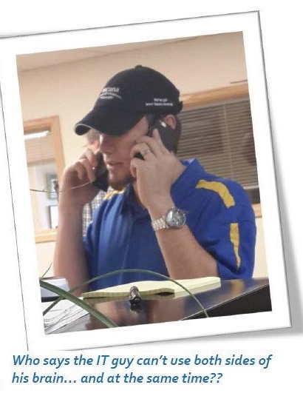
He eventually learned that it is okay to stand out and show the world what you are made of
5 years after we met Michael, he was a completely different person. Through inclusion, work experiences, and hard work, he learned that his disability was insignificant, and his abilities were SIGNIFICANT.

Slide 29
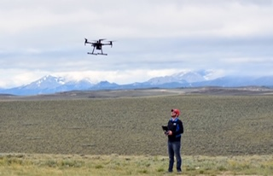
Michael’s happy place

Slide 30
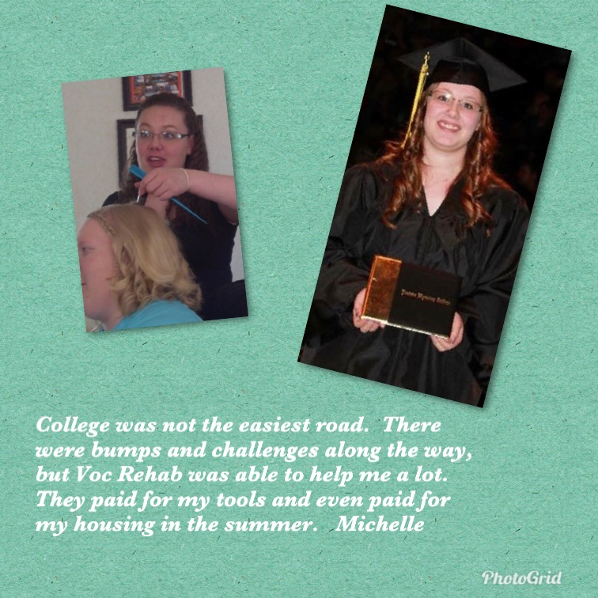
Michelle’s story
Gained Work experience at the local beauty shop through Vocational Rehabilitation
Worked as a classroom Assistant in the Preschool
Gained a variety of work experiences through the summer employment project and earned a college credit for Employability
Graduated from cosmetology school in Torrington WY
Vocational Rehabilitation paid for her styling tools as well as room and board during the summer

Slide 31
Thank you Cody, Mayson, Michael, and Michelle for letting me share your success stories to encourage and inspire others!
~You have so many special abilities~
THANK YOU!
Michelle Martin
Timber Lake School District
Special Education Director

Slide 32
Good morning,
I want to thank you for taking the time to read this article about work experiences in high school. I graduated from a small town with a population of about 700, which had a K-12 school.
I started volunteering with the IT department in my sophomore year (2010) as I wanted to know and learn more about computers. After a year had passed, I knew I needed to start working in my field that I wanted to pursue. The issue was that I needed to work during the summer, but I had no transportation to travel to the next city so I had to stay in the small town of Shoshoni, Wyoming.
With the help of Fremont County School District #25, Wyoming Workforce, Wyoming Vocational Rehabilitation, and Michelle Martin I was able to work the rest of my high school career at our school.
Being able to work and get paid for it was nice, but it also helped me to obtain the experience I needed and I built relationships that I never knew I would use after high school. During the time I worked at the school district, not only did I learn a lot about the IT world, but I also learned the life skills that I need after high school and college. Without the help that I was able to get from this work experience in high school, I would have had a hard time after high school.
A little bit about me:
My name is Mike Woodward, and I came from a family that was struggling after the market crash in 2008 and moved to Wyoming in December of 2008. I graduated from Shoshoni High School in 2012 and went directly into college at Central Wyoming College.
I graduated from Central Wyoming College in Spring 2014 with an AAS in Computer Technology. Before I graduated from college, I applied and got the job at Inberg-Miller Engineers (a Wyoming local Engineering firm) as an IT Tech. After six months as an IT Tech at Inberg-Miller, not only did I become the IT Manager for the company, but I also got married to my beautiful college lover.
I took four years off from school as I needed to focus on my job, as I am a one-person show for the company. As of Fall 2017, I am currently pursuing my bachelor’s degree in Computer Technology from Western Governors University (WGU).
Without the help of Shoshoni School staff, Wyoming Workforce and Wyoming Vocational Rehabilitation I would have struggled after high school without this knowledge.
Thank you for an amazing and unforgettable experience!
Mike

