Slide 1

RESOURCES AT YOUR FINGERTIPS
JESSICA HOVLAND & CINDY KIRSCHMAN

Slide 2
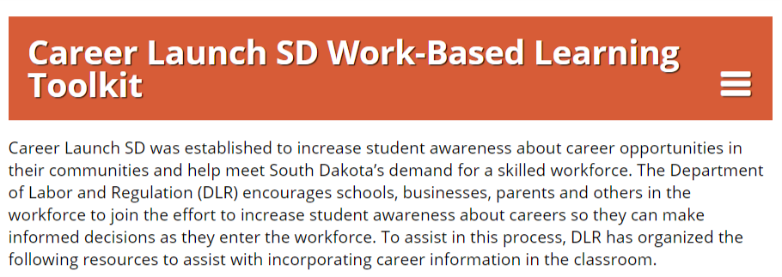
Career Launch SD Work Based Learning Tool Kit
Youth Employment Laws
Job Shadowing
Internships
Classroom Presentation Activities
Career Exploration in the Classroom
Other Resources/Related Sites
Notes:
Ctr+Click on the image to follow the link!!

Slide 3


SKILLS TO PAY THE BILLS
"Skills to Pay the Bills: Mastering Soft Skills for Workplace Success," is a curriculum developed by ODEP focused on teaching "soft" or workforce readiness skills to youth, including youth with disabilities. The basic structure of the program is comprised of modular, hands-on, engaging activities that focus on six key skill areas: communication, enthusiasm and attitude, teamwork, networking, problem solving and critical thinking, and professionalism.
Notes:
Ctr+Click on the image on the RIGHT to get to the STPTB Website.
Ctr+Click on the “PLAY ALL” image to get to the YouTube videos.

Slide 4
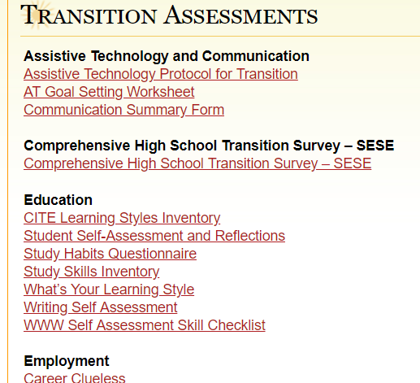
TRANSITION ASSESSMENTS
Assistive Technology
Communication
Employment
Independent Living
Self-Determination
Social Skills
And more!
Notes:
Ctr+Click on the image on the right to get to website.

Slide 5

Landmark College has identified their five “essential foundations” that are necessary for students with learning disabilities and AD/HD to be successful in college. This assessment looks at these foundations which are academic skills, self-understanding, self-advocacy, executive function, and motivation and confidence. This assessment uses a checklist format to identify student strengths and needs.
Notes:
Pass out handouts!

Slide 6
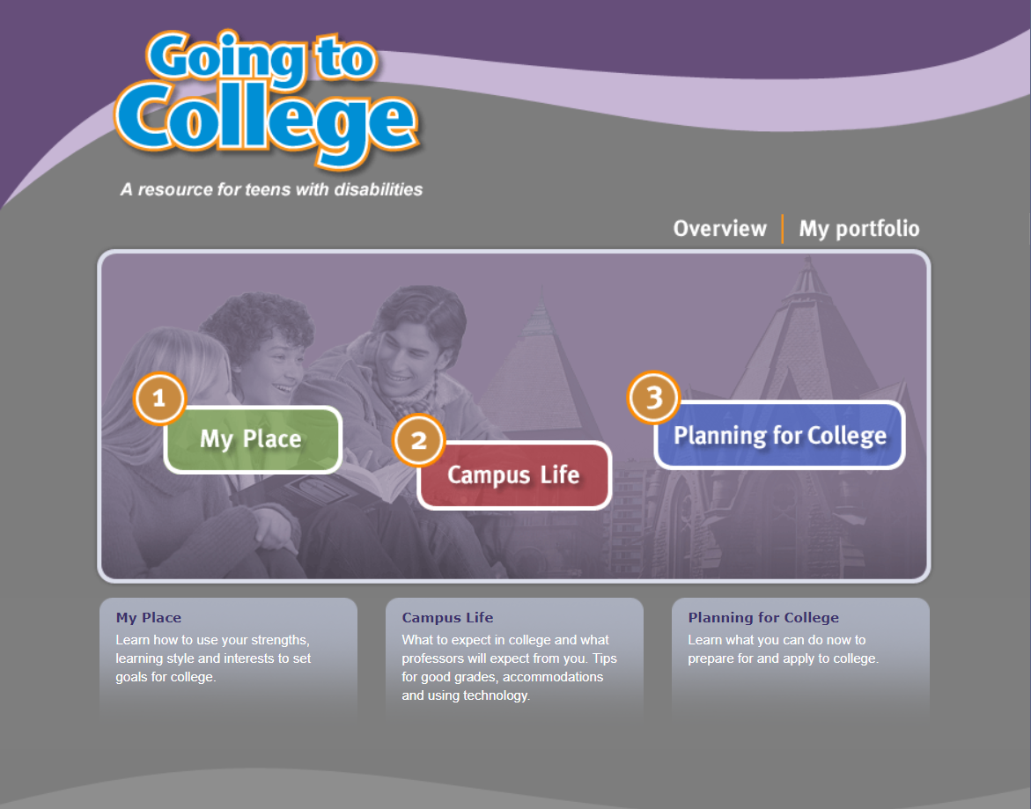
Going to College –
A Resource for Teens with Disabilities
Students can learn how to use their strengths, learning style and interests to set goals for college. They can learn what to expect in college and what professors will expect from them as well as learn tips for good grades, requesting and using accommodations, and using technology.
Notes:
Ctr+Click the image to the right to get to the website.

Slide 7


Expanding the Circle
The Expanding the Circle curriculum offers culturally relevant activities that facilitate the successful transition from high school to postsecondary experiences for American Indian students. The curriculum is designed to help youth explore who they are, what skills they need, and what their options are for life after high school.
Notes:
Ctr+Click image on the left to get to Expanding the Circle website.
Ctr+Click the “Learning for American Indian Students” image on the bottom right to get to the survey.

Slide 8

My Future
Helps young adults plan their next steps in life by bringing together the most recently available information about colleges, careers and military service opportunities from the U.S. Departments of Commerce, Defense, Education and Labor.
Notes:
Ctr+Click on the image on the right to get to the website.

Slide 9

Self-Motivation Quiz: How to Motivate Yourself
The Self-Motivation Quiz is all about finding out what makes you tick. What pulls you toward the things you are going for – those top 3 motivating types that make you get going.
The more you align yourself with what makes you tick, the more you’ll be magnetized to get there. You are motivated in a very specific way and you might not realize that. Your neighbors may get a kick out of being the “Joneses” while that guy at work gets his kicks off being a go-getter leader.
Notes:
Ctr+Click the image on the left to get to the website.

Slide 10

The Personal Preference Indicators are not checklists but are a guide to accessing information about the person’s preference. Developed specifically for individuals with significant cognitive and multiple disabilities.
Notes:
Ctr+Click image on the right to get to the indicator document.

Slide 11
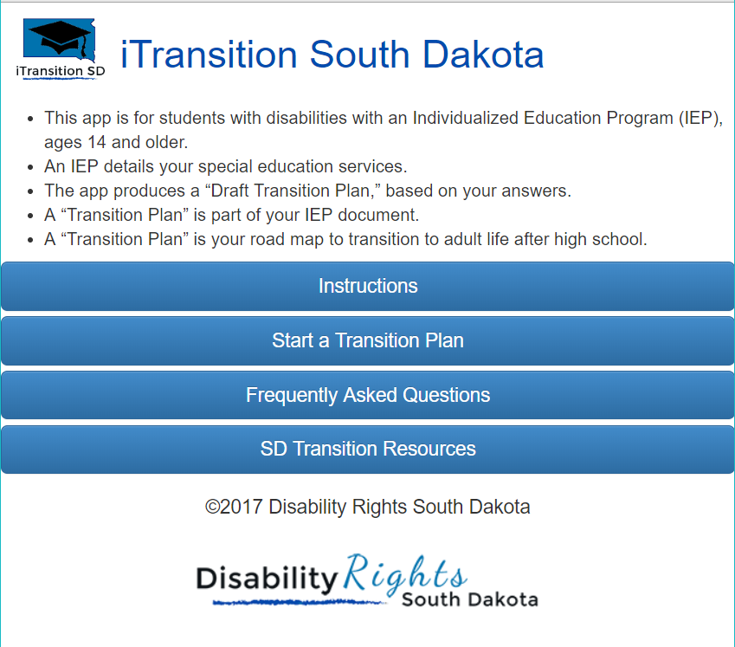
Notes:
Ctr+Click on the image to get to the website.

Slide 12

The Zarrow Center at the University of Oklahoma facilitates student-directed educational, employment and adult living outcomes for individuals with disabilities, fosters innovative self-determination-oriented instruction and transition education practices, and prepares educational leaders.
Notes:
Ctr+Click on the Zarrow Center banner to get to the website.

Slide 13
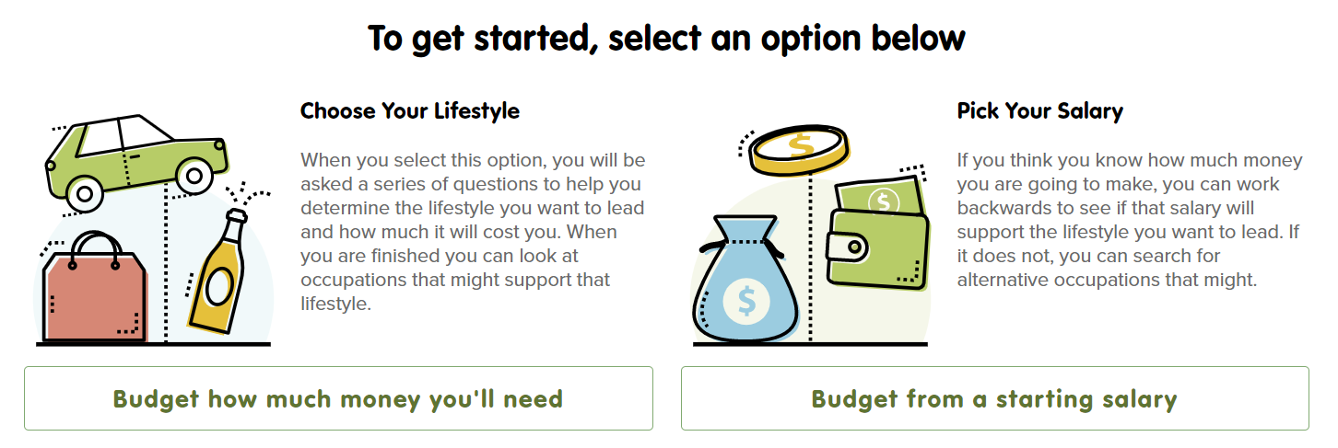
Make Money Choices
Forming a budget is one of the most important parts of financial success. As you first enter the workforce, or even if you switch jobs, knowing how much money you will have available to spend on different aspects of your life will help you avoid debt & possibly even save some money for a rainy day.
Notes:
Ctr+Click the image on top to get to the website.

Slide 14
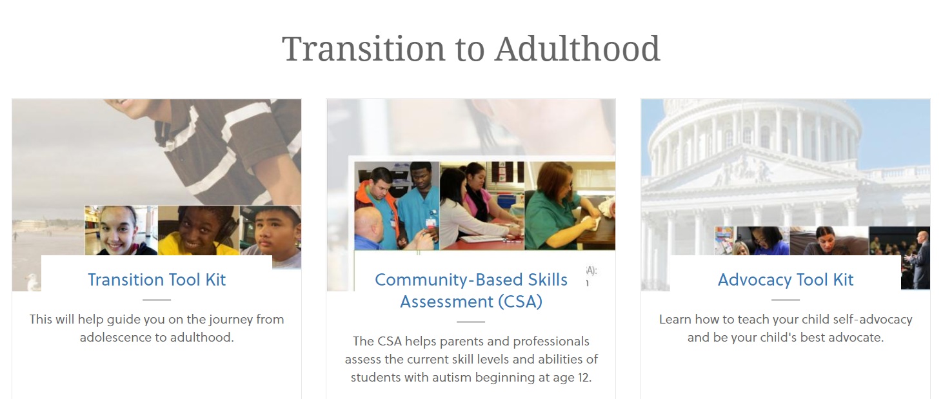
Autism Speaks
The website provided a transition tool kit, community-based skills assess, and access to an advocacy tool kit to learn self-advocacy skills. As well as a variety of other helpful resources and tools.
Notes:
Ctr+Click the image to the right to get to the website.

Slide 15
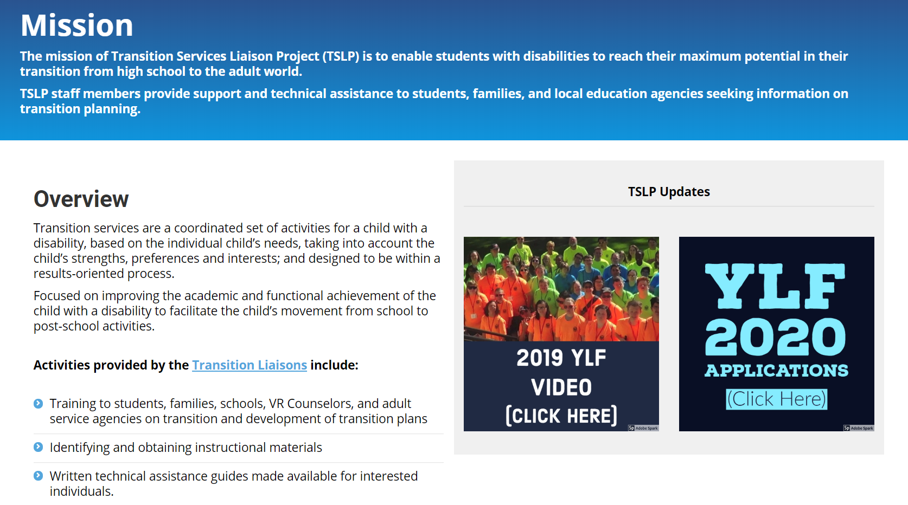
Notes:
Ctr+Click image to follow the link.

Slide 16

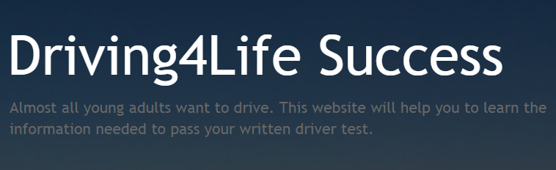

Interactive Websites for Students
Notes:
Ctr+Click on the images to get to the websites/documents.

Slide 17
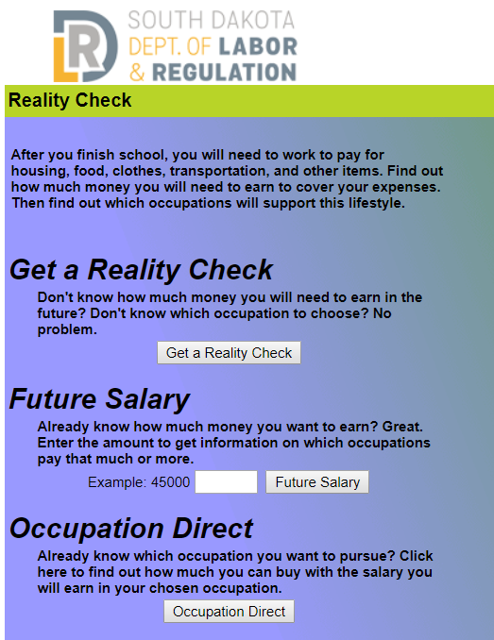


Interactive Tools for Students
Notes:
Ctr+Click on the images to get to the websites/documents.

