Slide 1

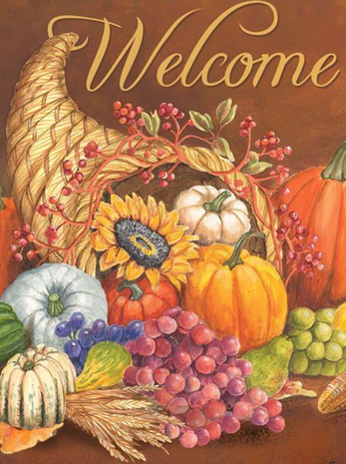
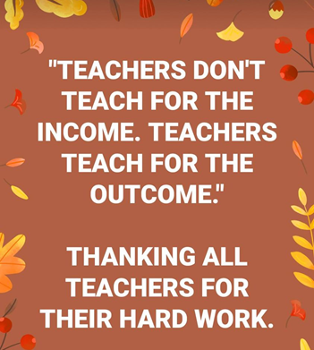

Teacher Round Up
November 24, 2020
Notes:
Dan– Welcome all – go thru agenda

Slide 2

Our Agenda for Today
Ben- YLF 2019 Graduate
Graduation –
Beth Schiltz, Special Education Programs
DHS Grant Opportunity-
Kristy Jackson, Teachwell Solutions
Wrap Up
Notes:
Dan

Slide 3
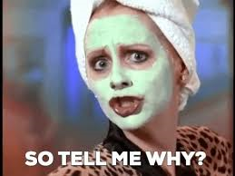

Jessica & Cindy
Notes:
Cindy introduce Ben -YLF delegate talking --??

Slide 4


Graduation Tips
Beth Schiltz, Special Education Programs
Ann Fortin, Aberdeen VR Office
Notes:
Dave introduce Beth

Slide 5

What Are the Graduation Requirements?
Ann Fortin, Aberdeen VR Office

Slide 6

Ann Fortin, Aberdeen VR Office
How do modifications affect graduation requirements?

Slide 7


How Are Decisions Made?
https://doe.sd.gov/gradrequirements/
Documents & Links section
2018 Graduation Requirements Handbook
Disabilities Policy (Updated 2020)
Graduation Coding Guidance for Students on an IEP
Ann Fortin, Aberdeen VR Office
Notes:
Bring up these documents to show…

Slide 8
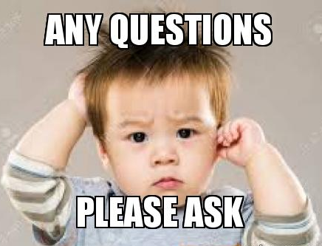
?s about specific students, please contact Beth.

Slide 9


“Reminder – DHS Grant Opportunity”
Kristy Jackson, Careers Program Coordinator
www.teachwell.orgKatie
Notes:
Bev will introduce Kristy.

Slide 10

Tech Tools for Distance Learning and Beyond
PEAR DECK + GOOGLE SLIDES
FLIPGRID
CANVA
Ann Fortin, Aberdeen VR Office
https://www.edutopia.org/article/3-tech-tools-distance-learning-and-beyond
Notes:
Bev---These (mostly) free tools make it easier for teachers to connect with remote students and provide plenty of ways to engage them.

Slide 11



G RODEOS’
YLF Delegate Applications – Due 12/18/2020
Teacher Round Up – January 27, 3-4:00 CST
YLF Gathering – December 28, 6:30-7:30 CST
(last Monday of the month)
Let’s Talk About Work – virtual
Notes:
Dan

Slide 12

Teacher's Poem
On Days When No One Brings You An Apple
-Travis Jacobs
Notes:
Cindy

