Slide 1
ILAUGH
Getting to Work
Brittany Schmidt, MA-CCC/SLP
www.abc-autism.com
605-351-1002

Slide 2
This session will introduce attendees to the ILAUGH model
Social Thinking© and how these identified need areas impact the top 10 skills for entering and succeeding in the workforce.
Learner Objectives:
Attendees will be able to state the key features of each of the ILAUGH components.
Attendees will be able to list at least two examples of how each component of ILAUGH could impact each of the 10 skills for entering the workforce.

Slide 3
www.socialthinking.com
The ability to consider your own and others thoughts, emotions, beliefs, intentions, knowledge, etc., to help interpret and respond to the information in your mind and possibly through your social behavioral interactions.
No specific diagnosis – Difficulty sharing space effectively.

Slide 4
Why Social Thinking?
Based on Theory of Mind (Baron-Cohen, Leslie, and Frith, 1985)
  Thinking about what others are thinking about you
Based on Executive Functioning (McEvoy, Rogers, Pennington)
  Difficulty with organization and flexibility
Based on Gestalt Processing (Frith, 1989)
  Thinking in pieces without relating to a larger picture/context or scenario

Slide 5
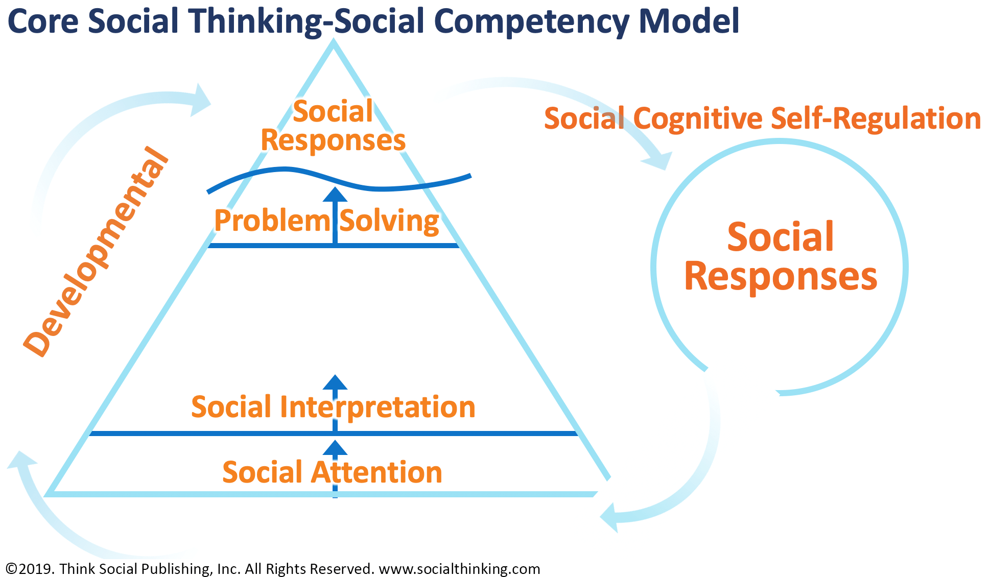

Slide 6
Critical Skills Required for Social Thinking
I LAUGH
I Initiating
L Listening with eyes, ears, and brain
A Abstracting and Inferencing
U Understanding Perspective
G Getting the Big Picture
H Humor

Slide 7
I = Initiating
Ask a question, follow up question
Handling communication breakdowns
Approach a person or a situation
Start a task
Restart after a break
Role of anxiety

Slide 8
L = Listening with eyes, ears and brain
Social Detective/Observer
Eye gaze and eye shift
Body language (tone of voice, facial expression, gestures, proximity, eye gaze/eye shift)
Multisensory input challenges
Prior knowledge and experiences

Slide 9
A = Abstracting and Inferencing
Figuring out what is important
Making a smart guess about intention
Subtle or hidden curriculum

Slide 10
U = Understanding Perspective
Thoughts of others
How to respond
Point of view based on social memories
Result(s) of perspectives of others

Slide 11
G – Getting the Big Picture
Part to whole thinking
Executive functioning falls here
How does my role fit with the rest of the situation, job, workplace, family?

Slide 12
H = Humor
At myself
Timing
Context
Is it funny?

Slide 13
World Economic Forum
Surveyed 350 top executives, 9 industries, in 15 of the world’s biggest economies.
The function of the resulting report is to predict how technological advancements will transform labor markets.
E.g. ”How will technology impact employers and therefore what will they want from employees?”
7/8/2021: https://www.inc.com/melanie-curtin/the-10-top-skills-that-will-land-you-high-paying-jobs-by-2020-according-to-world-economic-forum.html

Slide 14
#10 – Cognitive Flexibility
This involves creativity, logical reasoning, and problem sensitivity. It also means being able to adapt how you communicate based on who you're talking to. Employers want to know you don't just say the same thing to everyone -- that you think critically about who you're talking to, deeply listen, and tailor communication to that person.
ILAUGH?

Slide 15
Critical Skills Required for Social Thinking
I LAUGH
I Initiating
L Listening with eyes, ears, and brain
A Abstracting and Inferencing
U Understanding Perspective
G Getting the Big Picture
H Humor

Slide 16
#9 – Negotiation Skills
This will be in especially high demand in computer and math jobs, such as data analysis and software development. It will also be critical in the arts and design (including commercial and industrial designers).
ILAUGH?

Slide 17
#8 – Service Orientation
This was defined as actively seeking ways to help others. How much do you assist those on your team, your superiors, and people across your industry? How much are you known for that?
ILAUGH?

Slide 18
#7 – Judgement and Decision Making
As organizations collect more and more data, there will be an even greater need for workers who can analyze it and use it to make intelligent decisions. Good judgment also involves knowing how to get buy-in from a colleague, or making a strong suggestion to a manager (even if it might not make you popular).
ILAUGH?

Slide 19
#6 – Emotional Intelligence
Robots can do a lot, but they still can't read people the way other humans can (at least not yet). Employers will place a strong emphasis on hiring those who are aware of others' reactions, as well as their own impact on others.
ILAUGH?

Slide 20
#5 – Coordinating with Others
Again, this falls under the social skills umbrella (sensing a trend?). It involves being able to collaborate, adjust in relation to others, and be sensitive to the needs of others.
ILAUGH?

Slide 21
#4 – People Management
In the report, this included being able to motivate people, develop the talents and skills of employees, and pick the best people for a job. This will be especially in demand for managers in the media and energy industries.
ILAUGH?

Slide 22
#3 - Creativity
In 2015, creativity ranked 10th on the list. It's now one of the top three skills employers will seek. Why? Because as we're bombarded by new technologies, employers want creative people who can apply that tech to new products and services.
ILAUGH?

Slide 23
#2 – Critical Thinking
As automation increases, the need for humans who can employ logic and reasoning increases. This is, in part, because machines must be directed ethically and optimally. Employers want people with critical minds who can evaluate the uses or abuses of the power of technology, and use them to benefit the company, the people in it, and the future.
ILAUGH?

Slide 24
#1 – Complex Problem Solving
Technology can make life easier, but it can also make things more complicated. For example, you could use wearables to help map the walking patterns of nurses and doctors in a hospital to see how to make things more efficient. But without a human being analyzing those results while also having intelligent conversations with nurses, doctors, and patients, you will likely end up with a wrong or even dangerous result.
The report shows that 36% of all jobs across all industries will require complex problem-solving abilities as a core skill by 2020.
ILAUGH?

Slide 25
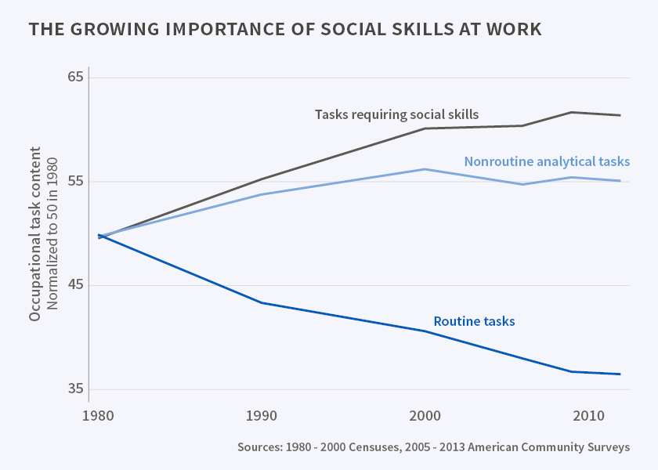
7/8/2021: https://www.nber.org/digest/nov15/growing-importance-social-skills-labor-market

Slide 26
Smart is not enough

Slide 27
Invisible Disability in the Workplace
https://www.healthlinkscertified.org/uploads/files/2021_03_26_22_09_20_OMaW_Invisible-Diversity-Report_2018-.pdf

Slide 28

Brittany Schmidt, MA-CCC/SLP
1105 W. Russell St.
Sioux Falls, SD 57104
www.abc-autism.com
605-351-1002

