Slide 1
Ready, Set, Transition!
Sydney Kurtz
Becky Erickson
6-12 Special Education Teachers
Groton Area School District

Slide 2

TRANSITION – WHAT TO DO?
  We have so much fun with our students learning about TRANSITION skills. Everything we do with our students can be related and applied to life after they leave high school. We hope you find a few things that you can take back and use with your students!
  Sydney and Becky

Slide 3

curriculum
*ME! Curriculum
*Consumer Math Curriculum
*Teacher created curriculum based on Gen Ed curriculum and standards and Core Content Connectors
*Based on individual needs/ IEP goals

Slide 4
training SKILLS
JOB SKILLS:
*Job searching
*Job Applications
*Interviews
*Promotion/Dismissal
*Skills needed
-Strengths and Needs
*Getting along with co-workers

Slide 5

Transition skills
Planning nutritious meals/making grocery lists
Estimating costs/figuring best buys
Comparison Shopping
Grocery shopping
Cooking
Ordering in Restaurant
Money Skills – paying for lunch, computing change, purchasing groceries
Cleaning Skills
Organization Skills
Independent Living (buying vs. renting)
Insurance
Buying/financing a vehicle

Slide 6
Transition Skills Continued…
*Bill paying
*Check writing
*Debit Cards
*Volunteering/Giving
-Baking cookies for assisted living center
-Playing Bingo with residents
-Random Acts of Kindness around the community

Slide 7
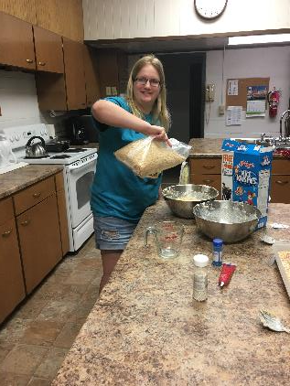
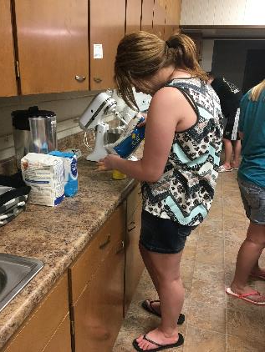
COOKING

Slide 8
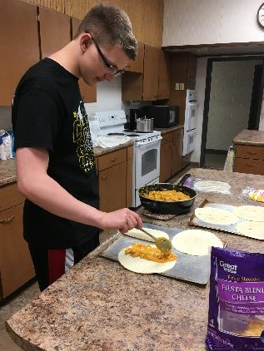
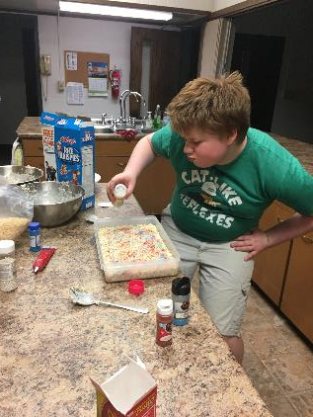
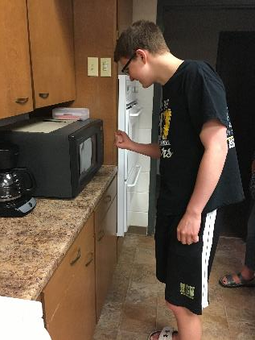

Slide 9
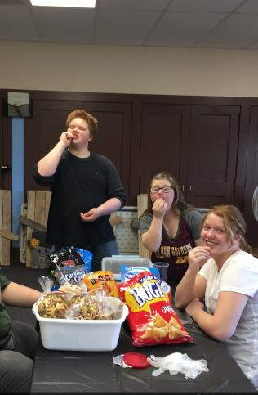
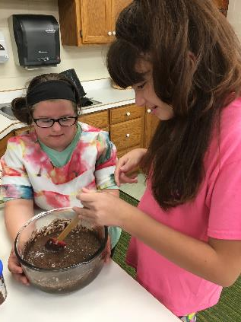
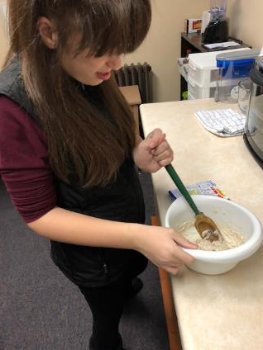

Slide 10
Self-advocacy skills
*Reviewing and participating in IEPs and meetings
-Modifications
-Goals
-Strengths & Needs
*Touring the school prior to start date to locate classes and lockers
*Emailing teachers to request modifications and
accommodations
* SOP meetings

Slide 11

Benefits to our school
RAOK
Helping Staff
Social Skills
More Exposure
Community Involvement with the School
Interagency Collaboration
Comfort Closet
School Store

Slide 12
Classroom projects
*Celebrity Disability Power Point
*Job Awareness
*Targets
*Team Member Posters
*Me Posters
*Vision Boards
*Label Jars – Not People
*People First Language
*Scrapbooking
*Bulletin Boards

Slide 13
Community involvement
*School Store/ Clothing
*Valentine Cocoa Bombs
*RAOK around community
*Touring local businesses
*Project Skills/ Employment
*Taking pictures at sporting events
*Sports Team Manager

Slide 14
Project skills
*Local grocery store
*Nursing Home
*Newspaper
*School kitchen
*Janitorial
*Lumber yard
*OST (after school program)
*Daycare
*Tech Coordinator Assistant

Slide 15
Summer initiative grant
*11 days each summer
*Supplies, Other Expenses, Personnel
    Food, incentives, RAOK, school supplies, service project
*Utilize local church for cooking lunches/ home base
*Trips to Aberdeen and around Groton to learn transition skills
*August- prepare for school

Slide 16


Slide 17
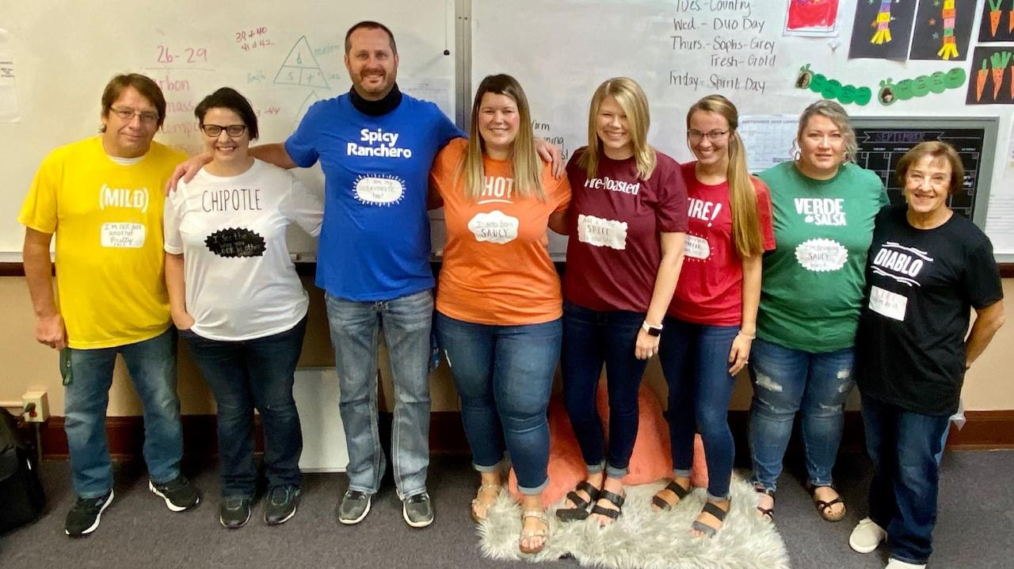
OUR TEAM

Slide 18
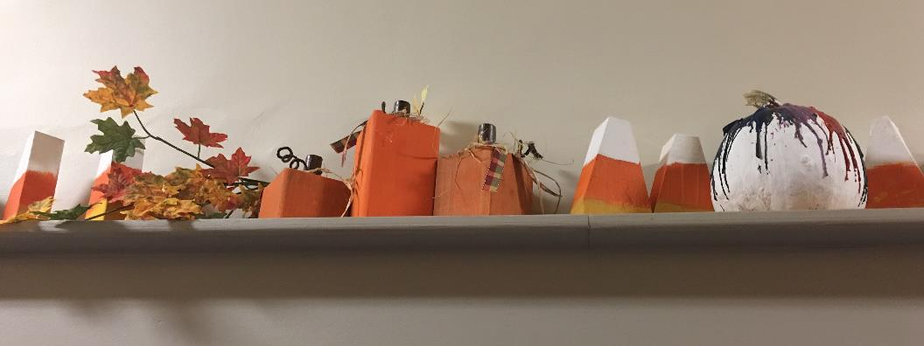
ARTS & CRAFTS CLASS

Slide 19
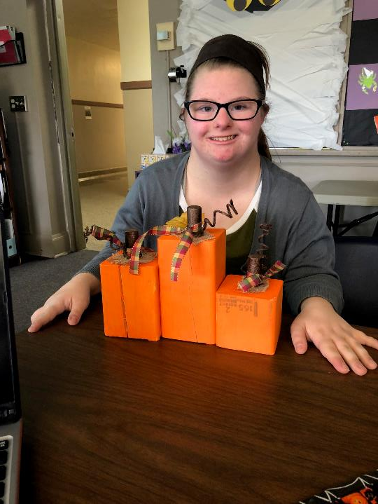

Slide 20
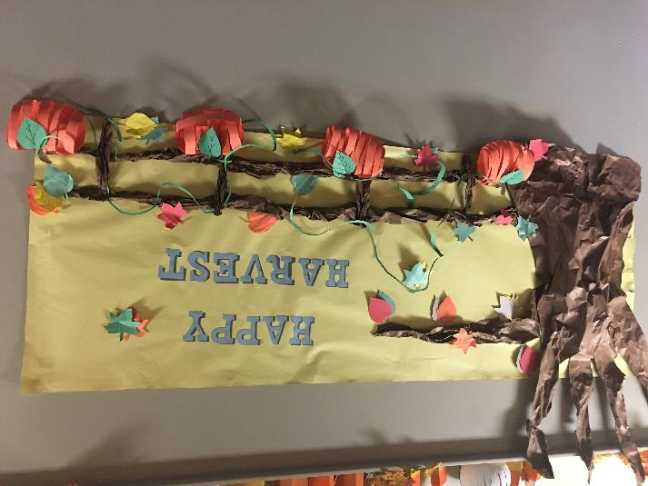

Slide 21
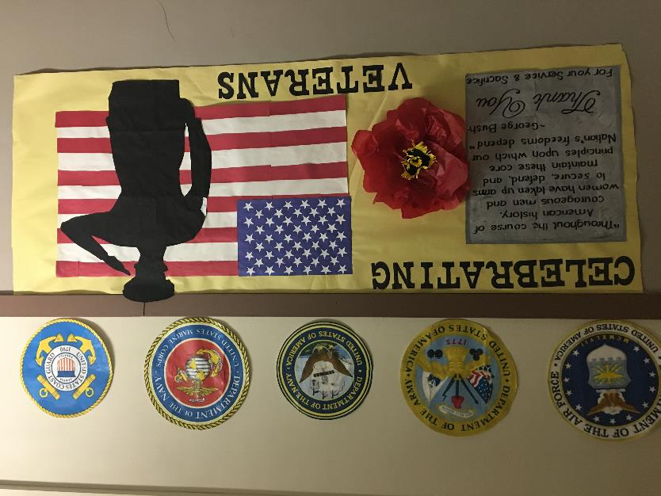

Slide 22
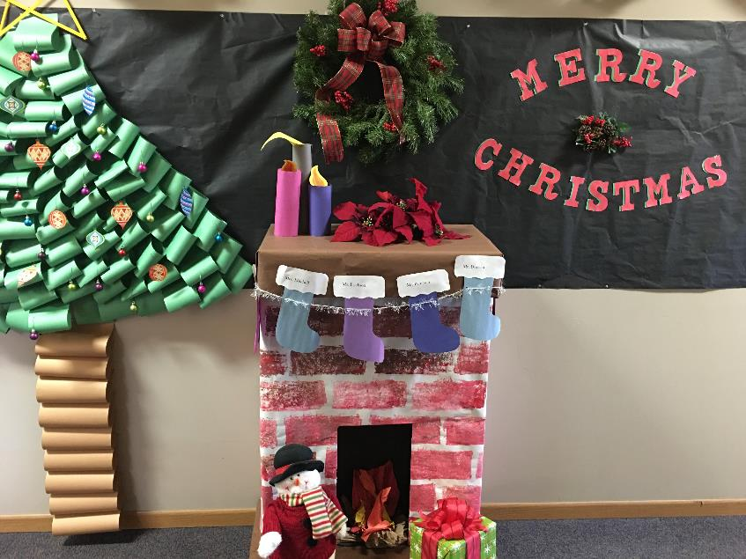

Slide 23
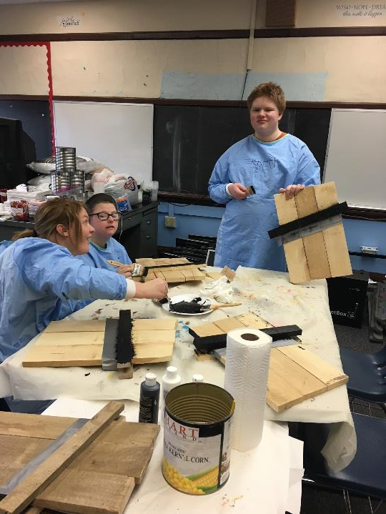

Slide 24
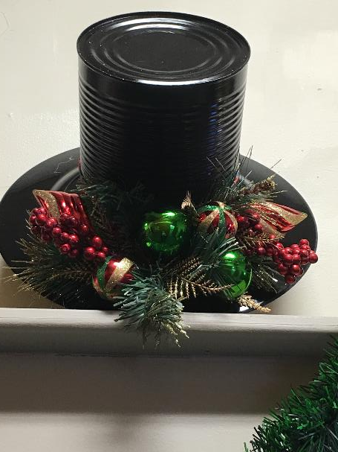

Slide 25
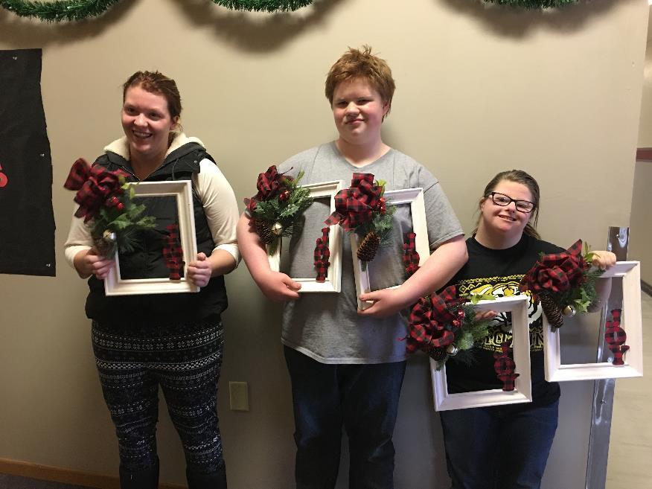

Slide 26
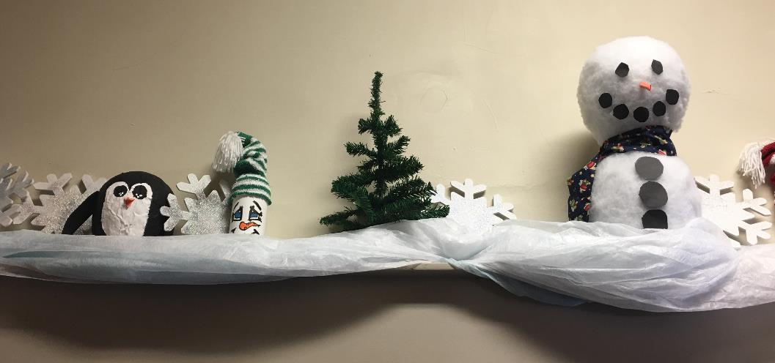

Slide 27
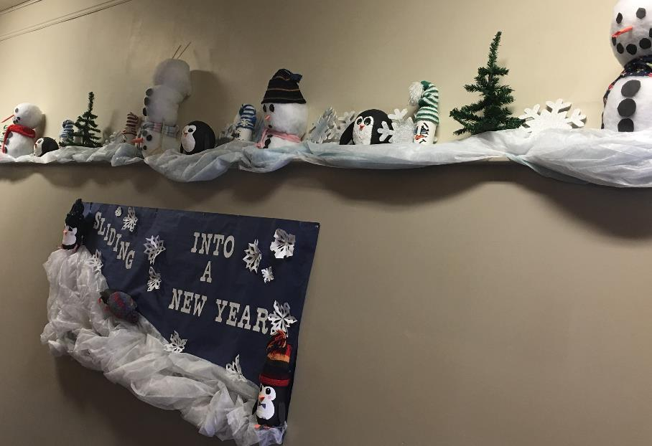

Slide 28
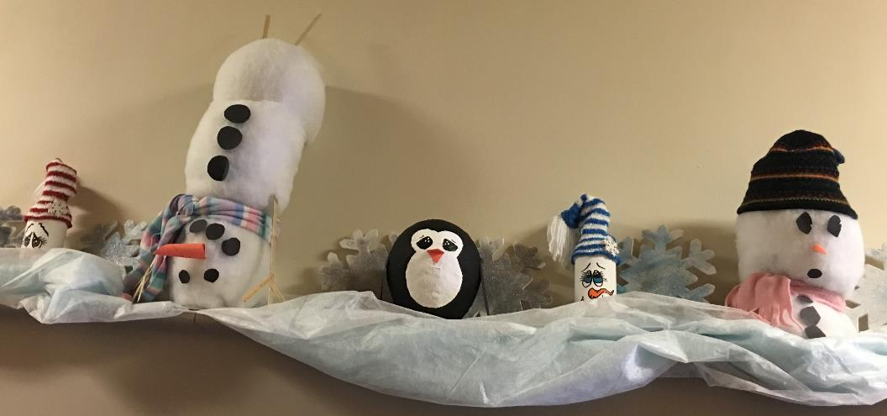

Slide 29
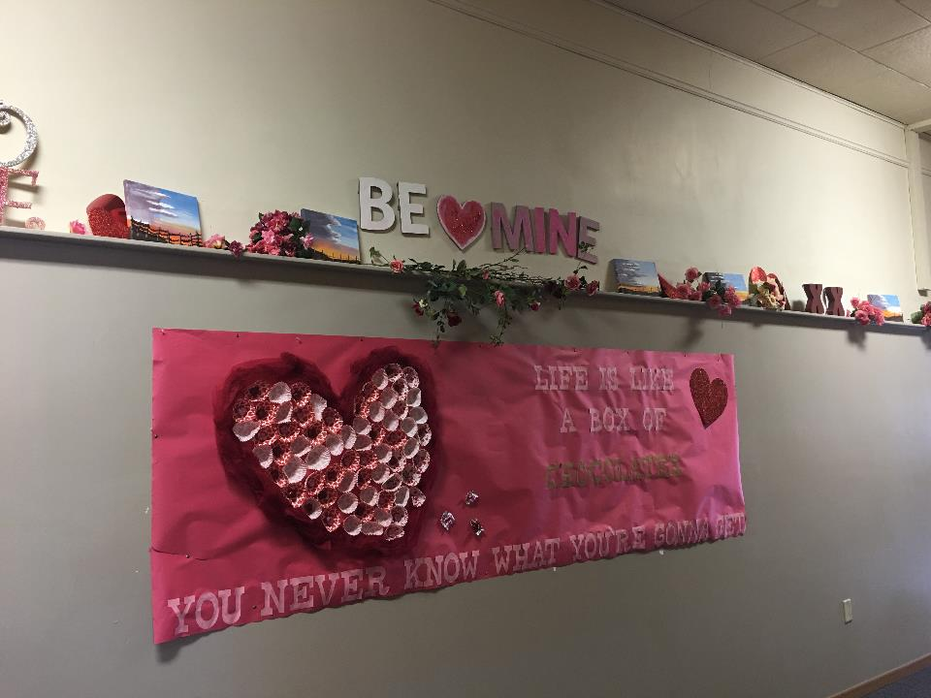

Slide 30
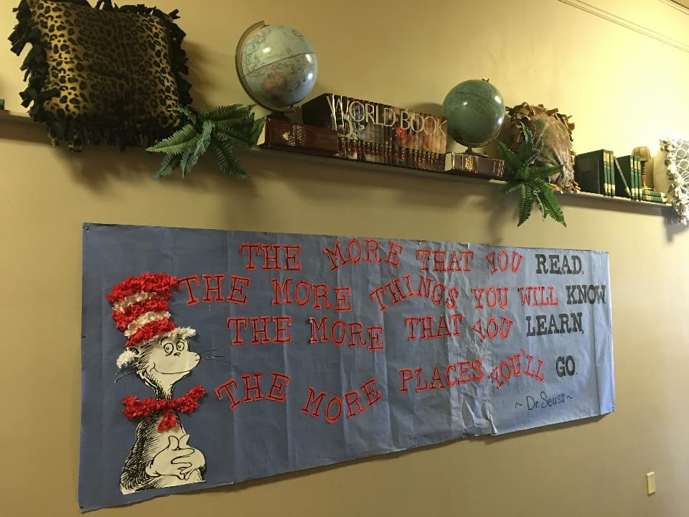

Slide 31
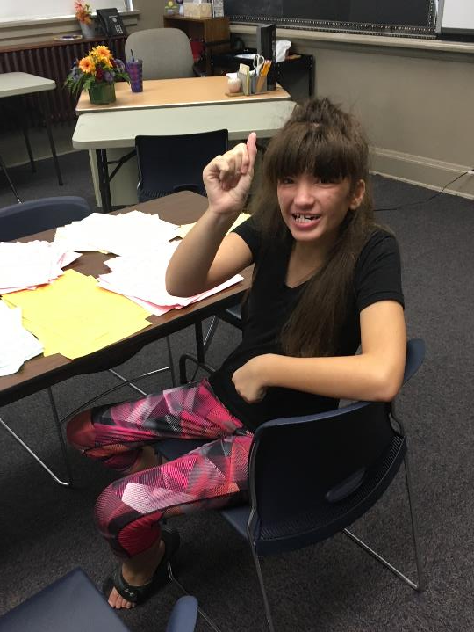
SORTING PAPERS FOR THE OFFICE

Slide 32
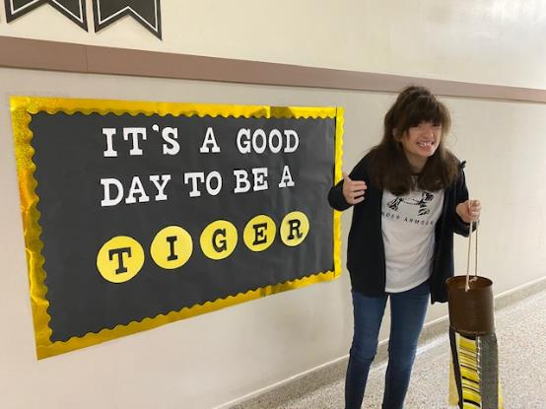
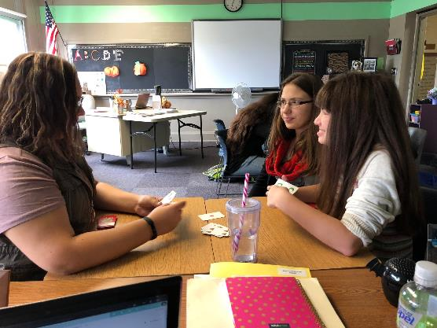

Slide 33
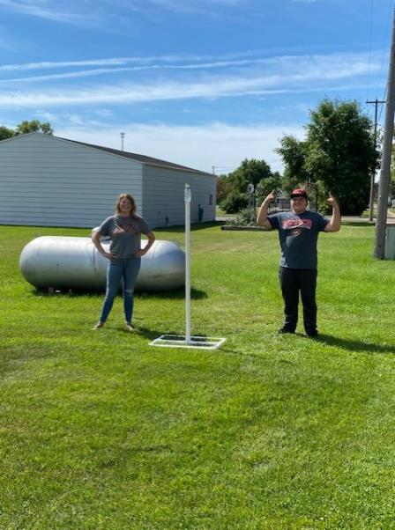
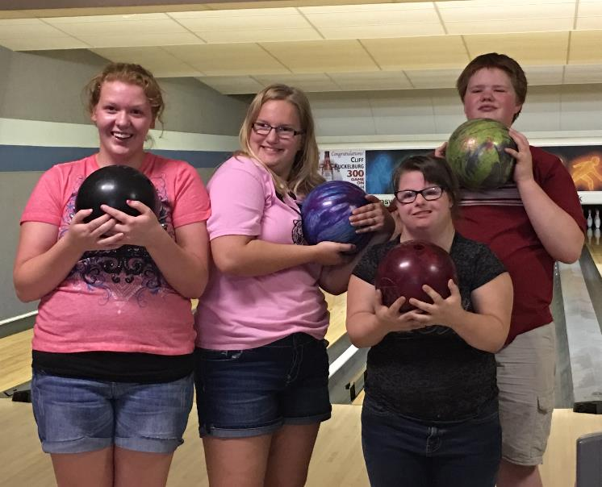

Slide 34
