Slide 1
End of Year Tasks
Summary Of Performance (SOP)
Parental Prior Written Notice (PPWN) – Change of Placement
Indicator 14 – Post School Outcomes (PSO) Survey
  Preparing students for survey
  Volunteering to call last year’s students
Exit Coding – Infinite Campus

Slide 2
SUMMARY OF PERFORMANCE (SOP)
Must be completed during the final year of a student’s high school education
Student should actively participate in the development
Contain the most updated information on the performance of the student
Include both the student’s abilities and aspirations.
SOP

Slide 3
Parental Prior Written Notice (PPWN)
No need to have a ‘dismissal IEP’ but why not have a celebration of completion??
PPWN must be completed to denote that the student will be graduating (document that SOP was given to student/parents)
Graduation with a regular diploma means special education will cease
If getting a certificate, PPWN should contain a statement that student continues to be eligible for special education services through June 30 after he turns 21.
WHO WILL HELP THE STUDENT FOLLOWING GRADUATION?

Slide 4
Indicator 14 – Post School Outcomes Survey
For students who are graduating, aging out, or have dropped out
Students will be contacted one year after exiting to determine their status regarding employment, postsecondary school, and other outcomes
It’s a culminating measure of the success of a district’s goal of preparing students with IEPs to be college, career, and life ready.
How can you prepare student for this survey
  Self-address a post card to be sent the following spring reminding student of survey
  Go over survey with student
    Copy of survey here

Slide 5
Indictor 14 – Post School Outcomes (PSO)
Use the PSO website to check previous years of data
  Post School Outcome website
  To look at district specific data requires login and password
  Each district has a login and password
Volunteer to call last year’s students
  Contact Beth Schiltz to volunteer

Slide 6
Indicator 14 – Appendix A
Log into Launchpad to put in student information
Can input data in the spring
  Need to put in all the information
Wait until fall
  Demographic data will be uploaded into LaunchPad – just need to look at to see if correct
  District need to:
    Check uploaded information for accuracy
    Complete the few questions that need to be answered
  Contact Beth if student:
    Returned to school
    Listed twice
    Transferred to another district

Slide 7
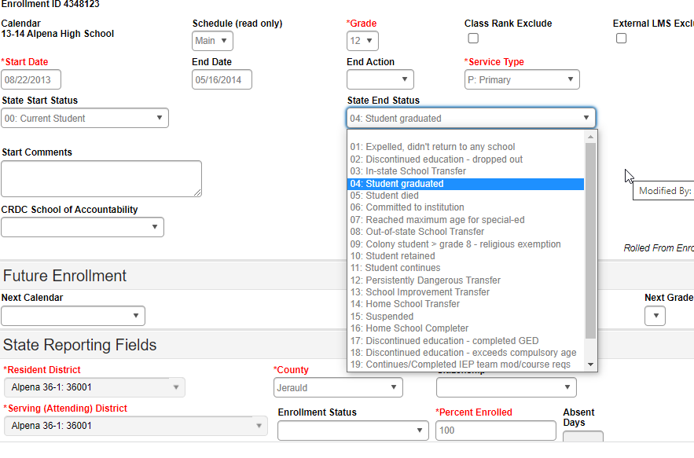
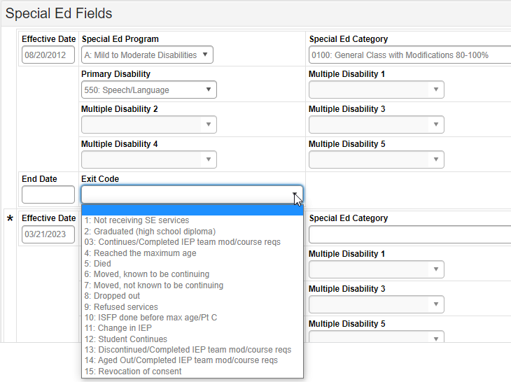
Special Education Coding
In Infinite Campus
Two sections
  General enrollment
  Special Ed Fields
Resources
  Exit code training
  Exit code PPT
  Student Data Collection Desk Guide (Infinite Campus – page 106)

Slide 8
Crosswalk of Exit/End Codes
General Enrollment
Special Ed Fields
02: Discontinues education – dropped out
04: Student graduated
07: Reached maximum age for special-ed
OR
21: Aged out/Completed IEP team mod/course reqs
08: Dropped out -- OR –
07: Moved, not known to continue
02: Graduated (high school diploma
04: Reached the maximum age
OR
14: Aged Out/Completed IEP team mod/course reqs

