Slide 1


Gather ‘Round Your Transition IEP

Slide 2



What Color is Your Marshmallow (IEP)?
Compliant – Basic
Non-Compliant
Enhanced Practices

Slide 3
Let’s Score Some IEPs

Slide 4

Transition Assessment
Is there at least one age-appropriate transition assessment to address:
  Employment
  Education or Training
  Independent Living
Assessment results documented on PLAAFPs
Transition assessment summary includes input from student and parents

Slide 5

Enhanced Practices
Two or more age-appropriate assessments given/ results documented on PLAAFP
Transition assessment is comprehensive and not just a single snapshot of student
Transition assessment data was gathered through a combination of methods and variety of sources
Assessment results demonstrate a clear connection to:
Post-secondary goals
Present levels
Courses of Study
Transition services
Annual goals
Evidence that assessments are updated annually

Slide 6
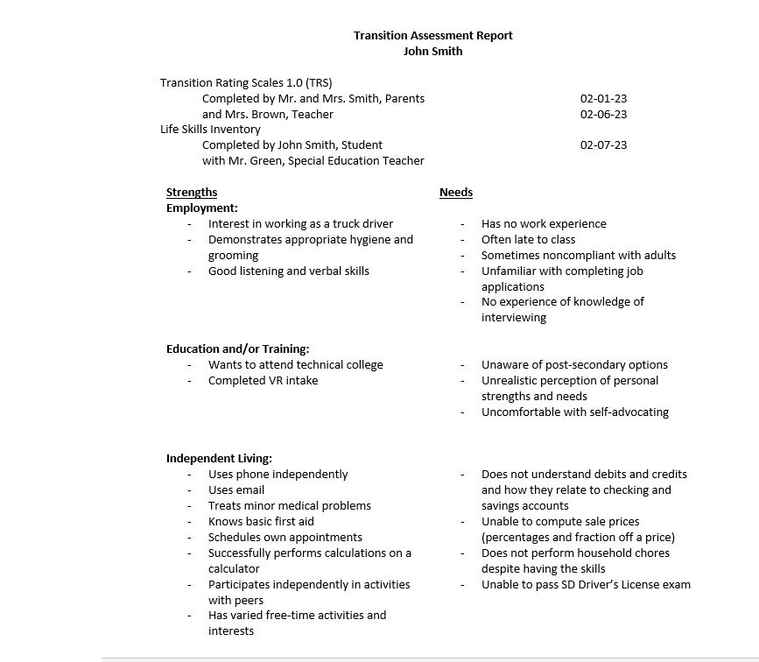
What Color is the Marshmallow?

Slide 7
Compliant!
Assessments and respondents are listed
Assessment dates provided
Assesses each area of transition: employment, education/training, and independent living

Slide 8
Transition PLAAFPs
Present Levels of Academic Achievement and Functional Performance (PLAAFP) references transition assessments
Adequately contains transition strengths, needs, and interests of students in:
Employment
Education or training
Independent Living

Slide 9
Enhanced Practices
Transition assessments results demonstrate a clear connection to the student’s post-secondary goals
Strengths/needs/interests of student relate to employment (Project Skills or competitive job) or to post-secondary education/training

Slide 10
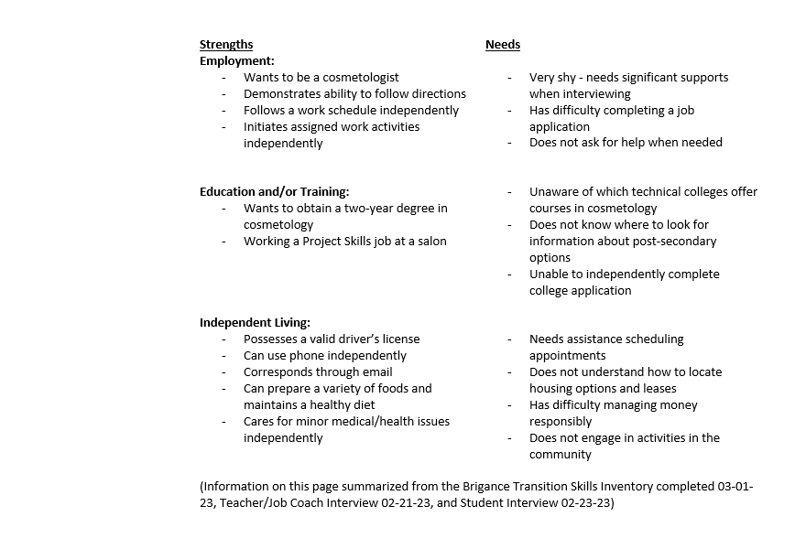
What Color is the Marshmallow?

Slide 11

Enhanced!
Strengths and needs directly address the student’s post-secondary goals
Create a clear picture of the student’s desired outcome

Slide 12
Appropriate Measurable Post-Secondary Goals
Includes goal for:
Employment
Education/training
Independent living when appropriate
Appears appropriate based on file contents
If no independent living goal is needed, supporting evidence is included (PLAAFPs)
Written in measurable terms (will work, will attend, etc.)
Written to occur after receipt of high school diploma or ‘age out’

Slide 13
Enhanced Practices
Are the basis for decisions regarding courses of study, annual goals, and development of transition services
Are designed to be attainable by the student
Aligned with transition assessment summary or based on PLAAFPs

Slide 14
What Color is the Marshmallow?
Measurable Post-Secondary Goals (MPSG)
Employment: I will be a stocker at Kessler’s (see linked annual goal(s) #1)
Education/Training: I will attend Project SEARCH (see linked annual goal(s) #3)
Independent Living (where appropriate): I will live in my own apartment with supports (see linked annual goal(s) #2)

Slide 15
Non-Compliant
Education and training goal to attend Project Search is not post-secondary in nature.
Consider “on the job training” or other post-secondary option for the goal.

Slide 16
Post-Secondary Goals
Updated Annually
IEP contains evidence that post-secondary goals were discussed and either remain the same or changes were made accordingly

Slide 17
Enhanced Practices
Post-secondary goals become more specific each year
Post-secondary goals were discussed, and progress is reflected by adjustments to:
    PLAAFPs
    Transition Services/Activities page
    MPSGs are different from last year’s IEP

Slide 18
Related Annual Goals
Reasonable link between annual goals and post- secondary goals
At least one annual goal supports/relates to the post-secondary goals

Slide 19
Enhanced Practices
At least one annual goal specifically addresses an identified transition service need
Annual goals are closely related to post-secondary goals

Slide 20
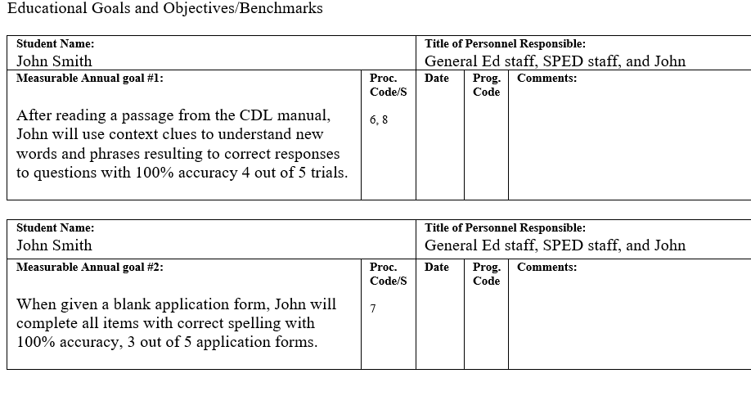
What Color is the Marshmallow?

Slide 21
Enhanced!
Annual goals relate directly to post-secondary goals and are functional in nature

Slide 22
Courses of Study
Courses are listed from time of current IEP through completion of special education services (graduation or aging out)
Courses listed are aligned with post-secondary goals and are specifically identified

Slide 23
Enhanced Practices
Courses are clearly aligned with post-secondary goals, interests, and needs
Student has met with school counselor to develop courses of study
Parent took an active role in developing and planning the courses of study
Includes the required and recommended coursework for admission and success at a specific post-secondary program
Student enrolled in appropriate dual credit, capstone coursework, or related work experience, such as Project Skills

Slide 24
What Color is the Marshmallow?
Transition Course of Study
(Required on or before the student’s 16th birthday) (Complete for current school year through the planned exit year) (Should relate to and help the student progress towards achievement of the Measurable Postsecondary Goals above)
Grade 10 | Grade 11 | Grade 12
Fundamentals of Math | Algebra 1 | Algebra 1 (continued)
English 2 | English 3 | English 4
US Government | US History | World History
Art 1 | Fundamentals of Science | Biology 1
Health and First Aid | Weightlifting | Personal Finance
Speech | Welding 1 | Residential Construction
Introduction to Building Trades | Welding 2 | Internship

Slide 25
Compliant!
Courses reflect a clear path toward graduation requirements, as well as addressing the student’s interests and career planning.
Specific courses are listed. This can change if the student’s interests or wishes change.
For students who will continue past their senior year, be sure to project courses into the years beyond 12th grade.

Slide 26
Transition Services/Activities
At least one service or activity aligned for each measurable post-secondary goal addressed
School, student, family, and agency share responsibility for providing and implementing services/activities

Slide 27
Enhanced Practices
Sufficient activities are included to promote the attainment of stated post-secondary goals, based on the individual’s needs
Are a coordinated set of activities
Based upon the student’s needs taking into account strengths, preferences, and interests
Aligned with info on PLAAFPs
Support career and/or post-secondary education/training awareness

Slide 28
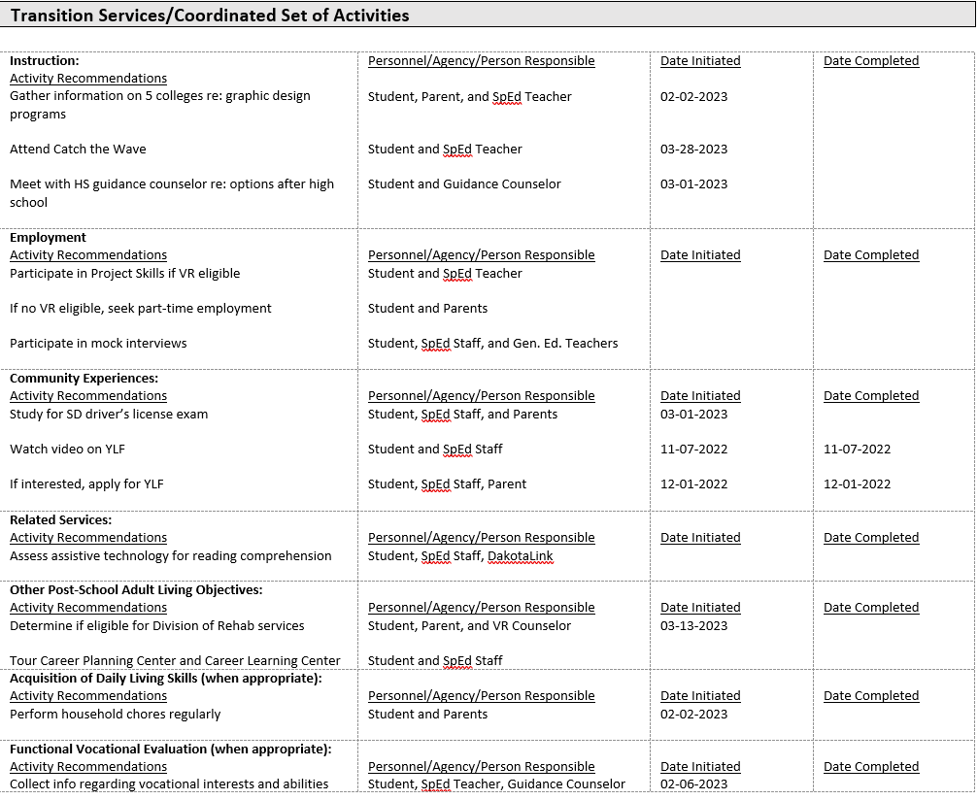
What Color is the Marshmallow?

Slide 29
Enhanced!
Multiple services and activities listed in each area
Services and activities are coordinated to help the student reach post-secondary goals
See the Technical Assistance Guide for Transition in the IEP for more examples:
  https://tslp.org/wp-content/uploads/2019/02/TA-Guide-FINAL09-updated-2016doc-1-1-1.pdf

Slide 30
Student Invite -
Self Advocacy
Evidence of student invitation
If the student was invited but did not attend, student preferences and interests are documented

Slide 31
Enhanced Practices
Personalized student invitation
Student attended IEP meeting
Student has received instruction in self-advocacy and self-determination, as well as the IEP process
Student participated in meeting by
  Providing information about their strengths, preferences, and interests
  Discussing post-secondary goals
  Discussing annual goals
  Summarizing own transition assessments
  Discussing disability/needed accommodations
  Actively participating in discussions and decisions
  Leading the IEP meeting

Slide 32
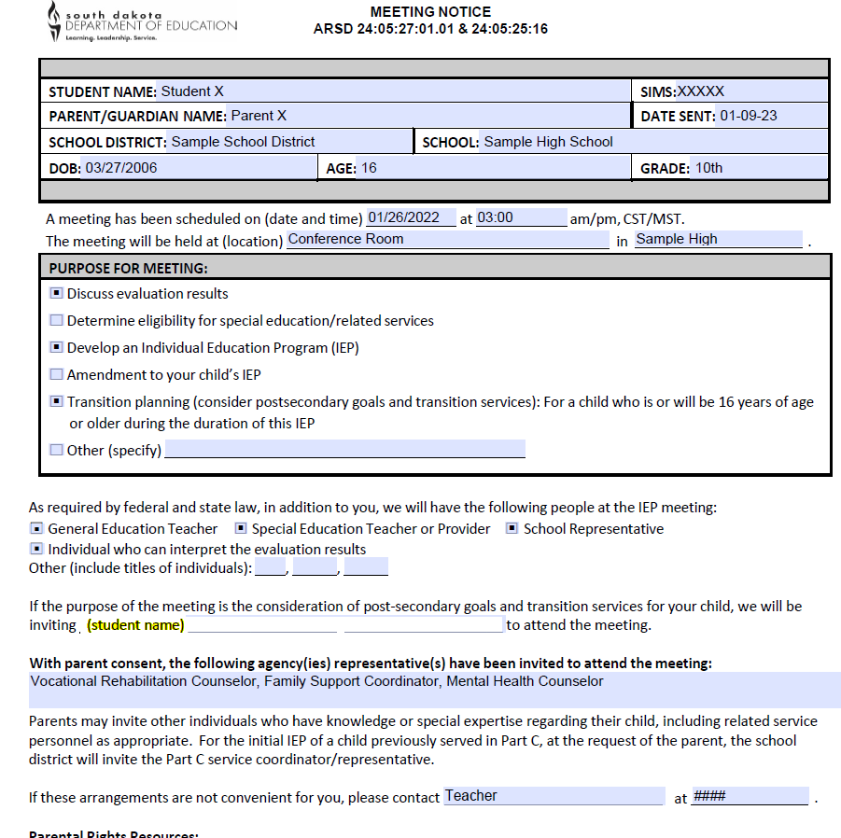
What Color is the Marshmallow?

Slide 33
Non-Compliant
Student is not listed on the meeting notice
No other evidence the student was invited to the meeting
Note: at age 18, unless the student has a guardian, the meeting notice should be addressed directly to the student.

Slide 34
Agency Invite – Collaboration
Agency was invited with parent or adult student's consent
Consent to Invite Outside Agency is signed prior to the meeting notice being sent to meeting participants
Student may be too young to determine whether outside/transition agency is appropriate
Agency involvement should be considered for all students, but may not be required/needed to achieve MPSGs based on individual file information

Slide 35
Enhanced Practices
Agency attends meeting to explain possible services
Agency visits and communicates regularly with staff and students in person and/or virtually
At the IEP meeting, the agency representative was an active participant in the development of the needed transition services, including those they will provide and pay for
Evidence of agency rep participation found in IEP or PPWN
If unable to attend, evidence of how/ when connections with agency will be made is documented in PLAAFP/PPWN

Slide 36
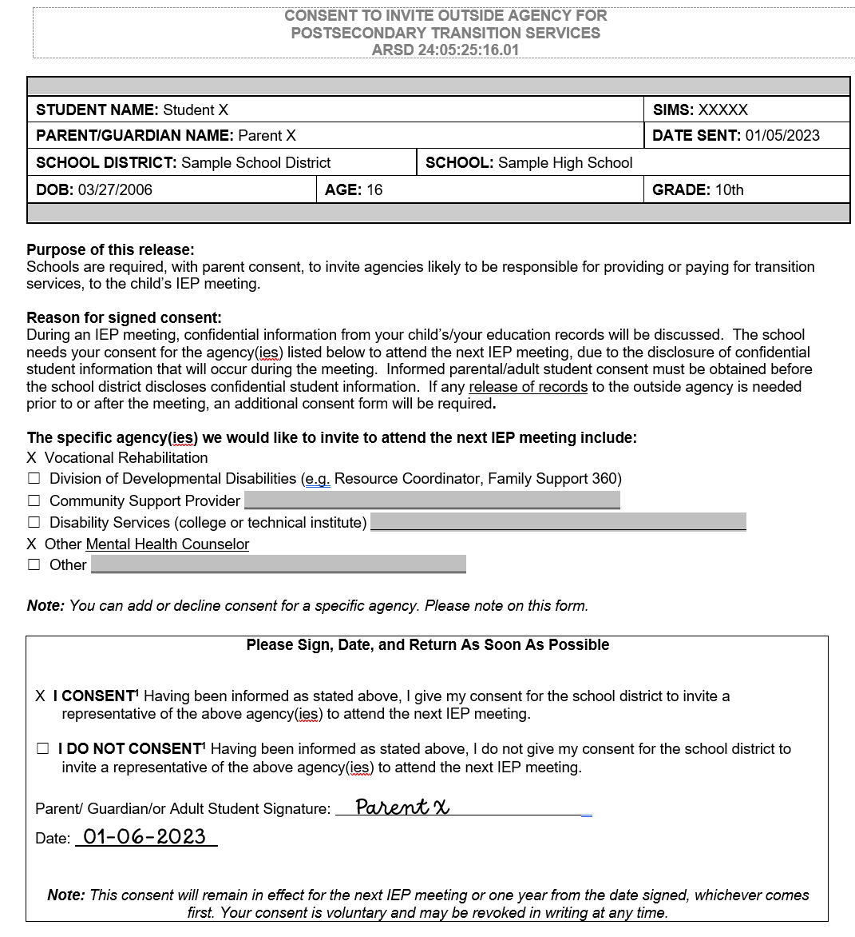

Slide 37
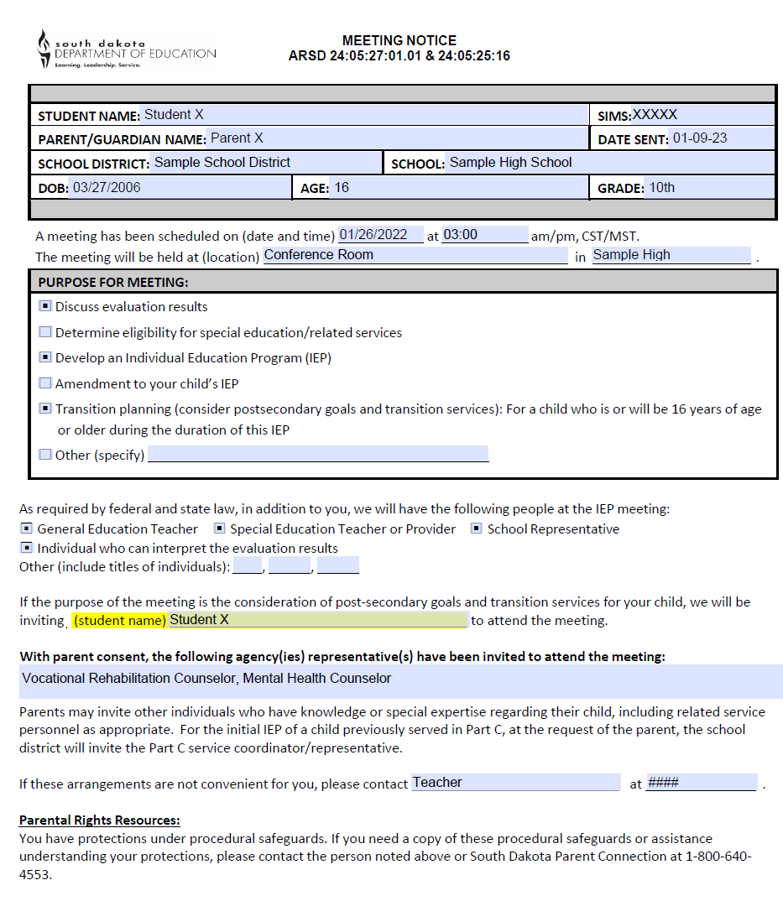

Slide 38
Compliant!
Consent includes physical signature
Meeting notice sent after receipt of signed Consent to Invite Outside Agency
Includes list of agencies (VR and mental health counselor) that were included in the consent
Student is listed on the meeting notice as being invited to the IEP
If parents/student bring additional agencies or participants to the IEP meeting, include this information on the PPWN

Slide 39
Process for Inviting Outside Agencies
To IEP Meetings for Transition-Age Students
Step 1
Step 2
Step 3
Step 4
Note
District & parents discuss which agencies may be beneficial to invite to IEP.
District gets written consent form (signed & dated) from parent.
After written consent is received, district sends Meeting Notice that includes the names of agencies being invited to mtg.
IEP meeting is held with parents, student, school, and invited outside agencies.
Consent form is valid for next meeting OR a maximum of one year.
Consent may be signed at current meeting for next meeting.

Slide 40
Contact Your Transition Liaisons
www.TSLP.org
Transition Coordinator Dan Rounds Office: (605) 494-3618 Cell: (605)280-6192 drounds@bhssc.org | Western Region Dave Halverson Office: (605) 720-4847 Cell: (605) 347-1379 dhalverson@bhssc.org
South Eastern Region Bev Petersen Office: (605) 362-4856 Cell: (605) 360-1877 bev.petersen@state.sd.us North Central Region Cate Diede Office: (605) 626-2398 Cell: (605) 216-6391 cate.diede@state.sd.us | South Central Region Miah Gillen Office: (605) 995-8172 Cell: (320) 583-6731 miah.gillen@state.sd.us

