Slide 1

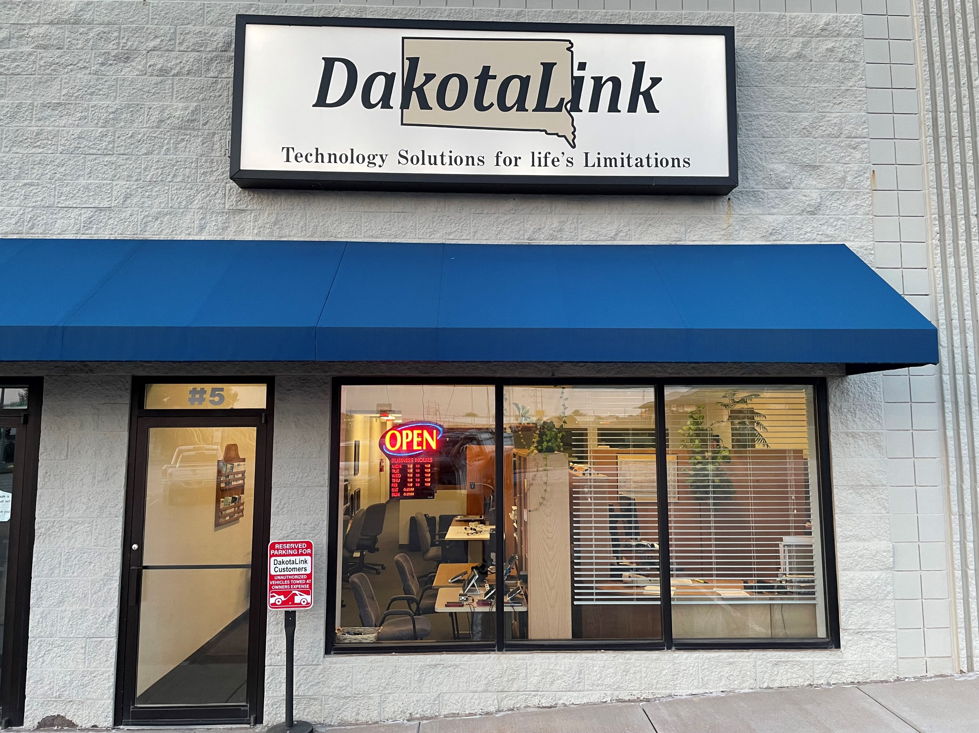
AT for Independent Living, Education & Work
2023 Summer Transition Institute
Presenter:
Brett Burden, ATP
bburden@dakotalink.net
605-394-6742 x3 or
1-800-645-0673 x3

Slide 2
DakotaLink – brief overview & history
Established in 1992, DakotaLink is a program of the South Dakota Department of Human Services, Division of Rehabilitation Services administered by Black Hills Special Services Cooperative and funded in part through a grant from the United States Department of Education, Office of Special Education and Rehabilitation Services through the Rehabilitation Services Administration under Public Law 108-364, referred to as the Assistive Technology Act of 2004 or the Assistive Technology Act of 1998, as amended.

Slide 3
DakotaLink – Mission & Goals
Our mission is to assist individuals with functional limitations; due to a disability, illness, injury, or the effects of aging; maximize their potential whether at home or in the community, at school, at work, or at play through the use of Assistive Technology.
Improving access - defined as information, knowledge, awareness and understanding
Improving acquisition - defined as obtaining assistive technology devices and services

Slide 4
DakotaLink – Fee for Service
Provide assessment, sales, installation and training
Six technicians are available to provide assistive technology devices and services to individuals with disabilities of all ages
From start to finish, a one stop, turn key solution
Offices in Rapid City, Sioux Falls, Brookings and Aberdeen

Slide 5


What is Assistive Technology?
Assistive technology (AT) is any item, piece of equipment, software program, or product system that is used to increase, maintain, or improve the functional capabilities of persons with disabilities.
No Tech – Low Tech – High Tech: All are considered AT

Slide 6
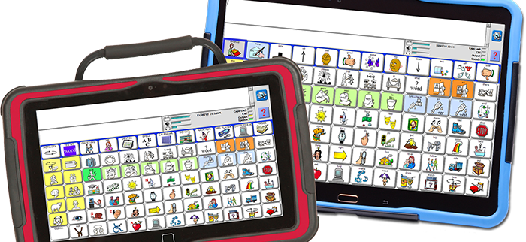
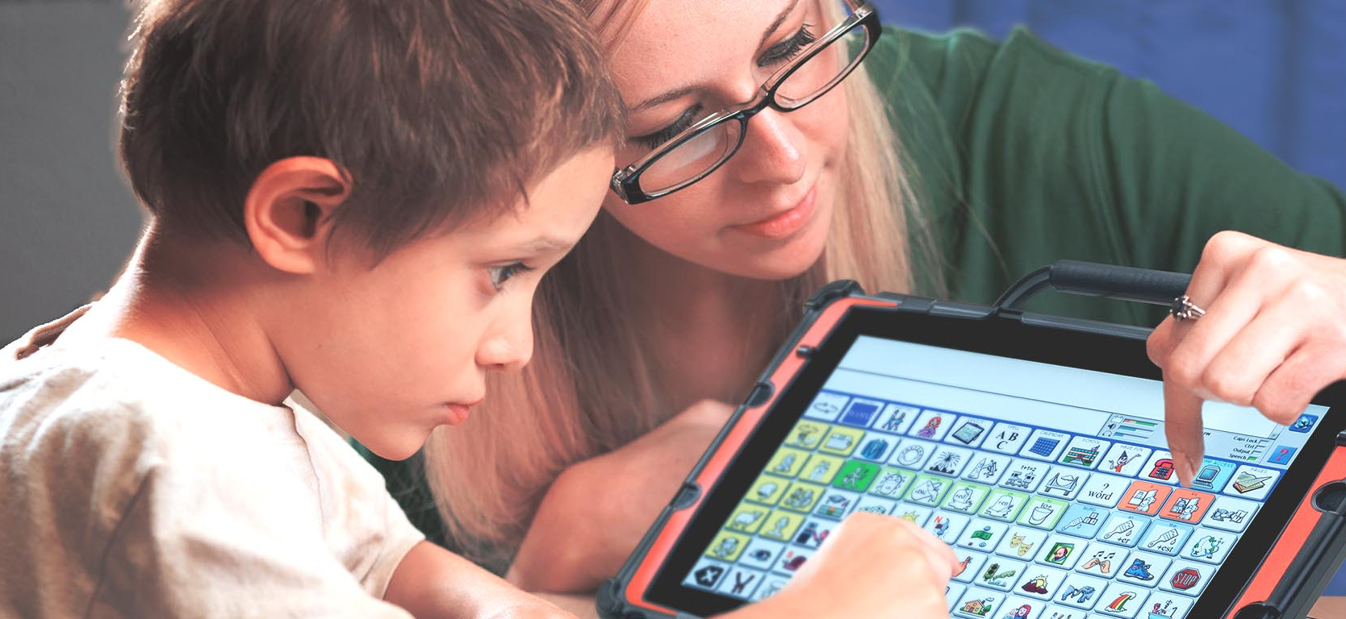
Devices + Services = ….?
AT Devices & AT Services are the two halves of the AT world.
Devices are any item that is used to increase, maintain or improve functional capabilities
Services directly assist an individual in the selection, acquisition, or use of a device
Services for any device is essential in ensuring that the consumer has the correct device, a way to obtain it, and education for how to use & maintain it… which leads to….
Success!

Slide 7
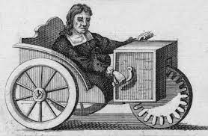
Types of AT
Low Tech
Medium Tech
High Tech
Simple, affordable tools that are often not electronic
Simple Electronic Devices
Advanced tools that incorporate computers, tablets & smart devices and the internet.
AI…..?
Did you know? AT has been around for centuries: eyeglasses, for example, date back to the late 13th century. Wheelchairs were known to exist in China almost 1500 years ago!

Slide 8


AT in School
Under IDEA(Individuals with Disabilities Education Act)
  Schools are legally required to consider assistive technology for each student who receives special education services.
  Any member of the team can provide input in this conversation.
  Many students, even those without disabilities, find AT to be extremely useful for success

Slide 9




Reading
Reading guides, colored overlays
Audio Books – human reader (recorded)
Text to speech
  Read & Write, Kurzweil 3000
  OneStep Reader, Seeing AI, Narrator
  Built in tools
Questions to ask:
Where do I get my books from?
What devices, if any, can be used in this area?

Slide 10
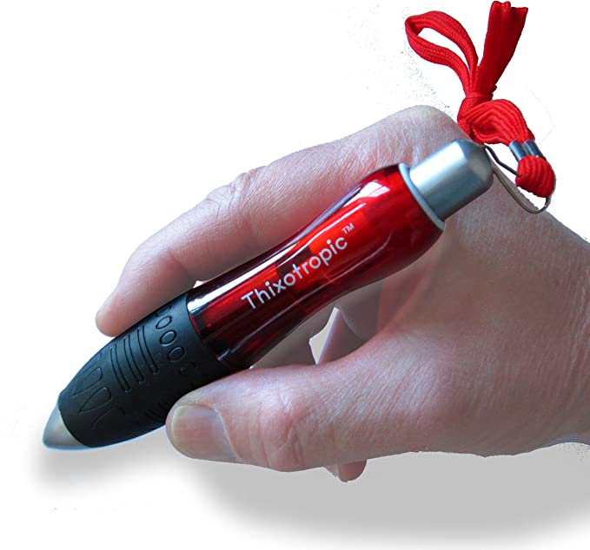
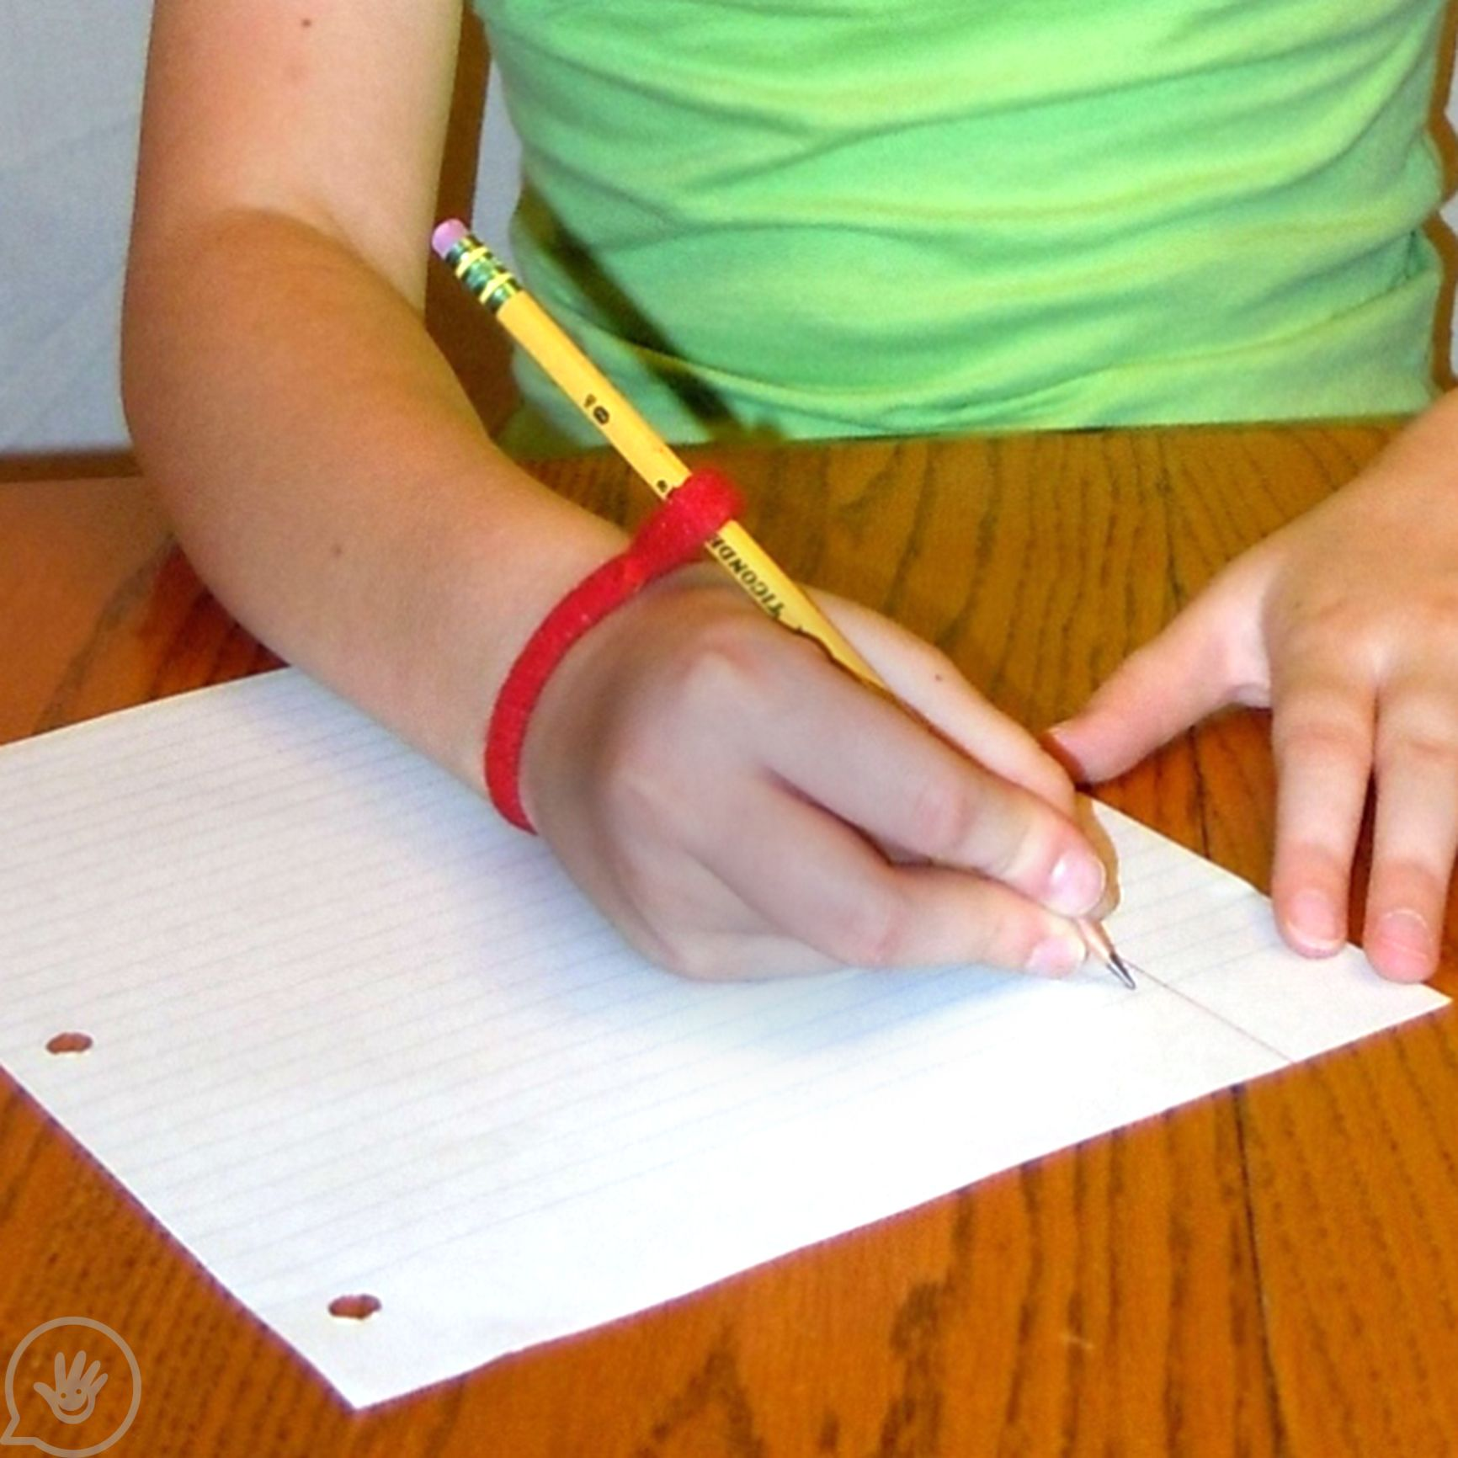

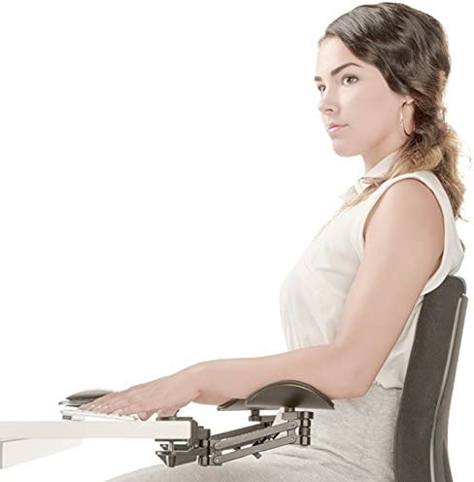
Writing
Pen/Pencil Grips, weighted/large pens
Raised line paper
Arm/wrist supports
Word prediction
Speech to Text
  Dragon
  Microsoft, Apple, Google dictation
  A good microphone!
Questions to ask:
Is speech clear?
What device is available?
Is a microphone available?
Test taking, paper assignments, etc?

Slide 11
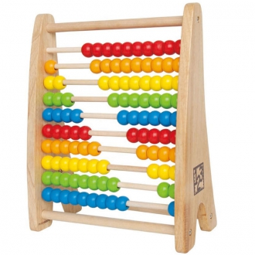
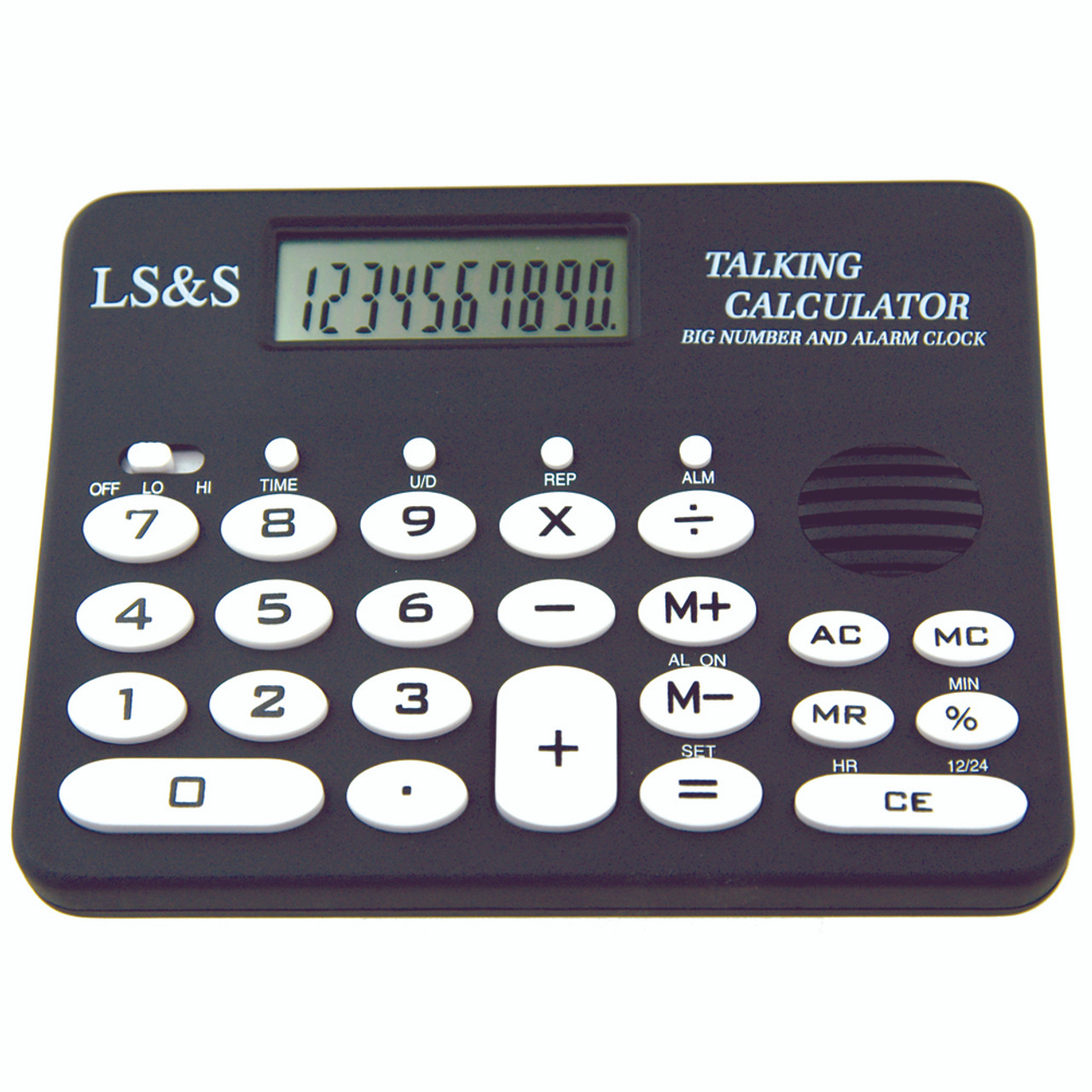
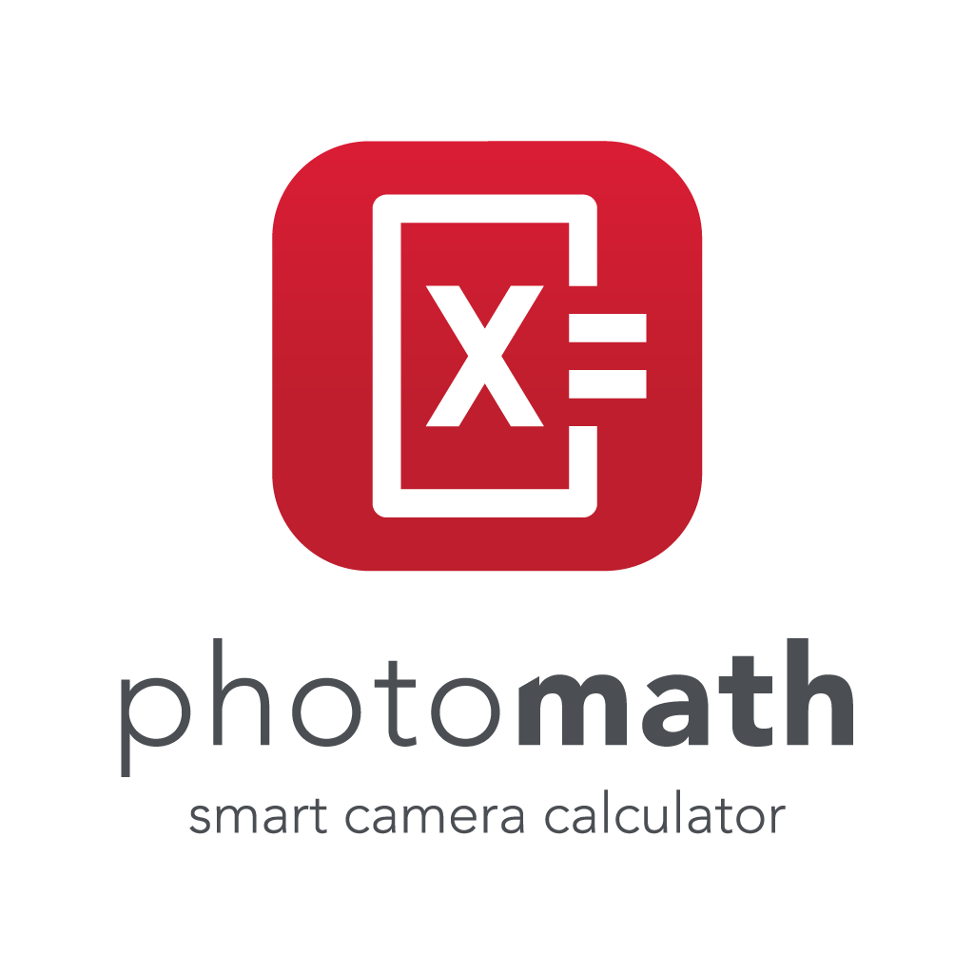
Math
Talking calculators, calculator apps
Other talking devices: tape measures, measuring cups, scales
Low tech manipulatives, games
Photomath, Google
Dragon/MathTalk
Questions to ask:
Is this related to reading, ie, story problems?
Will teachers consider Photomath “cheating”?
What will be used during tests?

Slide 12
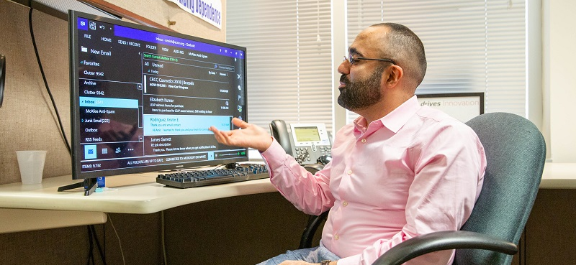
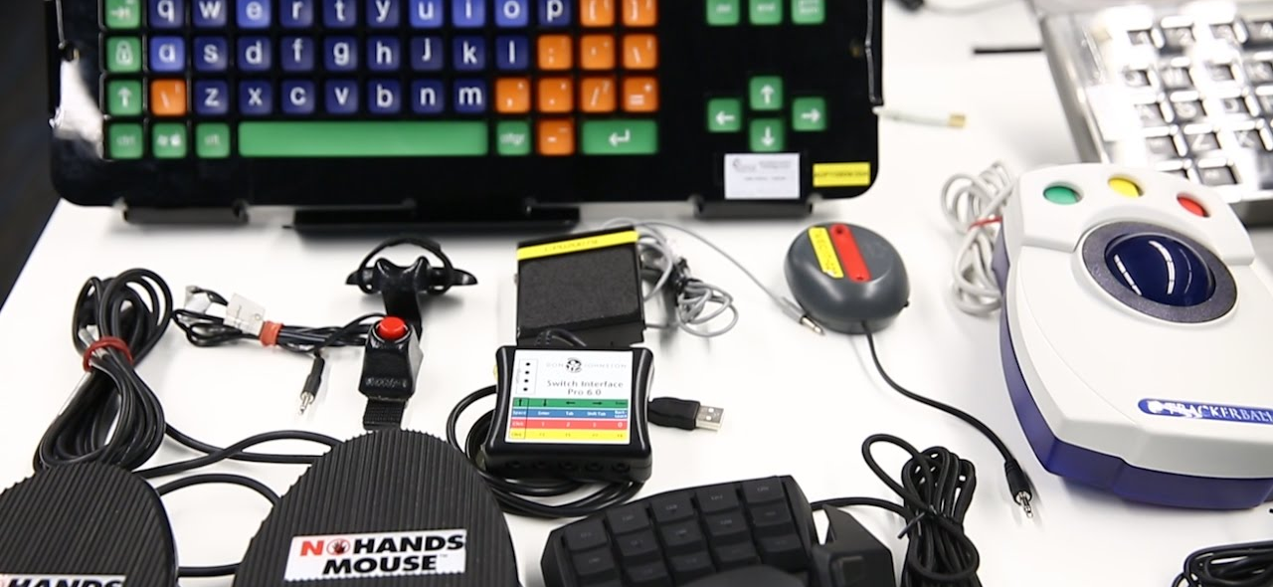
AT in the Workplace
AT can be essential for success in the workplace. Many consumers obtain technology through:
  Vocational Rehabilitation (State)
  Service to the Blind & Visually Impaired (VR)
  Veterans Administration VR
  Employer supplied equipment
  Private purchase/other funding sources

Slide 13
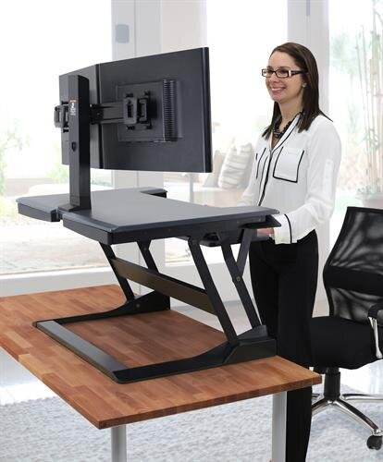
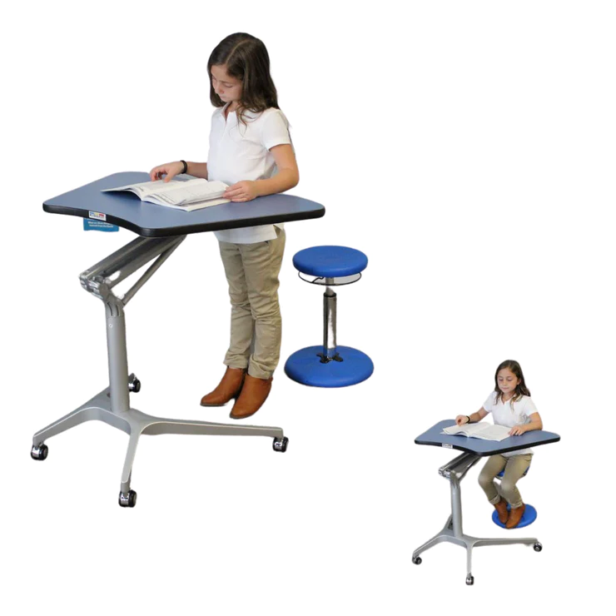
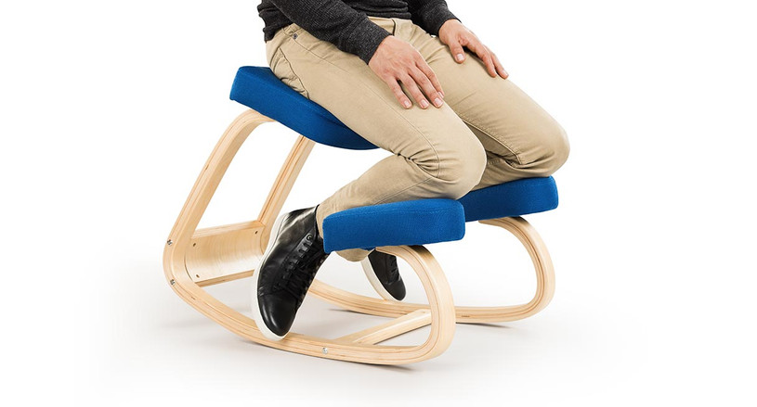
Ergonomics
Chairs and seating
Sit/stand workstations
Keyboards, mice, monitors
Wrist/arm support, lumbar support, neck support
This is one area that is often overlooked until it’s a necessity – repetitive stress injuries are preventable!

Slide 14
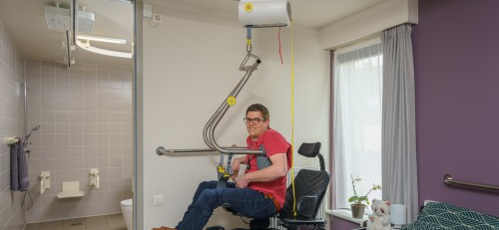
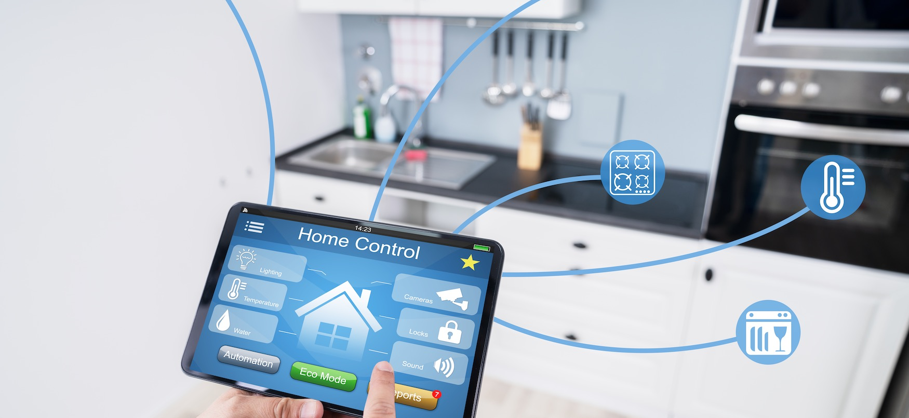
AT for Independent Living
AT at home keeps consumers safe, connected to loved ones, living independently, and out of care facilities
Could include medical equipment such as lifts, wheelchairs, stair lifts, etc
Communication access – in person (AAC) or distance (telephone or video)
Smart home devices
Very wide variety of low tech & no tech items

Slide 15
AT for IL – Many Types
Seating, Positioning, Mobility
  Wheelchair modifications, gait trainers, stand aids – mostly low/medium tech
  Lift systems (ceiling, wall, pool, van, equine, etc) – medium tech
Recreation/Sensory Aids
  Switch adapted toys, audible sports equipment, various types of stimulating devices
Daily Living Aids/Health & Wellness
  Pill dispensers, jar/bottle openers, alarm clocks, deaf signallers, feeding/eating/dressing/grooming aids
  Apps!
Environmental Controls
  X10 (simple)
  Automated devices – vacuums, door openers, sensors
  Siri, Google Home, Alexa enabled devices
    Thermostats, lights, appliances, cameras

Slide 16
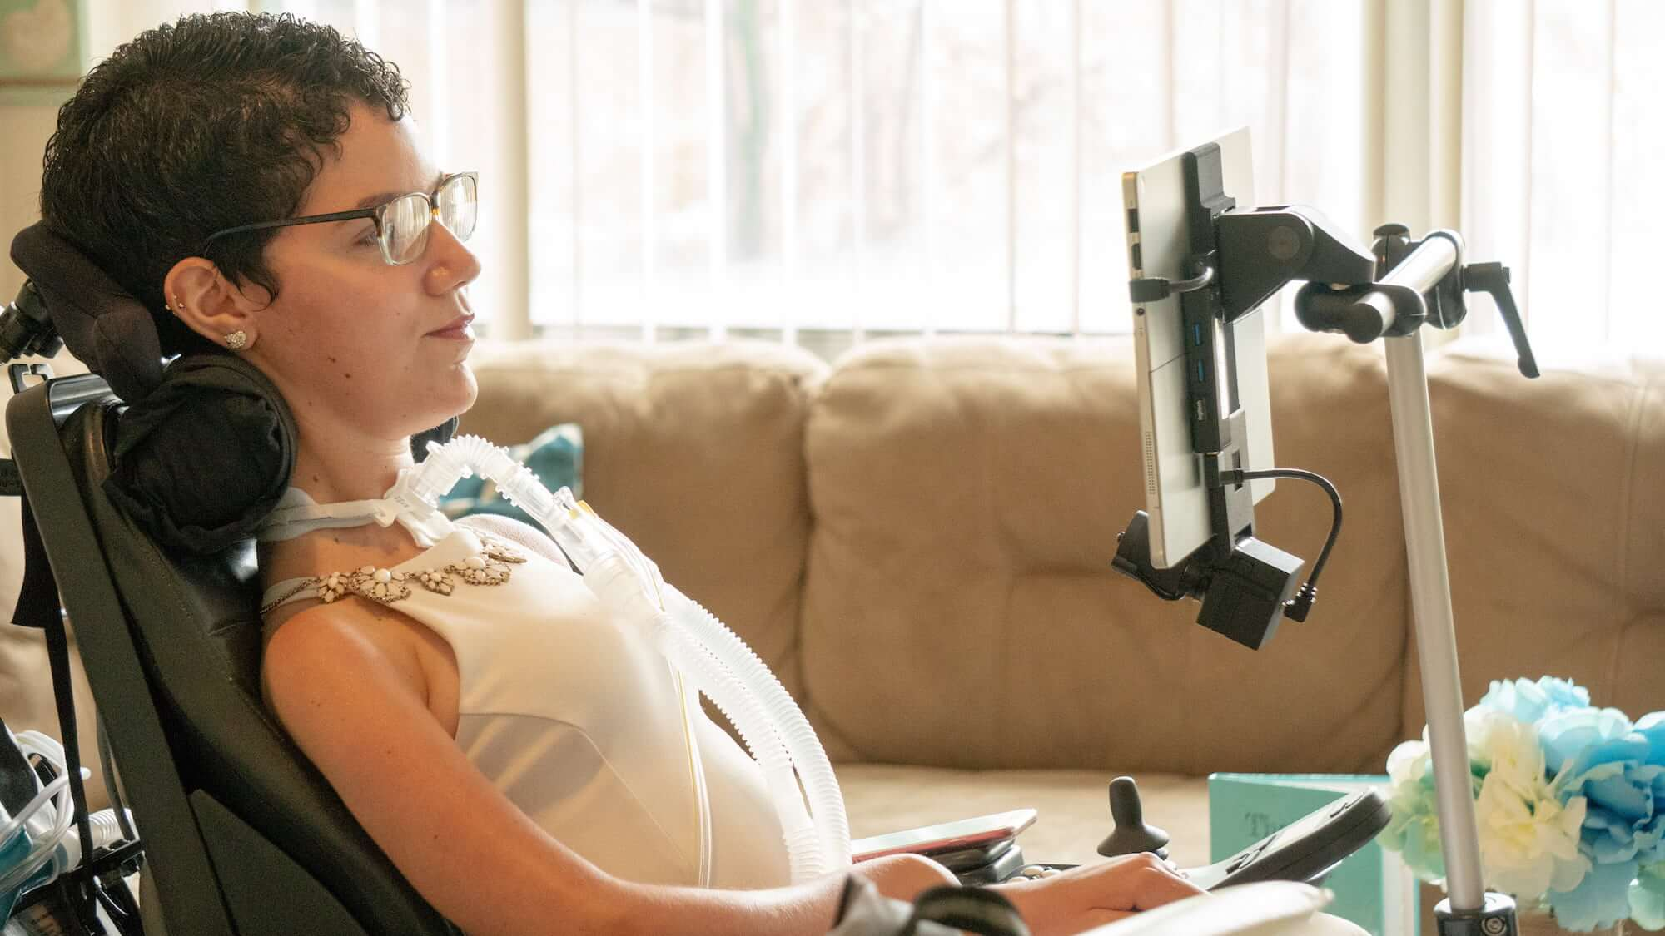
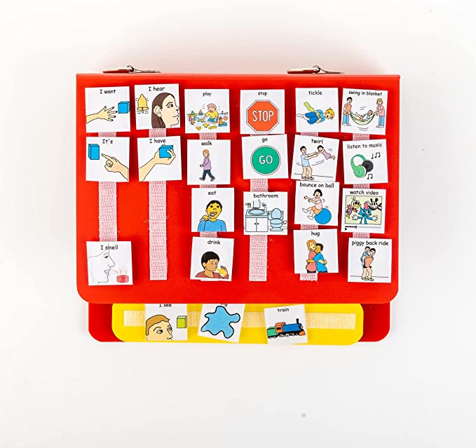
Communication
AAC – Augmented & Alternative Communication
  All of the ways that someone communicated besides talking
  AAC can be a supplement to speech and studies show that it does not negatively impact a person’s ability to learn to speak
  Low Tech – PECS
  Medium Tech – GoTalk, Big Mac, etc
  High Tech – DynaVox, TalkToMe, Saltillo and many smart devices apps
    GoTalk Now, Proloquo2Go, Avaz, Snap, TouchChat, Proloquo4Text, FlipWriter
Questions to ask:
Budget? Who pays for it? Medicaid?
Used at home, school or both?
Do I need switches? Eyegaze? Mounting?
Device durability?

Slide 17
Vision Loss ----------- Hearing Loss
Vision loss or hearing loss can happen at any age and for many reasons.
“Blind” does not mean “cannot see”, “Deaf” does not mean “cannot hear”
Low tech magnifying glasses
High tech video magnifiers
Text to speech
Screen enlargement software
Braille devices (high and low tech)
Talking devices/auditory alerts
Apps! iOS is very accessible!
Hearing aids
Amplified devices – phones, FM systems, personal amplification
Visual aids – strobe lights, other types of lighting
Vibrating alerts
TTY/Captions/Relay/Interpreters

Slide 18

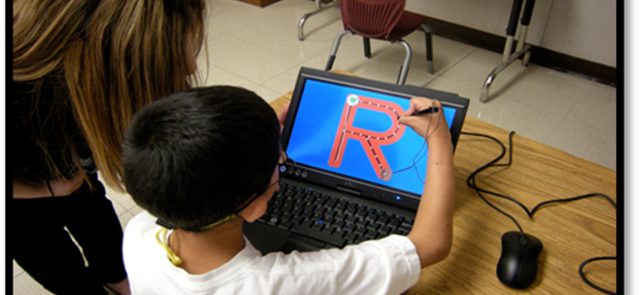
AT Demonstrations
Free, informal exploration of AT devices
Not a formal recommendation
“Try it before you buy it”
Could involve a two week loan of equipment if applicable
Available to all ages/all disabilities, usually works best at one of our locations by appointment but we are flexible for every situation

Slide 19
Thank you!
For more information, contact DakotaLink:
1-800-645-0673
atinfo@dakotalink.net
Web: www.dakotalink.net
Locations in Rapid City, Sioux Falls, Brookings, Aberdeen

