Slide 1
Practical Strategies & Activities to Improve Transition Outcomes for Students with Disabilities
July 11, 2023
https://www.youtube.com/watch?v=v8xgecy_ivw
Notes:
Mary

Slide 2


Slide 3
What is the National Technical Assistance Center on Transition: The Collaborative (NTACT:C)?
Jointly funded center: The US Department of Education - The Office of Special Education Programs (OSEP) and the Rehabilitation Services Administration (RSA)
Helps state and local schools and agencies to better support students and youth in making successful transitions to adult life
Builds on history of:
  WINTAC (RSA)
  YTAC (RSA)
  NTACT (OSEP & RSA)
Notes:
Michael
Knowledge Development and Technical Assistance Specialist
National Technical Assistance Center on Transition – The Collaborative (NTACT:C)
UNC Charlotte - Cato College of Education
NTACT:C is a federally funded project that supports
State Education and Vocational Rehabilitation Agencies,
Local Education Agencies and VR Service Providers
Youth, families and other secondary transition stakeholders – in developing and implementing effective, evidence based practices that help students transition from high school to meaningful and successful adult lives.

Slide 4

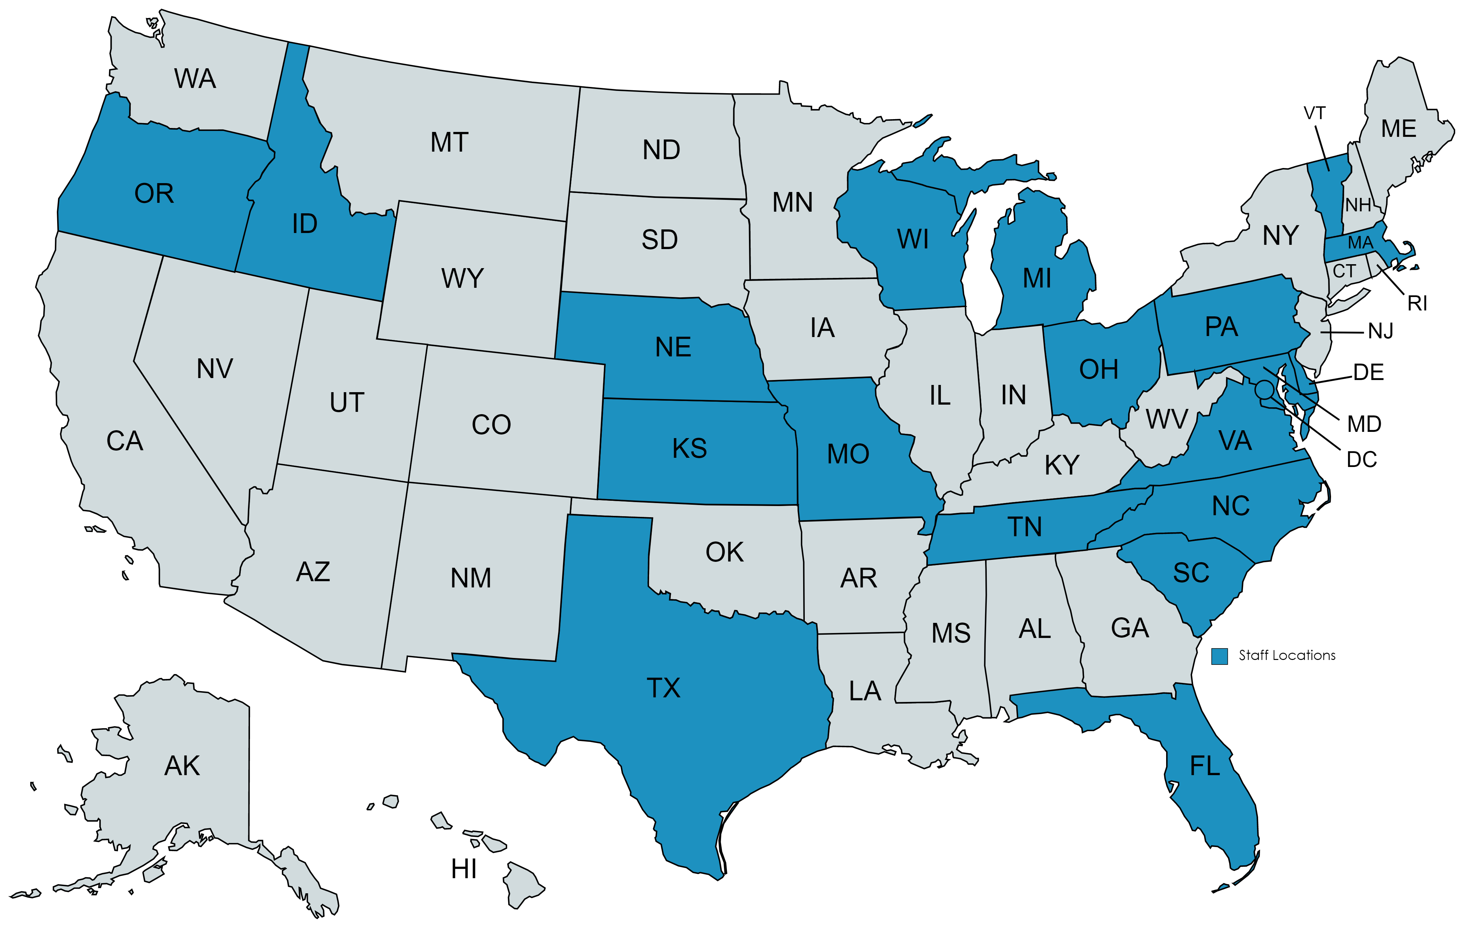






NTACT:C Staff
Notes:
Mary.

Slide 5
Outcome of the NTACT:C
All students and youth with disabilities will be prepared to graduate from high school with the knowledge, skills, and supports for postsecondary education, training, employment, and community engagement, with a focus on:
  enrollment in postsecondary education
  credential attainment
  competitive integrated employment
  community engagement
Notes:
Michael

Slide 6
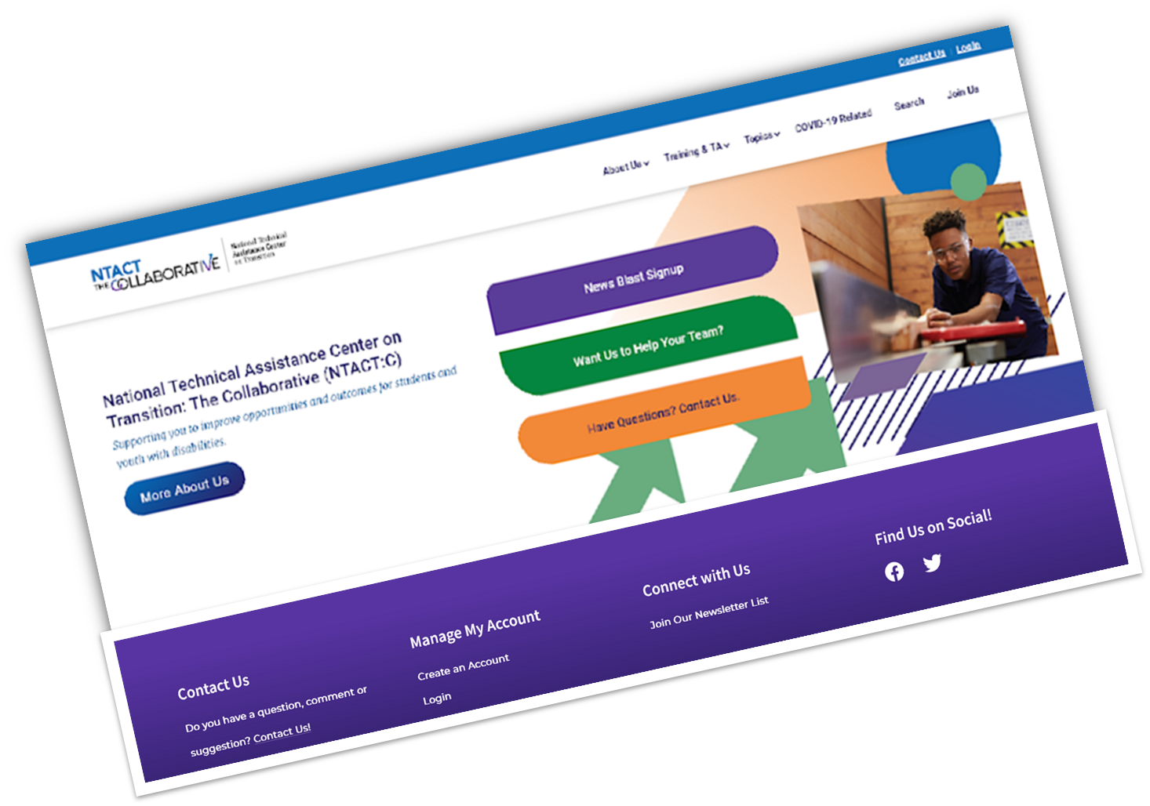
NTACT:C Website – www.transitionta.org
Live and Pre-recorded Webinars
Watch Parties
Transition Life Hacks (videos)
Online Modules & Mini-modules
FAQs
Presenter guides, videos, documents, toolkits, data resources, etc.
Notes:
Dana
NTACT:C Website – continually adding to it and “rearranging” to make space/organization
Live and Pre-recorded Webinars
Watch Parties – pre recording watched together or “live” then Q/A discussion afterward
Online Modules & Mini-modules – Transition Coalition website manages these
FAQs – probably generating more of these, but now they primarily cover very detailed Pre-ETS information
Presenter guides, videos, documents, toolkits, data resources, etc. – STUFF and STUFF some new and some repackaged, and some are existing resources from WINTAC or NTACT projects

Slide 7
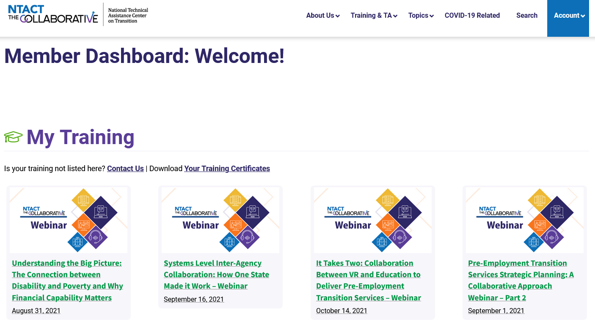
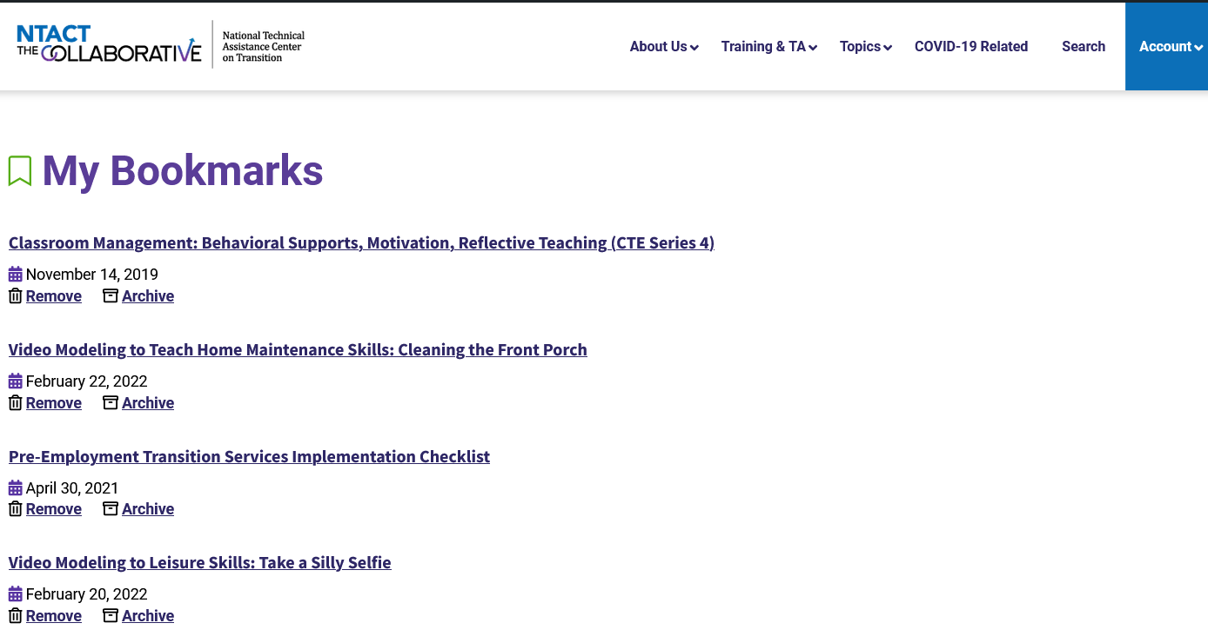
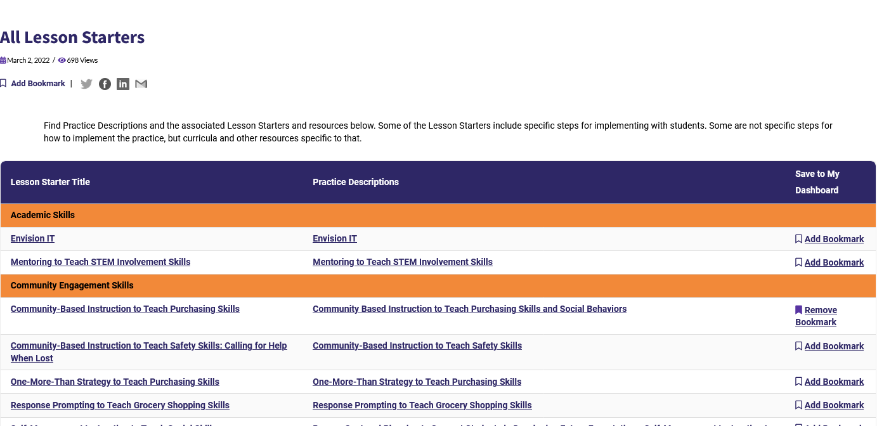
Helpful Hints
Set up an Account!!
Dashboard
  Training tracking
  Favorites
  Using the Search

Slide 8

Ways to engage with NTACT:C…
Sign Up on our website for our weekly News Blast
Communities of Practice
  Complex Support Needs
  Pre-ETS/Blindness
  K-12+ - Transition
Peer Networks
  SpeEd/VR/CTE
Training Modules and DIY How to Videos & Resources on the Transition Coalition website
Capacity Building Institute
Meeting facilitation
Specific TTA
  Building capacity to deliver services
  Resource mapping
  Dropout Prevention
Questions/More Information:
  Email ntact-collab@uncc.edu
Notes:
Kelli – here is where you can expand to include more on what specific types of TTA have been requested and provided
Team huddles are where folks might gather or huddle together virtually to discuss a certain hot topic. (e.g., Systems PD, Community-based Transition Programs)
COP s –
Peer Networks are facilitated by NTACT:C staff, to navigate the implementation of a particular transition or pre-employment transition related topic through information sharing and problem solving, and often includes state education and VR agency transition leads.
SHORT COURSES - just mention we will go into more detail next.
DIYs – How to videos and resources geared toward practitioners that target specific evidence-based transition practices and effective strategies for working with students
CBI’s – explain this briefly
Meeting Facilitation – not sure what this is… maybe going to state meetings?

Slide 9
Online Modules https://transitioncoalition.org/online-modules/
Best Practices in Planning for Transition
Transition Assessment: The Big Picture
Engaging with Families
Interagency Collaboration: the Groundwork
The Essentials of Self-Determination
Notes:
Dana
On transitioncoalition website – www.transitioncoalition.org
Green – live and online
Red – January
Yellow – next spring/summer

Slide 10


Slide 11
This Session’s Additional Take-Aways
Gain awareness of validated and new predictors of post-school success
Gain awareness of validated and new secondary Evidence Based Practices (EBPs) for secondary transition
Gain increased knowledge of resources to support implementation of secondary transition Evidence Based Practices in working with yours students with disabilities.

Slide 12
EBPs & Predictors to Support Post-School Success
Positive Post-School Outcomes
In-School Predictors of Post-School Success
Evidence-Based Practices
School, District, & State Level
Student Level

Slide 13
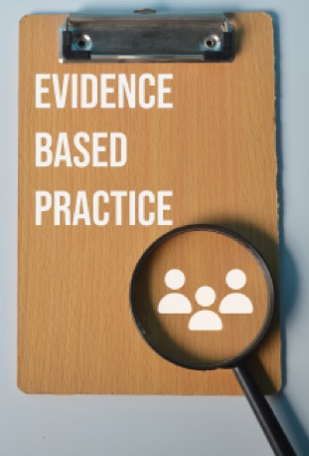
Why Do YOU Care About EBPs and Predictors?
ESSA (2015), WIOA (2014), and IDEA (2004) each note the expectation of the use of scientific and/or research-based, and/or evidence-based and promising practices
When school personnel use practices that research has shown to be effective, student’s perform better (Cook et al., 2008)
School personnel need trustworthy resources that tell them what (transition) practices have the “best available evidence” or “best level of evidence”

Slide 14

Predictors of Post-School Success
A predictor is defined as an in-school experience, typically a program (e.g., a work-based learning experience) correlated with improved post-school outcomes.

Slide 15
Predictor Findings to Date
23 predictors
Outcomes organized by relevant transition area
  Education
  Employment
  Independent Living
Notes:
Read content as appropriate

Slide 16
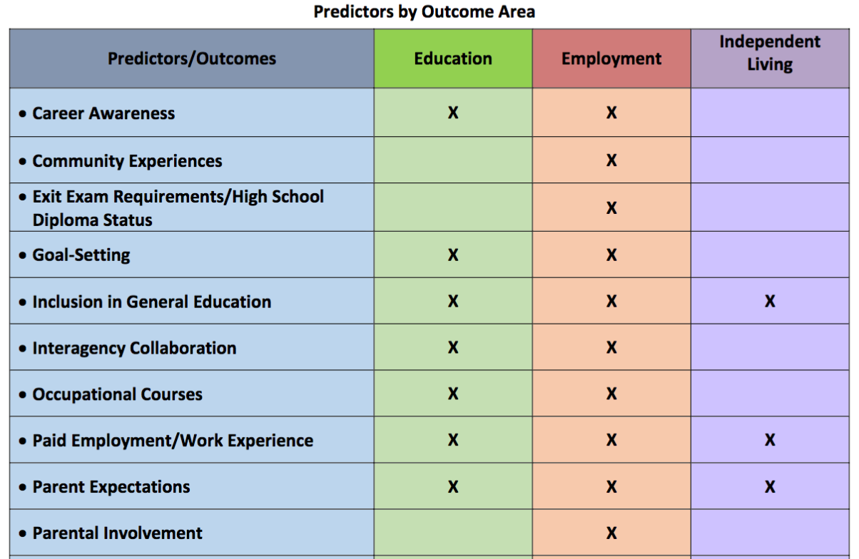
Predictors by Outcome Area
Notes:
Read content as appropriate

Slide 17
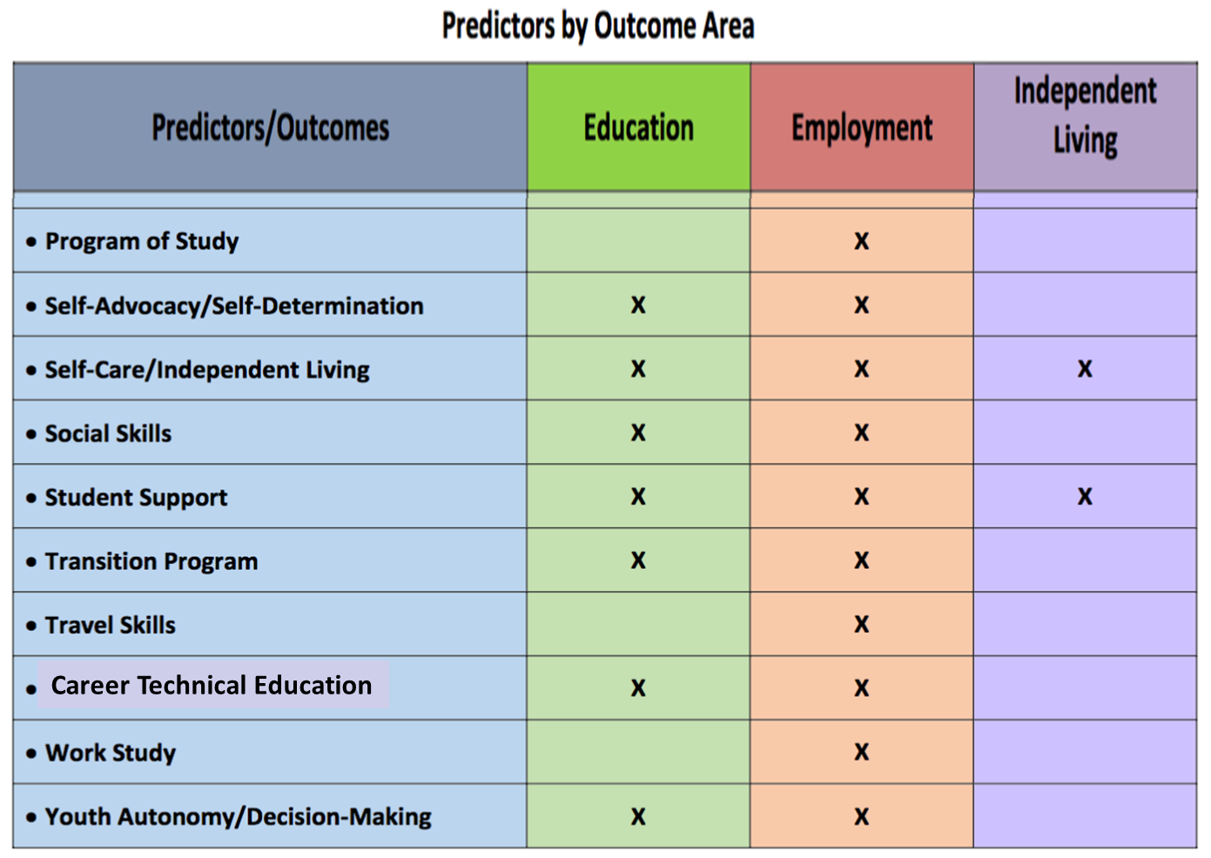
Predictors by Outcome Area
Notes:
Read content as appropriate

Slide 18
Why Implement
Predictors of Post-School Success?
Predictors provide:
  Evidence-based information to inform what we do while youth are in high school
A framework to:
    Evaluate, develop, and improve secondary transition programs and practices
    Determine if transition programs are implementing effective practices to increase the likelihood youth with disabilities will achieve positive outcomes post-school
Notes:
Predictors provide:
Evidence-based information to inform what we do while youth are in high school
A framework to:
Evaluate, develop, and improve secondary transition programs and practices
Determine if transition programs are implementing effective practices to increase the likelihood youth with disabilities will achieve positive outcomes post-school

Slide 19
What is an Evidence-Based Practice (EBP)?
demonstrates a strong record of success for improving outcomes
uses rigorous research designs
adheres to indicators of quality research
What is a Research-Based Practice?
demonstrates a sufficient record of success for improving outcomes
uses rigorous research designs
may adhere to indicators of quality research

Slide 20
Secondary Transition
Evidence-Based and Research-Based Practices
Practice | Evidence
Check and Connect | Evidence-based
EnvisionIT Curriculum | Evidence-based
Parent Training | Evidence-based
Project SEARCH | Evidence-based
Self-Advocacy Strategy | Evidence-based
Self-Determined Learning Model of Instruction | Evidence-based
Self-Directed IEP | Evidence-based
Take Charge Curriculum | Evidence-based
Video Modeling | Evidence-based
Notes:
9 EBPs

Slide 21
Secondary Transition
Evidence-Based & Research-Based Practices
Practice | Evidence
Communicating Interagency Relationships and Collaborative Linkages for Exceptional Students (CIRCLES) | Research-based
Community-based instruction | Research-based
Mentoring | Research-based
Multimodal Anxiety and Social Skills Intervention | Research-based
One-More-Than strategy | Research-based
Peer Assisted instruction/support | Research-based
Person-centered planning | Research-based
Notes:
9 EBPs

Slide 22
Secondary Transition
Evidence-Based and Research-Based Practices
Practice | Evidence
Response prompting | Research-based
Self-management instruction | Research-based
Simulation | Research-based
Student-directed Transition Planning lesson package | Research-based
Whose Future Is It? Plus Rocket Reader | Research-based
Working at Gaining Employment Skills (WAGES) | Research-based
Notes:
9 EBPs

Slide 23
Lauren’s Story
https://www.youtube.com/watch?v=vPMVIe629bk
The ASPIRE Program (Active Student Participation Inspires Student Engagement) is a Georgia Dept. of Ed program that takes social-emotional learning to another level by providing the student age-appropriate foundational skills that encourage self-awareness, self-determination and self-advocacy skills.
https://www.gadoe.org/Curriculum-Instruction-and-Assessment/Special-Education-Services/Pages/ASPIRE.aspx
https://www.gadoe.org/Curriculum-Instruction-and-Assessment/Special-Education-Services/Documents/Transition/2020-21/ASPIRE%20Resources/ASPIRE%20One-Pager.pdf

Slide 24
Predictor Implementation School/District Self-Assessment (PISA)
Predictor Implementation School/District Self-Assessment Instructions and Action Planning Guide (PDF)
Predictor Implementation School/District Self-Assessment (PISA) (PDF)

Slide 25
Notes:
Let’s talk through the PISA

Slide 26
Using/Scoring the PISA
Notes:
There are two measures for the PISA – these include degree of implementation and evidence of implementation
Talk through each

Slide 27
Let’s Break Down Self-Determination:
Degree and Evidence of Implementation
Program Characteristic | Rating | Evidence of Implementation
Utilize a student driven IEP process to allow students to demonstrate self-awareness, goal setting, problem solving, and self-advocacy. | 1 | No evidence
Collaborate with general education teachers to embed choices into the general curriculum and daily lessons and provide opportunities for students to practice self-determination skills. | 2 | Teacher lesson plans include activities in which students have choices.
Teach students to self-monitor self-determination skills (e.g., accommodations and modifications) and provide opportunities for students to practice the self-monitoring strategy. **As you work with students, take into consideration the cultural nuances involved in teaching self-determination skills and providing opportunities to develop self-determination to students from CLD backgrounds. | 4 | At the beginning of the school year, students write letters to their teachers describing accommodations needed. All special education teachers are using the SDLMI to teach students to set goals and monitor progress toward goals. All students are administered the AIR self-determination scale each year.
Notes:
This is an actual example from RI related to using the self-determination predictor

Slide 28
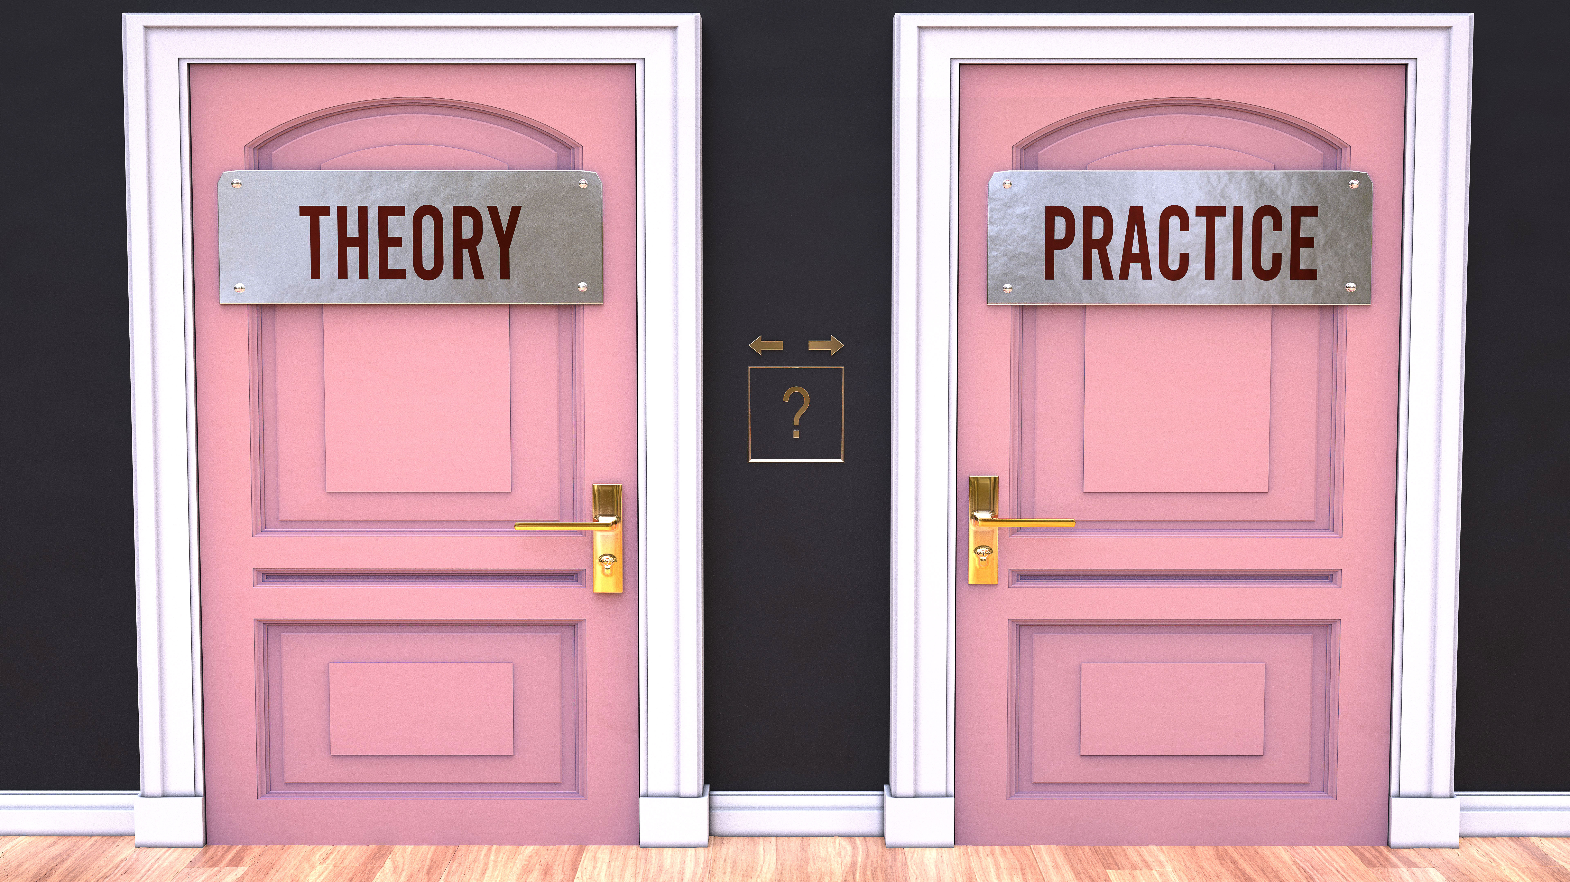
Considerations for Selecting EBPs
Was the practice effective for supporting student skill development?
Does the practice or predictor have evidence to support its effectiveness (i.e., identified as evidence-based from reputable sources, results of research described in manual, or link to research support)?
Has the practice been effective for the population of students I am working with?
Can the practice be individualized and adapted to fit the unique needs of my students?
Notes:
Stephen

Slide 29
Practice Descriptions and Lesson Starters
On the NTACT:C website there are 28 practice descriptions and lesson starters
  https://transitionta.org/skills-and-practices/#EBP
The effective practices identified have been evaluated regarding the amount, type, and quality of the research conducted. These designations indicate the confidence in the likely effectiveness of the intervention when implemented as defined and recommended.

Slide 30
Additional Resources to Consider
Online based on the five required Pre-Employment Transition Services (Pre-ETS) Areas

Slide 31
Job Exploration Counseling
  The Career Index Plus (TCI+)
  https://www.careeronestop.org/ExploreCareers/explore-careers.aspx
  https://www.mynextmove.org
  Road Trip Nation - YouTube Channel
  Dr. Kit Career Videos
31

Slide 32
Work-Based Learning Experiences
  Explore-work.com
  NTACT School Based Enterprise Toolkit
  Nebraska Virtual Industry Tours
  myFuture.com
  Youth.gov Youth-Employment

Slide 33
Exploration of Post-Secondary Education Programs
  School Beyond High School
  NTACT Postsecondary Education and Training Toolkit
  Career One-Stop – Find Training at a Glance
  myFUTURE.com – College
  Think College

Slide 34
Workplace Readiness Training
  Explore-work.com
  myFUTURE.com – Career
  Skills to Pay the Bills
  Realityworks Curriculum
34

Slide 35
Instruction in Self-Advocacy
  Explore-work.com
  University of Oklahoma - Zarrow Center
  The 411 on Disability Disclosure
  Project 10 - Student Engagement & Success
  Indiana Secondary Transition Resource Center - Self Determination
35

Slide 36
Katie’s Story
https://www.youtube.com/watch?v=vPMVIe629bk
Communicating Interagency Relationships and Collaborative Linkages for Exceptional Students (CIRCLES)
Project SEARCH

Slide 37
Now It’s Your Turn….
Discuss with a partner or quiet reflection:
  What 1 or 2 Predictors of Post School Success will you implement during the 2023-24 School Year?
  What strategies and/or activities that will you implement to support your selected predictors?

Slide 38

Thank you!
Notes:
Michael

Slide 39



Find us on:
Contact Us:
#transitionTA | transitionTA.org | ntact-collab@uncc.edu
Michael Stoehr
Knowledge Development and Technical Assistance Specialist
National Technical Assistance Center on Transition: the Collaborative (NTACT:C)
UNC Charlotte - Cato College of Education
mstoehr@charlotte.edu
The contents of this presentation were developed under a grant (H326E200003) from the Department of Education. However, those contents do not necessarily represent the policy of the Department of Education, and you should not assume endorsement by the Federal Government.
39
Notes:
Michael

