Slide 1
Creativity, social capital, and disruption!
Doug Crandell
Griffin-hammis
University of georgia

Slide 2
WHO’S THE BALD GUY? AND WHAT TO EXPECT IN THIS SESSION
Sibling first! My sister and my first IEP.
Started as a job coach supporting students in Indianapolis.
Rhode Island
www.advancingemployment.com
Writer: www.dougcrandell.com
First book about our work: www.abolish14c.com
A quick reading!
Book giveaways
I am going to push and provoke…Disruption doesn’t happen, it’s created.

Slide 3
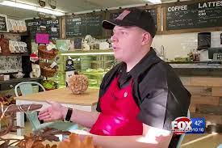
A reading…

Slide 4

Fur is gonna fly
Teacher’s connection
Transition was fragmented
Only supports offered were day programs
Brian was withdrawn, and felt he had failed
at two fast food jobs

Slide 5
What is a Community of Practice and how does it impact social capital?
It’s not just a phrase…
A CoP can be thought of as a grassroots method of continuous quality improvement.
Obviously, it is related to a specific area, both topically and geographically (i.e. Customized Employment, and wherever you are!)
Social capital happens in our local economies, in our local communities, and outside of the human service systems. Trying to build social capital within our disability and employment systems will only lead to the same conclusions we already know does not produce an employment outcome.
“Communities of practice are groups of people who share a concern or a passion for something they do and learn how to do it better as they interact.”
Wenger-Trayner 2015

Slide 6
CoP members form/start, and join a CoP because:
1) They care about the domain of interest. (Customized Employment)
2) They have shared competence and practice. (ACRE-CE Training)
3) They want to learn together how to develop their practice (at a detailed competence level).
4) Practice! What? Practice! What? You know the answer! PRACTICE!!!
5) Our disability and employment systems lack true CoPs, and in order to understand, build and use social capital, you must commit to practicing and honing those skills.

Slide 7
Basic COMMUNITY OF PRACTICE Principles
Participation – everyone in the community has a voice, can be heard and can contribute to the practice.
Commitment to practice – uncovering what works, why we do it, how its done, and to embrace reciprocity with others wanting to learn.
Understanding boundaries and scale – purposefully moving toward growth
Reflection - using evidence-based conversations as a core practice in itself.
Creativity as a source of energy for practice – using imagination, permission to explore, finding new ways of doing things (Discovery as assessment, Fidelity, Customized Job Development)

Slide 8
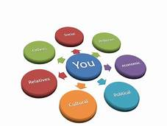

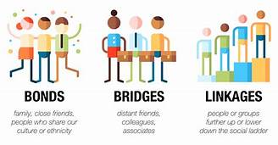
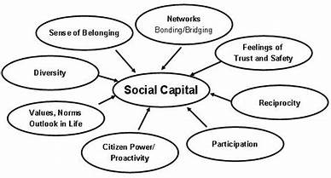
“Where people aren’t having fun, they are seldom producing good work.”
_David Ogilvy, the Father of Advertising and Human Behavior

Slide 9

CREATIVE EMPLOYMENT OUTCOMES
WHAT ARE WE DISRUPTING?

Slide 10
THE STATUS QUO IN TRANSITION OR WHAT ARE WE TRYING TO DISRUPT?
Students with less significant disabilities get most of the attention
The work-based experiences are programmatic and not individualized
Long gaps and waiting lists
Putting in applications
Lack of urgency
Programs are considered outcomes
Jobs are not developed and created but found!
Focus is almost entirely based on retail, and service industries

Slide 11

Disruption…
Used Cars
Mattresses
Christmas in Purgatory

Slide 12
CREATIVE TYPES OF EMPLOYMENT or disrupting the disability employment landscape
Resource ownership
Supported self-employment
Business-within-a-business
Income generating (gig and application-based)
Created, sculpted, and developed based on unmet needs (a diatribe on job descriptions)
Telecommuting, home-based, and the changes from covid

Slide 13
Sweet memories candy shop

Slide 14

Make your trip down memory lane extra sweet!!
These candies will help you remember your sweeter days while walking down memory lane in the museum, theatre, and ice cream parlor.
A classic movie is always better with one of your favorite childhood candies.

Slide 15
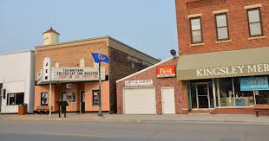
Student’s IEP referenced an interest in film, baking and communications.
The student was planning on exiting at 21.
The rest of the story…Informational Interview, Use of team’s social capital.
The adult provider was proficient in Customized Employment.
Instead of a transition that focused on what existed, the team created the employment path.

Slide 16
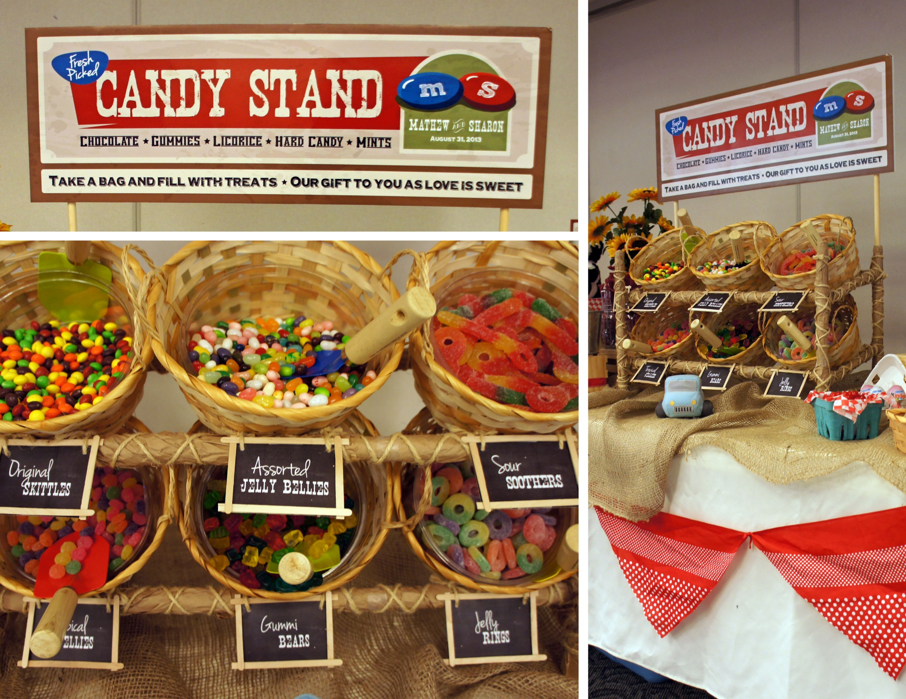
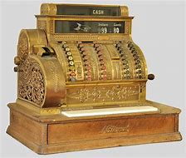
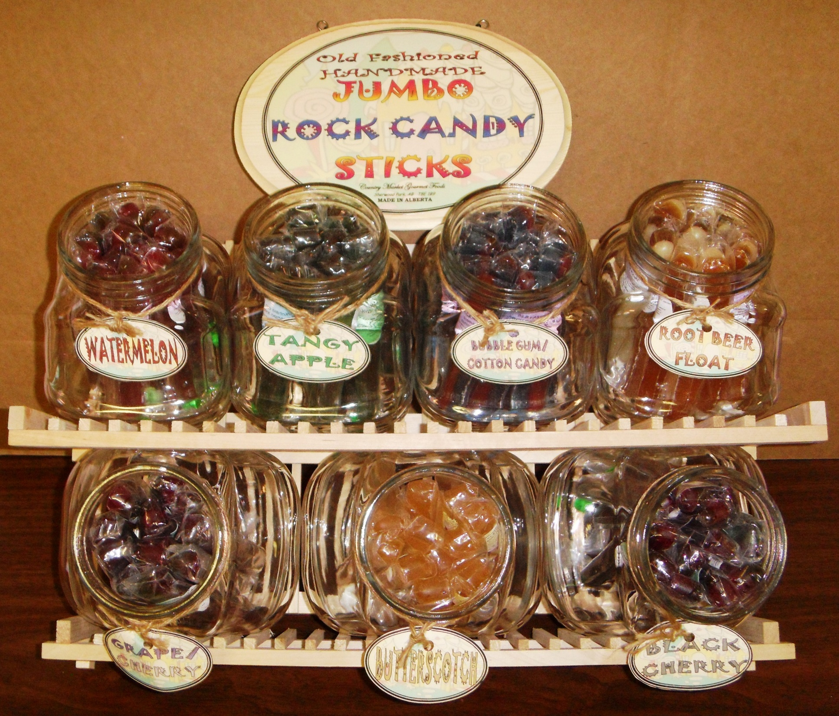
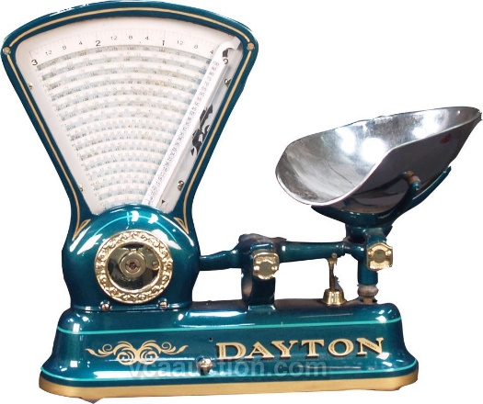
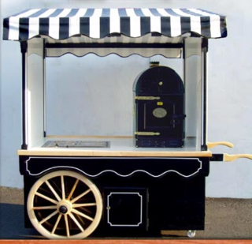

Slide 17
Job Duties:
Assisting customers with purchases
Stocking kiosk and maintain inventory
Maintaining kiosk area
Wage
$8.00/ hour
Cost of Equipment and Initial Supplies:
Kiosk- $2,500
Vintage Cash Register- $500
Vintage Candy Scale- $300
Various Old Fashioned Candies- $250
TOTAL: $3,550

Slide 18
Why is social capital important?

Slide 19
9 competencies and 80 plus KSAOs
Respecting and Relating to Others
Skills
- Skill in interacting socially with others
- Skill in being aware of others' reactions and understanding why they react as they do (that is, social perceptiveness)
Abilities
- Ability to work as part of a team
- Ability to build and maintain relationships with others
- Ability to put others at ease
Other Characteristics
- Values connecting with people
- Is culturally sensitive
- Has a world view that all people can work and that people with disabilities can contribute to the workplace
- Treats others with respect and dignity
- Is curious or interested in learning about others

Slide 20
An intersection of collaboration: A Core Competency
Identify social networks, strategically enter those networks, and act as a bridge to develop social capital(that is, relationships which can be leveraged to match the job seeker’s interests and strengths) for the job seeker.

Slide 21
Social capital?
Ability to build networks of social contacts with others in order to develop social capital
Identify social networks, strategically enter those networks, and act as a bridge to develop social capital (that is, relationships which can be leveraged to match the job seeker’s interests and strengths) for the job seeker.
Most people don’t think much about their own social capital. How much do they have? How’d they got it? If I have low amounts of social capital, what can I do to systematically build it?

Slide 22
A bit more on what social capital can be:
Social capital is similar to other forms of capital in that it can be invested with the expectation of future returns.
Social capital is different from other forms of capital in that it resides in social relationships whereas other forms of capital can reside in the individual.
Social capital is connected to solidarity as the notion connotes relations of trust, co-operation and reciprocity. (Resource ownership)
Social capital cannot be traded by individuals on an open market like other forms of capital, but is instead embedded within a group or person and can be leveraged for social change.

Slide 23
Types of social capital
Bonding social capital – ties between individuals with a relatively high degree of network closure. Bonding social capital is often described as horizontal ties between individuals within the same social group (as opposed to vertical ties between social groups). Bonding social capital is often associated with local communities where many people know many other people in the group (network closure). Bonding social capital is often associated with strong norms.

Slide 24
Types of social capital
Bridging social capital – ties between individuals which cross social divides or between social groups. Bridging social capital allows people to tap into the social network resources of each others social group. Bridging social capital may not involve many shared norms but is likely to be associated with reciprocity and trust. It may provide access to network resources outside of a person’s normal circles and as such can provide significant individual (and group) benefits.

Slide 25
Quick analysis of social capital
What groups do you belong to?
Are they formal, informal?
Where’d they come from? (School, faith, neighborhood, family, business, trade, interests)
Have those grown more significant over time? Are they the same now?
On a scale from 1-10, how full is your social capital account?

Slide 26
Steps to build more social capital
Be honest about your assessment.
Identify your three top areas where you will strategically build more social capital. (School, faith, neighborhood, family, business, trade, interests)
Under your top three areas, list names of real people to connect with (Notice I didn’t say contact.) Why?
If you can’t find a real person to connect with, brainstorm ways where you can use human bridges. What does that mean? Not a circus act, but it’s also known as someone who vouches for you☺

Slide 27
What does strategically enter those networks mean?
First, why am I making this connection? Think of purpose: general, specialty, for me, for whom?
If the social capital is for you (i.e. so you can personally draw from it later) what function will it play in Discovery and Customized Job Development?
If the social capital is for a job seeker, what is your approach?
How will you transfer that social capital? What’s your plan to support the social capital?
The point is: I must think and plan with purpose to be strategic. And a sense of urgency is a must!
Think of someone who has lots of social capital. What are some of their personality traits?

Slide 28
How to use social CAPITAL IN Customized employment
For informational interviews (both types)
To build a network for a job seeker
For advice about local economic activity
As a way to connect business with rehabilitation
To expand economic development in a community
To solve community problems (Leo)
As a tool to connect ordinary citizens with our work
To help others who need human services (Danville story)

Slide 29
Enlisting Citizens and Fellow Enthusiasts
Use Social Capital of the Existing Team Members
Google and google!
Use SCORE, Meetups, Trade Groups, Associations, Clubs, Hobby Groups, and faith-based connections.
Simply explain you need their advice and expertise!
Commitment should be the person’s choice.
But be concrete in your “ask.”
Make it reciprocal. Make it exciting! Make it pressure-free, and people will surprise you.

Slide 30
Now what is Social capital again?
Ability to build networks of social contacts with others in order to develop social capital
Identify social networks, strategically enter those networks, and act as a bridge to develop social capital (that is, relationships which can be leveraged to match the job seeker’s interests and strengths) for the job seeker.
Most people don’t think much about their own social capital. How much do they have? How’d they got it? If I have low amounts of social capital, what can I do to systematically build it?

Slide 31

Open Conversation…

Slide 32
Required (not suggested) ☺ Readings:
Implications of social capital for the inclusion of people with disabilities and families in community life--LESLEY CHENOWETH &DANIELA STEHLIK
https://adayinourshoes.com/social-capital/ How and Why to Build Social Capital for Your Child with Disabilities
Accessing Social Capital Implications for Persons with Disabilities http://ngsd.org/sites/default/files/accessing_social_capital_implications_for_persons_with_disabilities.pdf
https://centeronselfemployment.org
https://www.griffinhammis.com/wp-content/uploads/2019/01/Updated_CE_Stories_optREV4withPW.pdf

Slide 33
Reverse Q and A exercise
What keeps you awake at night?
Start, Stop, Keep: One thing to stop, one to start, one to keep.
Finish this sentence with 2-3 items: “I don’t understand…”

Slide 34
Book giveaways
In the next general session, I’ll focus on how to enlist others to help.
For now, we will give away two books.
The first two people to text me the correct answer win: 770-896-5812
Ready?

Slide 35
question
Wabash, Indiana is known for two things. Please name one.
770-896-5812
Thanks!

