Slide 1
SDMyLife 101
Kara Schweitzer
605.280.7501
kara.schweitzer@state.sd.us

Slide 2
SDMyLife
Kara Schweitzer
SDMyLife and Career
Development Specialist
605.280.7501
Kara.Schweitzer@state.sd.us

Slide 3
SDMYLIFE
www.sdmylife.com
powered by
Notes:
Explain that SDMYLIFE.COM is the ONLY way the student access it. XELLO is just the company that provides the service.

Slide 4
SDMYLIFE
What is SDMyLife?
FREE resource for all SD 6-12 grade students
Career Exploration & Career Decision Making
Secondary and Post-Secondary Planning
Academic Planning
ACT Test Prep Methodize

Slide 5
Why sdmylife?
Neither the State of South Dakota or the South Dakota Department of Education require its use.
However, it can be a free tool for the following Administrative rules:
“24:43:11:01. Number of required credits for graduation from high school -- Personal learning plan required.”… “All students in grades 9 through 12 must have a personal learning plan. The personal learning plan must document a minimum of 22 units of credit.”
“24:43:11:08. Testing requirements. School districts shall administer a career interest assessment by the conclusion of grade eight and a career aptitude assessment by the end of the fall semester of grade ten. The assessment used in the development of the student's personal learning plan shall be provided by the Department of Education.”
SDMyLife’s career interest assessment is called the Career Matchmaker, and the career aptitude test is called the Skills Lab.

Slide 6
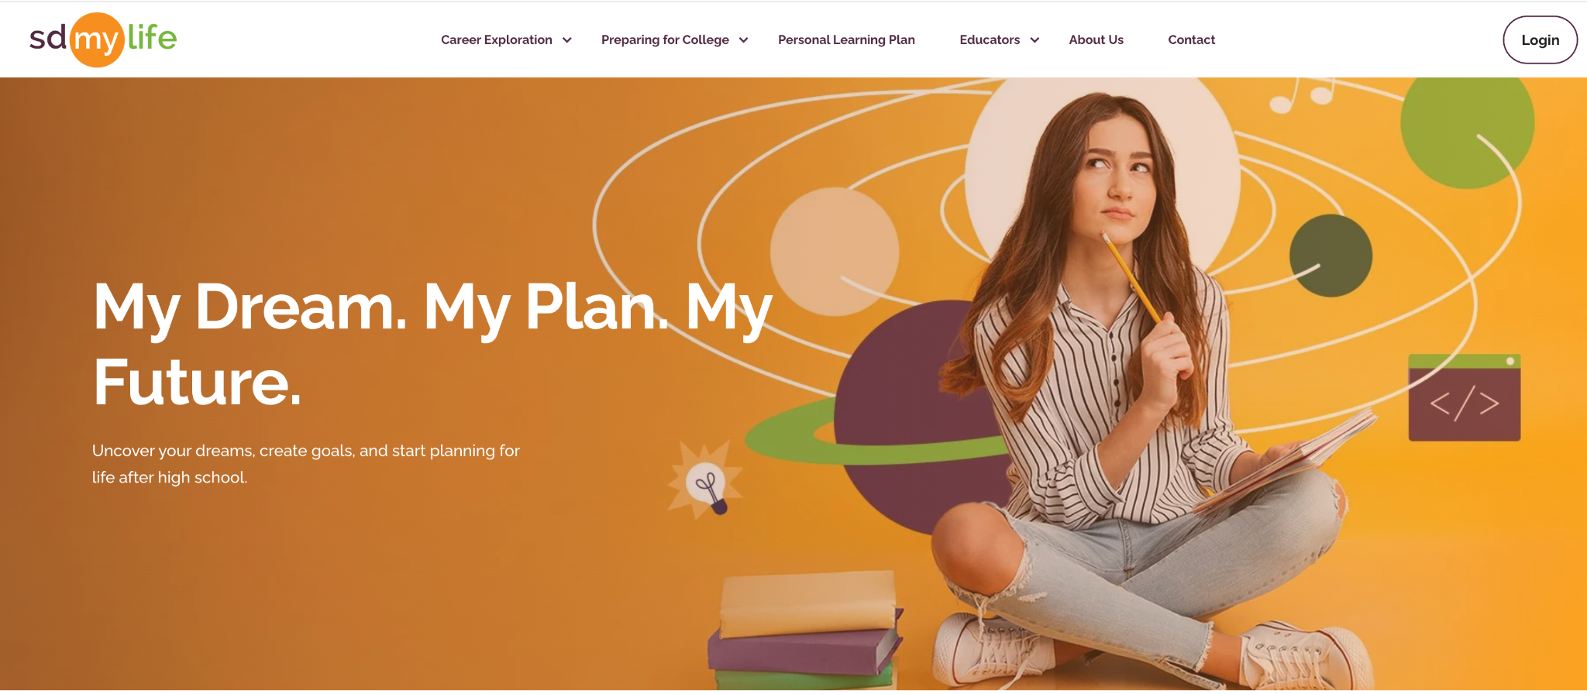
SDMyLife

Slide 8
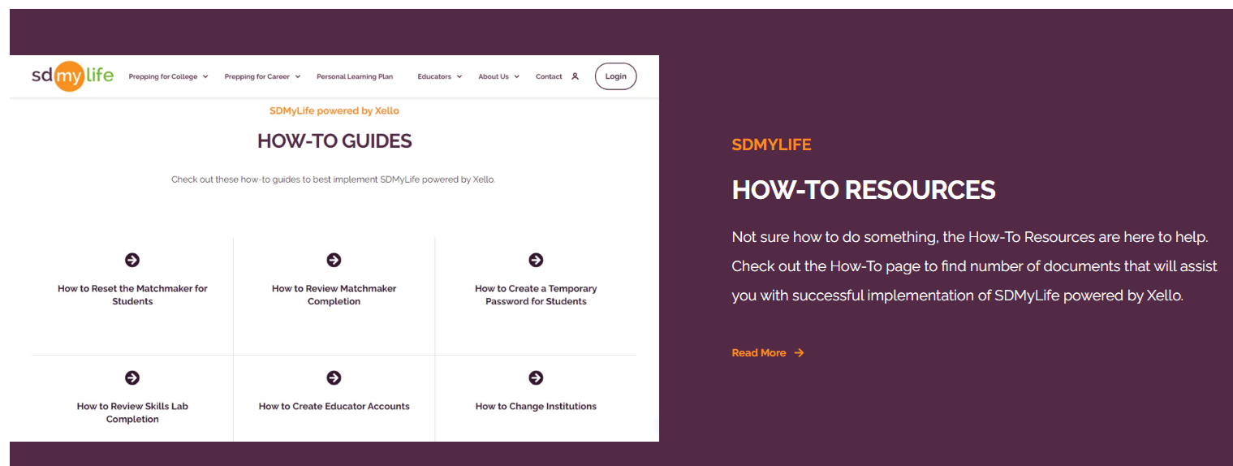

Slide 10
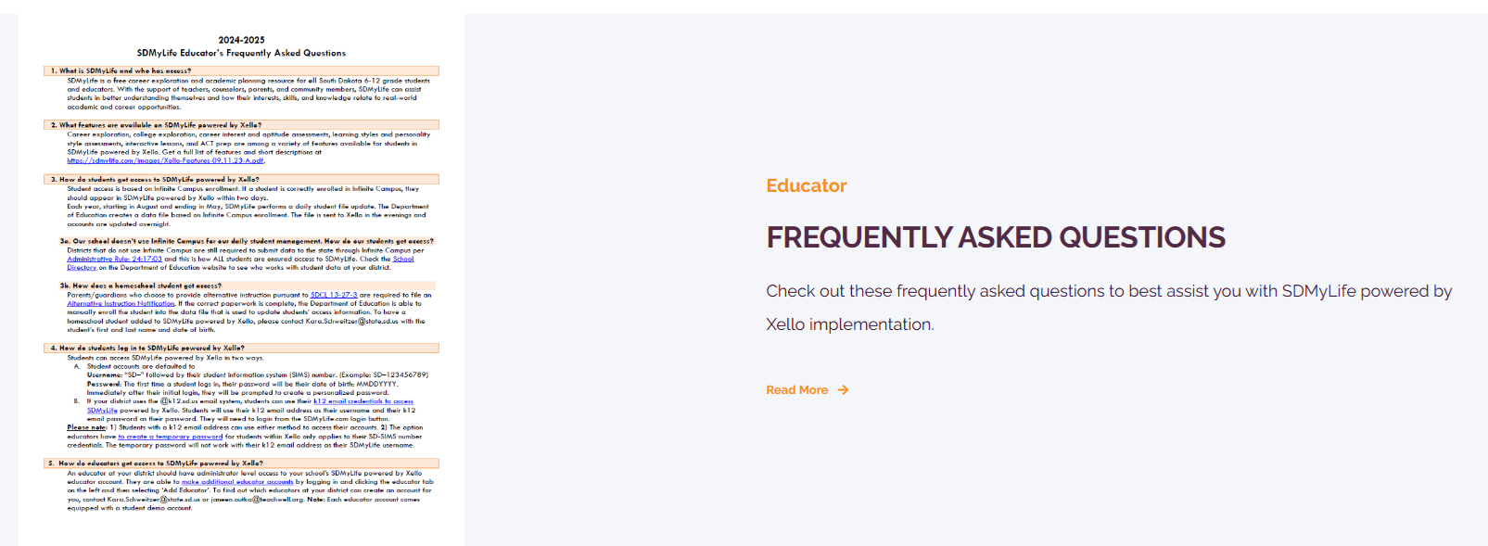

Slide 11
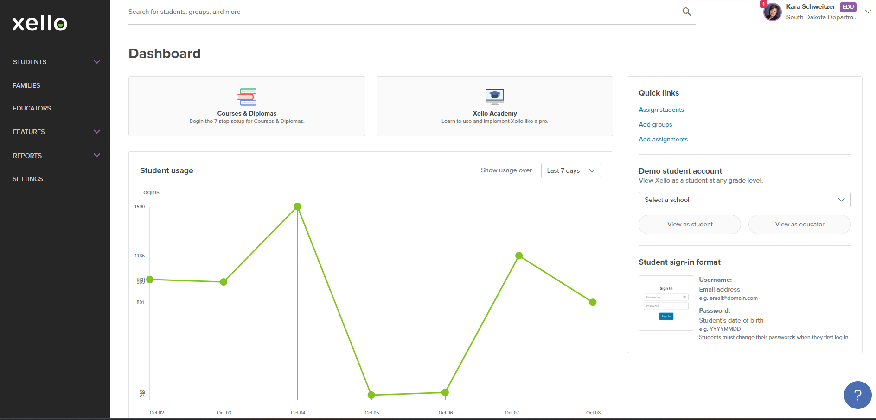
SDMyLife – educator dashboard
Notes:
If you choose to get an educator account, and log in, this is what your dashboard will look like. Explain Xello Academy.

Slide 12
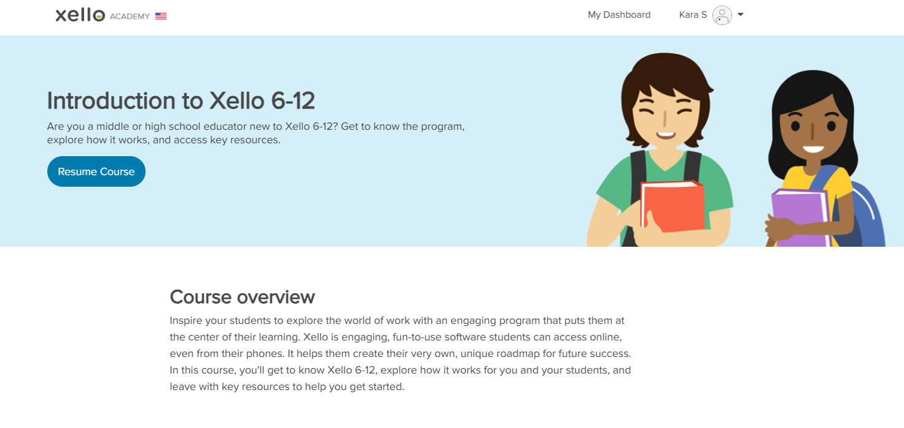
Takes approx. 1.5 hours

Slide 13
Student Xello accounts
Student Xello accounts are affiliated with their SIMS number (state student ID), NOT their school district.
Student SIMS numbers DO NOT CHANGE regardless of where the student is enrolled in school.
Therefore, the student SIMS number and Xello account follow the student from school to school to school.

Slide 14
Sdmylife & infinite campus
Local School District
Maintains daily local Infinite Campus enrollment data to ensure student access to Xello.
Collaborates with SD School districts as needed to monitor and document student enrollment changes.
SD DOE
Monitors and maintains daily state Infinite Campus data files from local school districts.
Sends daily state Infinite Campus data file to Xello overnight.
Xello
Uses daily state Infinite Campus file data to CREATE, manage, and maintain student access to Xello.

Slide 15
SDMyLife.com
Notes:
The only resource students need to get started is sdmylife.com,

Slide 16
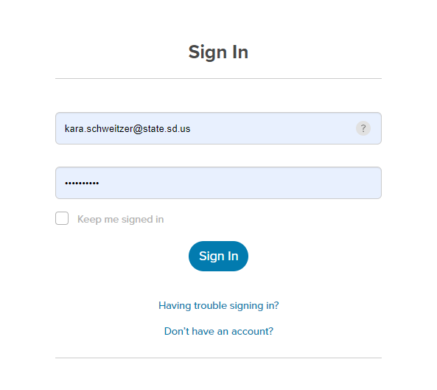
Xello student log in
Logging in to SDMyLife:
Username: k12 email address
(john.doe@k12.sd.us)
Password: k12 email password

Slide 17
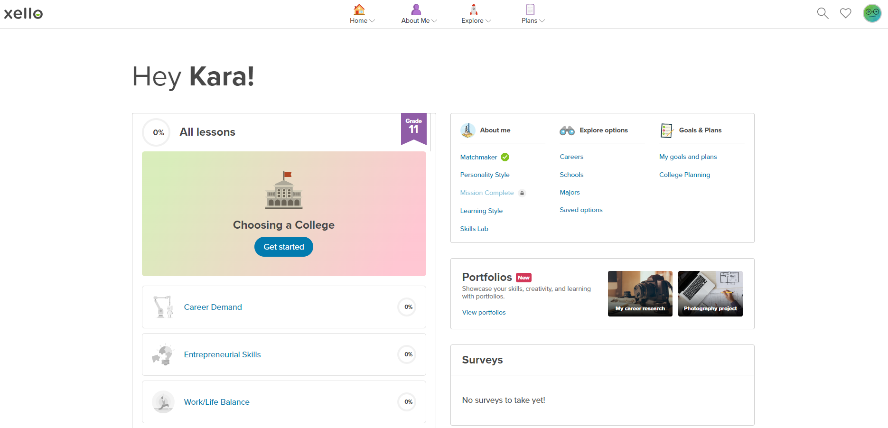
SDMyLife – Student view
Any progress students have made is easy to access on their dashboard!

Slide 18
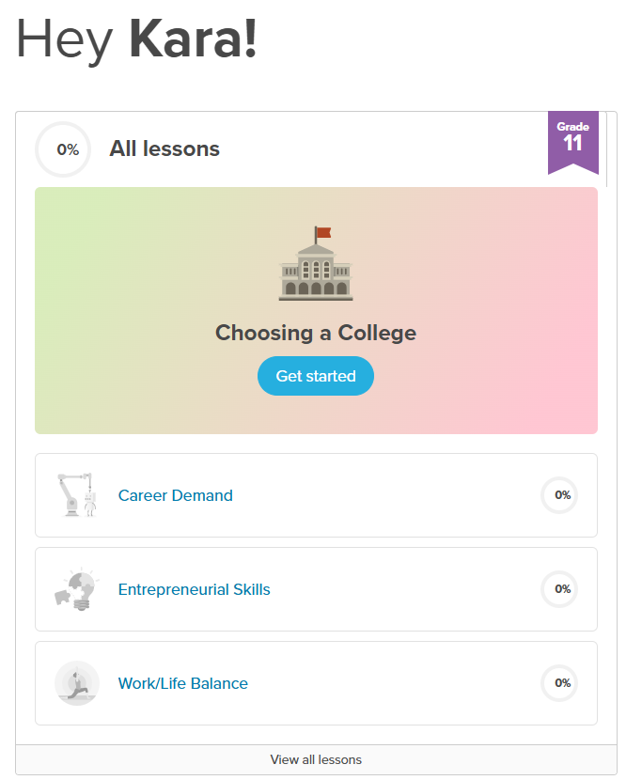
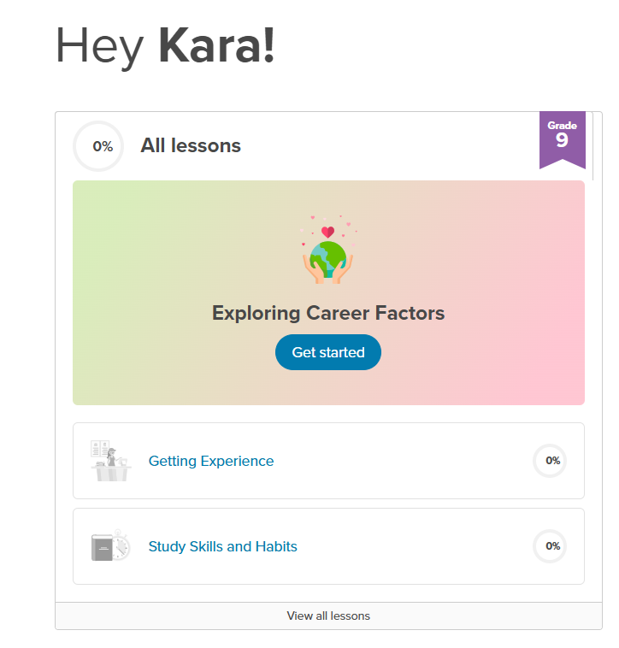
Student dashboard
Notes:
Notice a dashboard looks different for a 9th grader vs. an 11th grader.

Slide 19
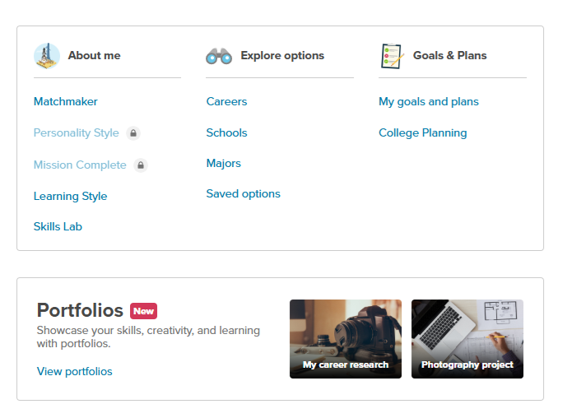
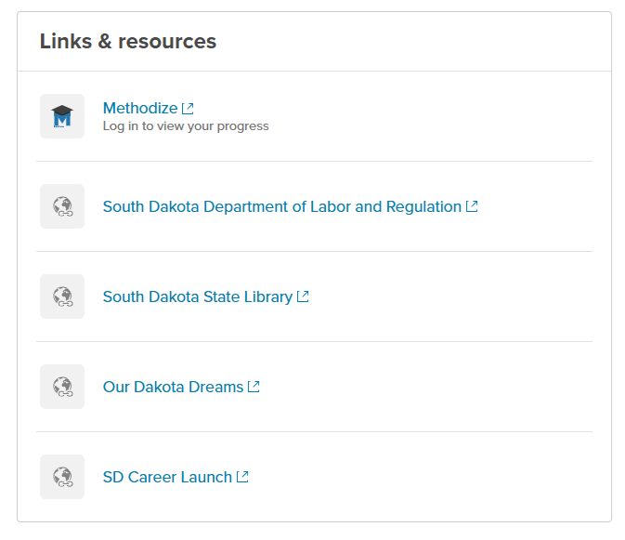
Student view
Notes:
Also located on their dashboard.

Slide 20
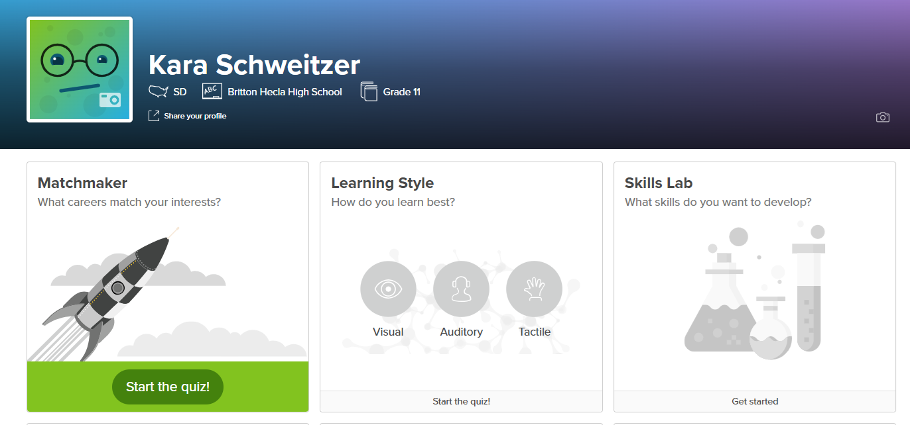

Slide 21
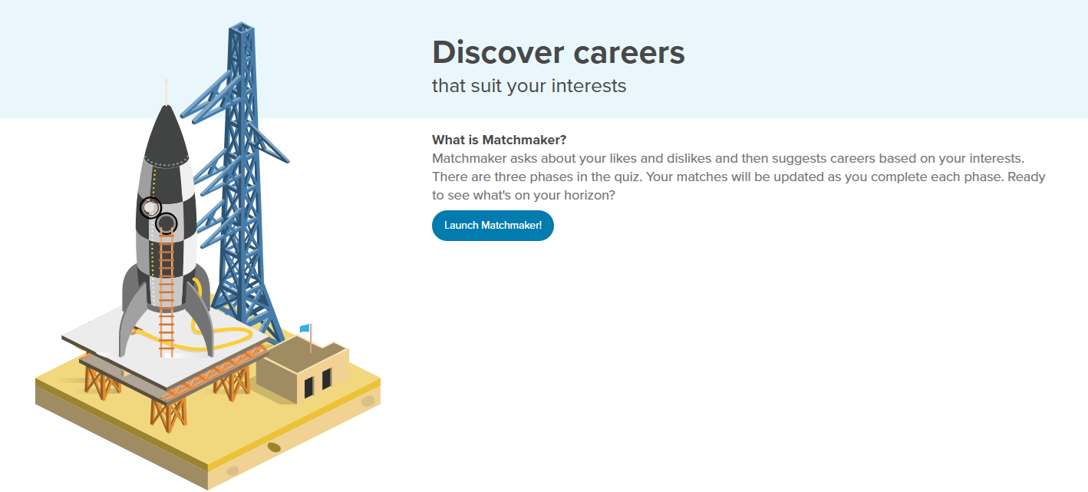
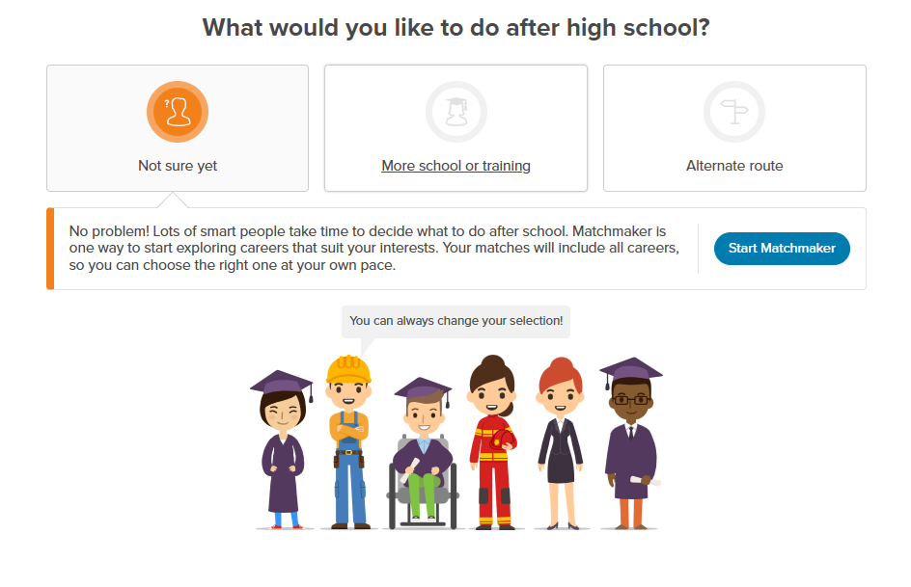
Matchmaker

Slide 22
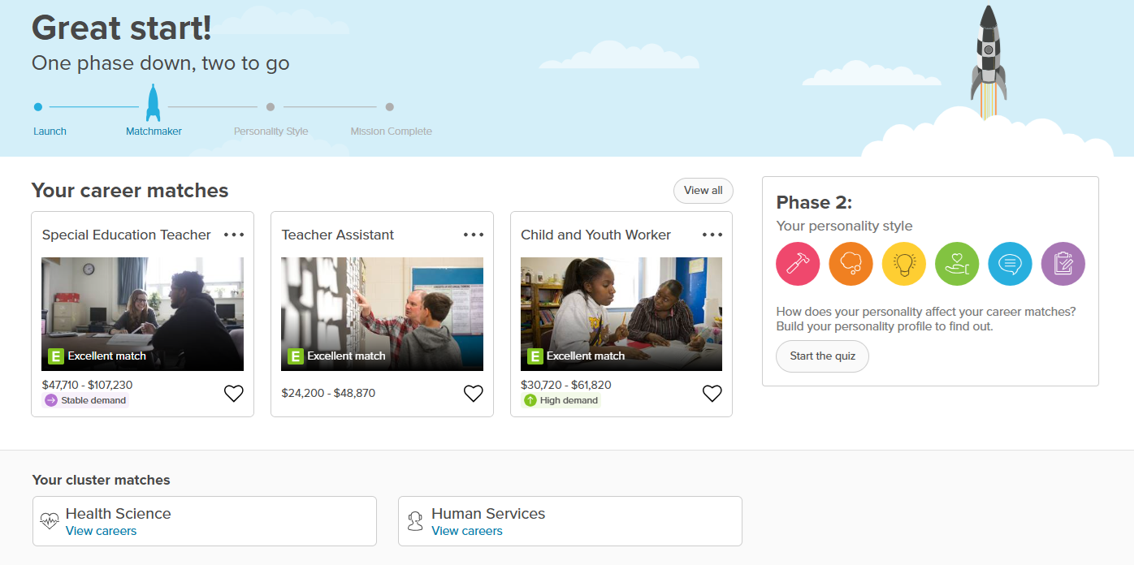
Matchmaker
On to Phase 2!

Slide 23
Matchmaker

Slide 24
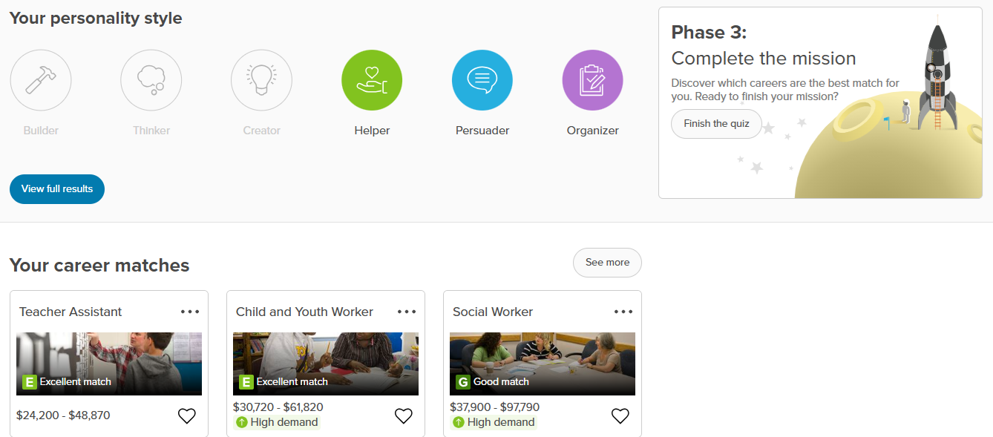
Matchmaker
On to Phase 3!

Slide 25
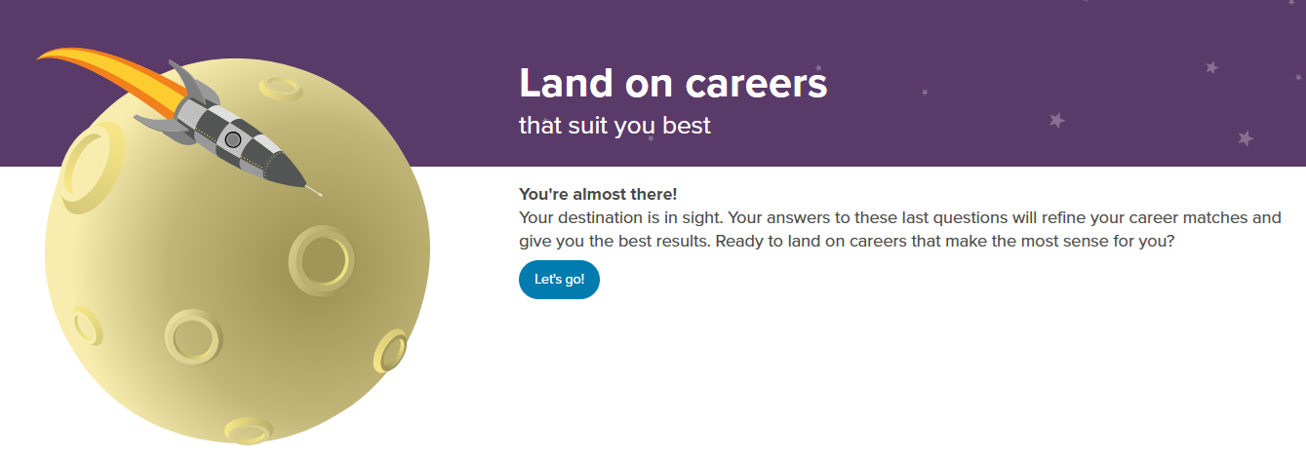
Matchmaker
On to exploring!

Slide 26
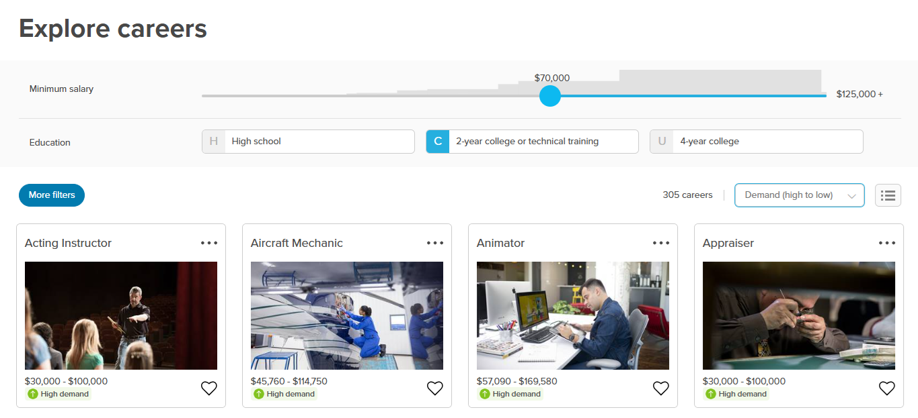
Student view

Slide 27
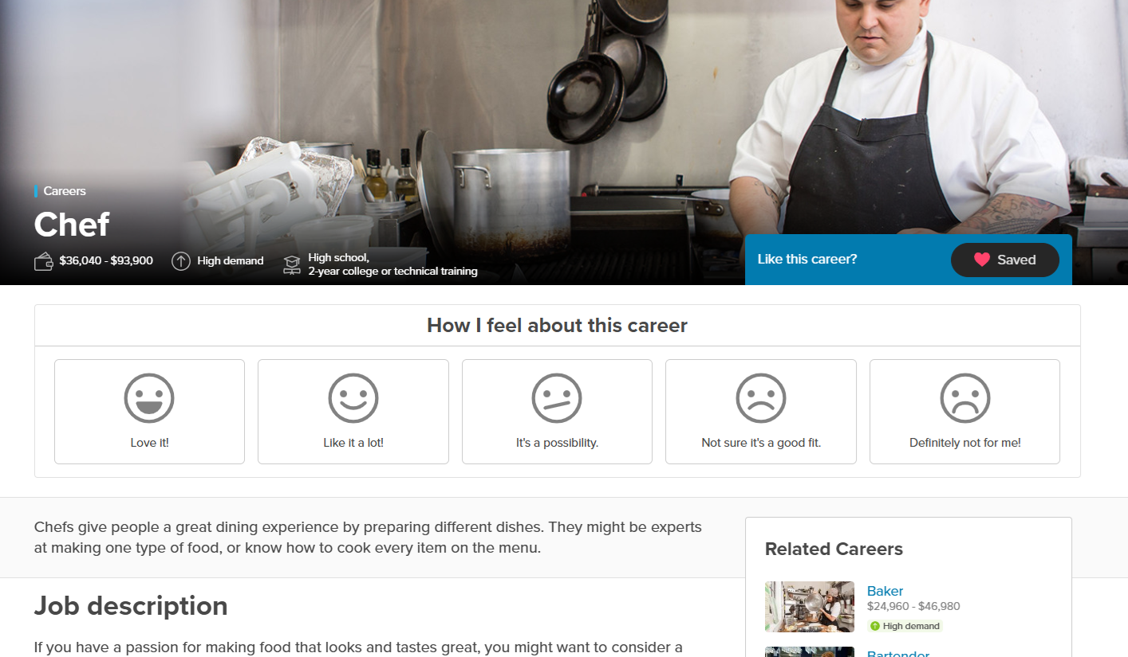
Exploring careers
Saved careers
Review job description
Demand
Salary
Education
Related Careers

Slide 28
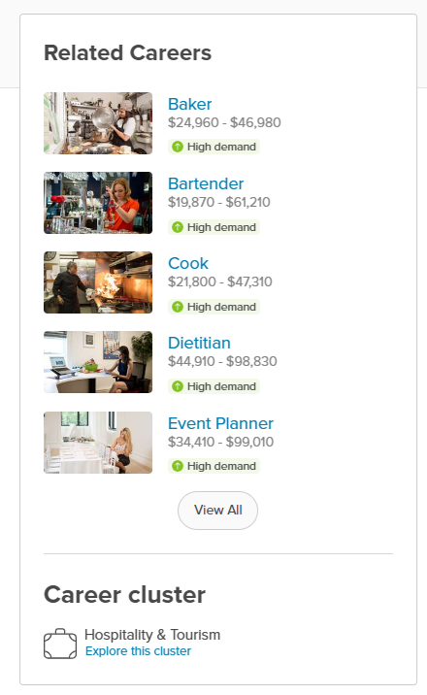
Exploring careers
Professional Interviews
Career Cluster

Slide 29
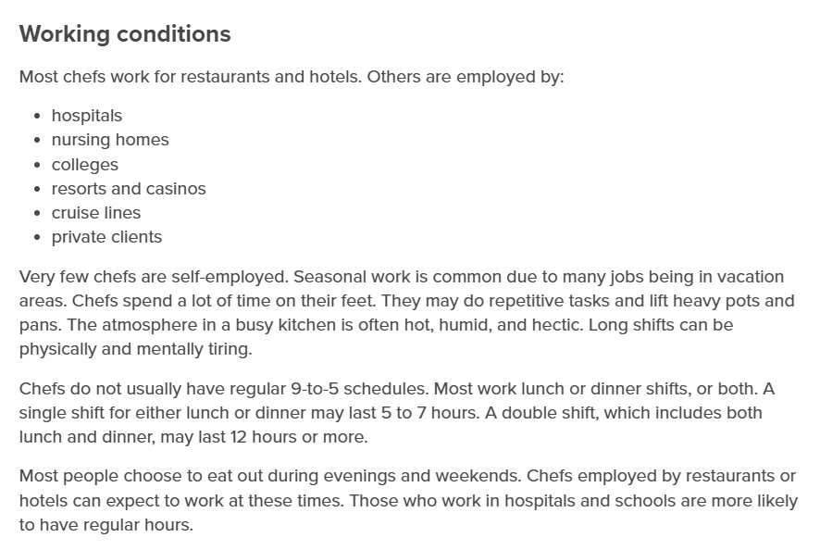
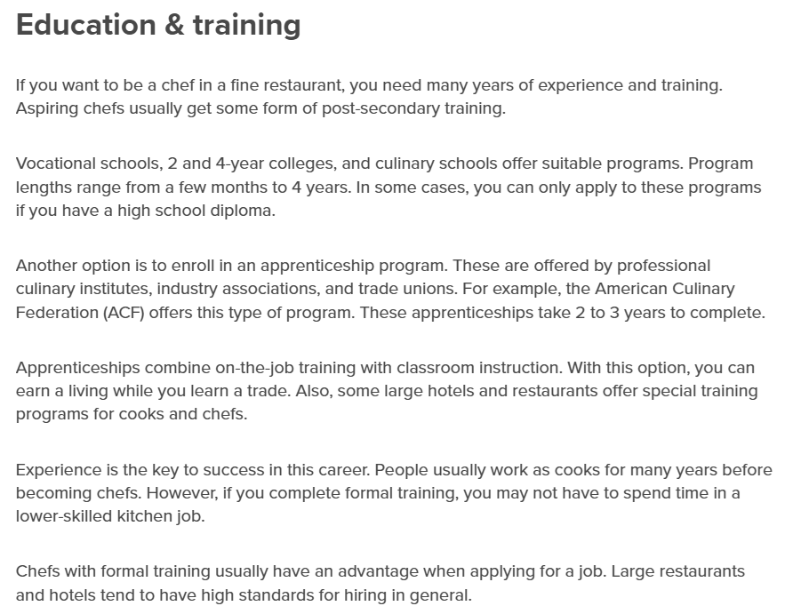
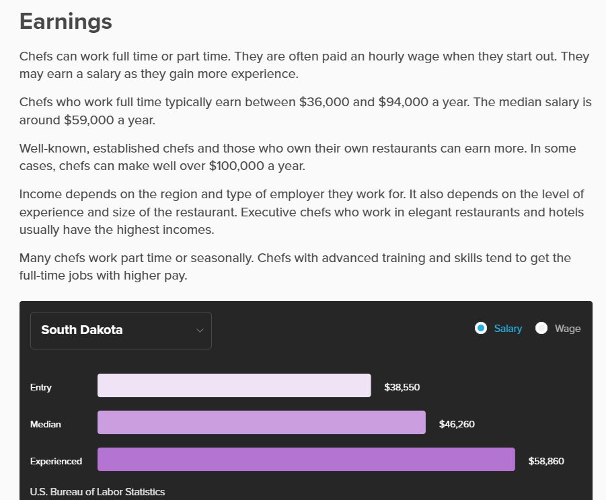
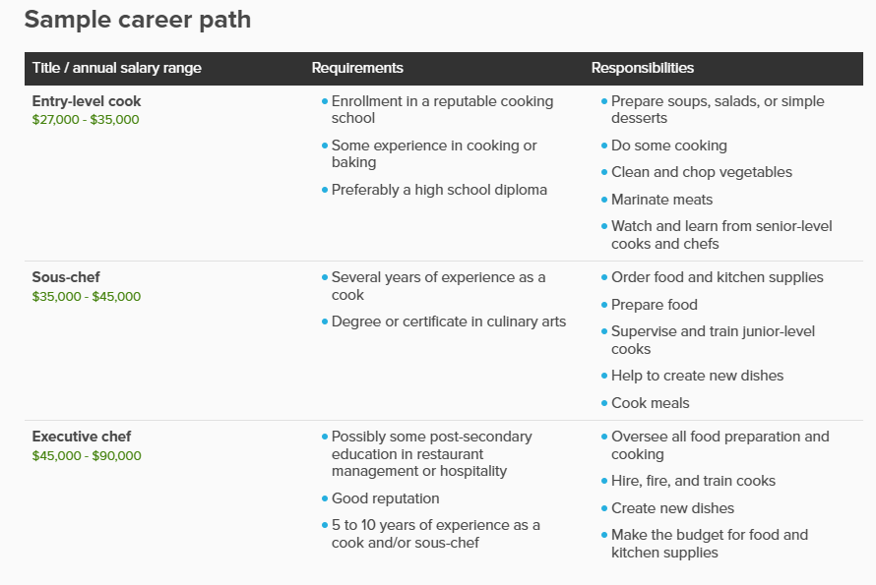
Exploring careers

Slide 30
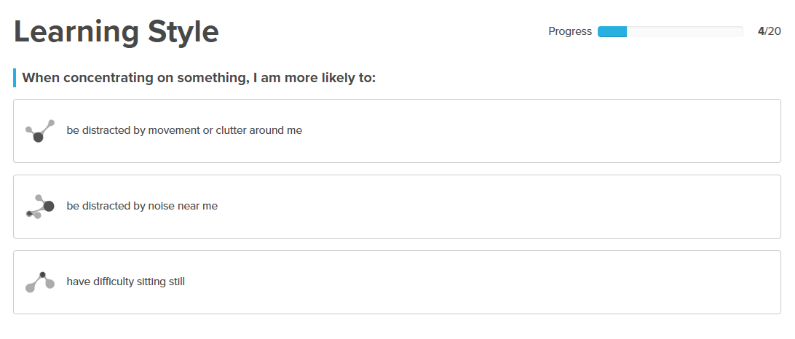
Additional assessments – learning style

Slide 31
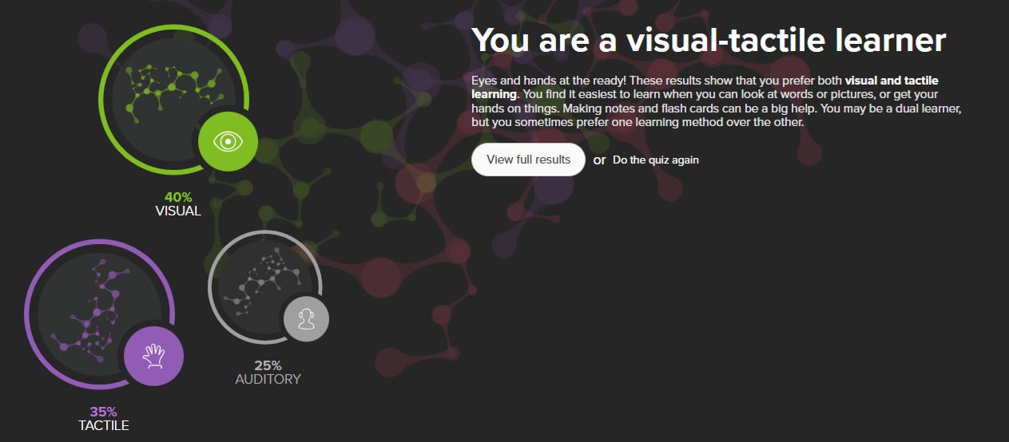
Additional assessments – learning style

Slide 32
Additional assessments – skills lab

Slide 33
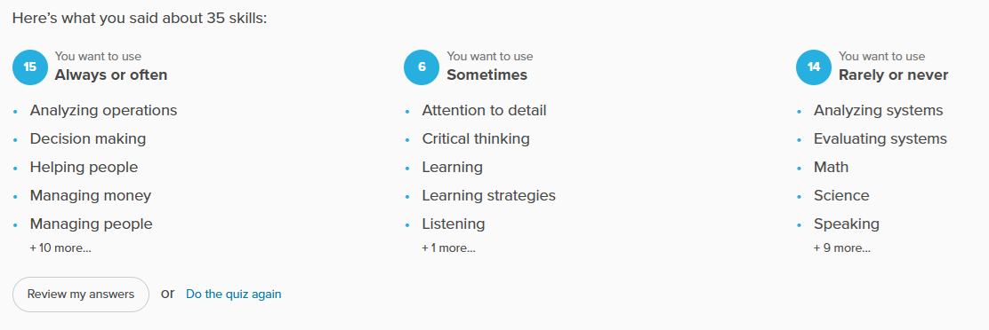
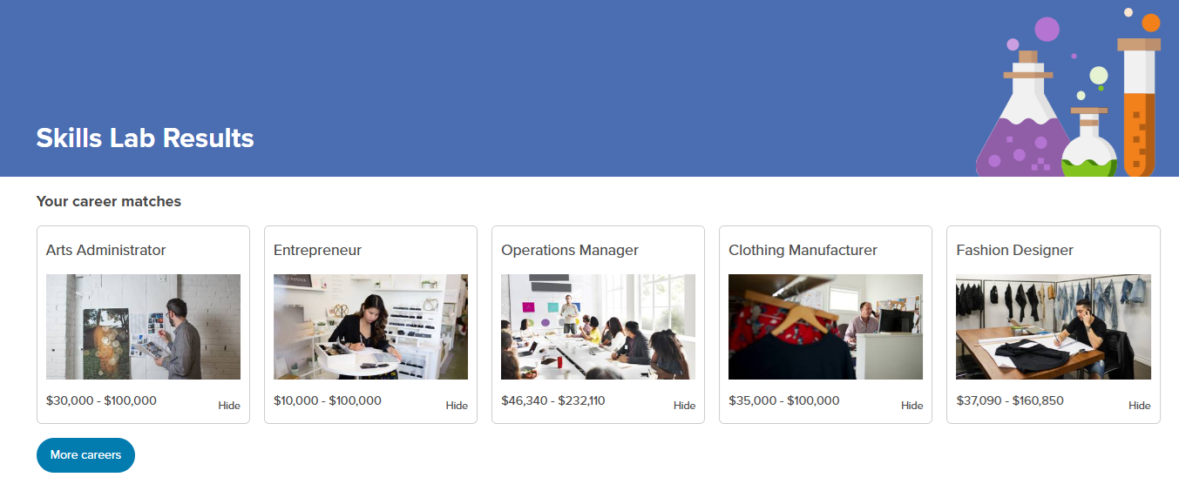
Additional assessments – skills lab

Slide 34
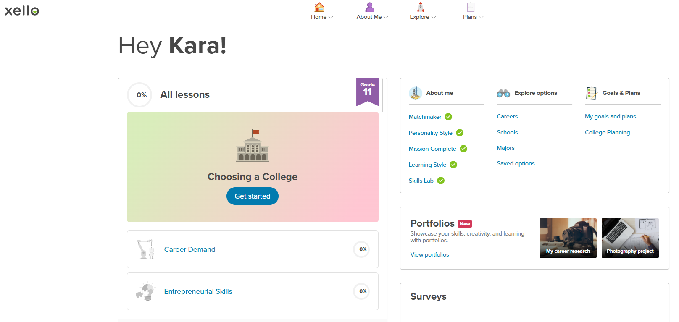

Slide 35
SDMyLife
Kara Schweitzer
SDMyLife and Career
Development Specialist
605.280.7501
Kara.Schweitzer@state.sd.us

