Slide 1

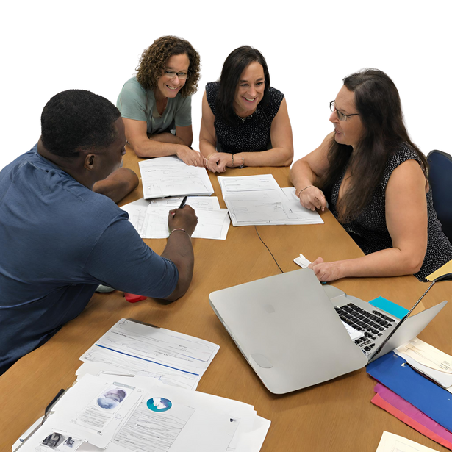
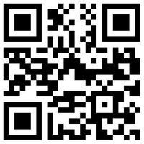
Regional Transition Liaisons:
The State of South Dakota has five regionally-based staff to provide support and technical assistance to students with disabilities and their families, as well as local education agencies seeking information on transition planning.
Activities provided by the liaisons include:
Training to students, families, schools, Vocational Rehabilitation (VR) counselors, and adult service agencies on transition and development of transition plans.
Identifying and obtaining instructional materials.
Written Technical Assistance Guide made available for special educators.
Services Provided:
Linkages with schools, families, and service agencies
Regional Transition Liaisons
Technical assistance and training
Identification of local resources
Transition assessment resources
Project Skills activities
Student leadership activities
Youth Leadership Forum coordination
Catch the College Wave and Let’s Talk Work events
Post-secondary linkages
TSLP Mission:
To be committed to the pursuit and application of ideas, strategies, and networks that will prepare students with disabilities to be life ready.
TSLP Website
http://tslp.org
The development of these materials was supported in part by IDEA Part B Grant #H027A 150091-15A from the U.S. Dept. of Education Office of Special Ed. Programs through the South Dakota Dept. of Ed. Special Ed. Programs. The views expressed herein do not necessarily reflect the views of the Dept. of Ed. and should not be regarded as such. Special Ed. Programs receives funding from the Office of Special Ed. Programs, Office of Special Ed. and Rehabilitative Services, U.S. Dept. of Ed. This information is copyright free. Readers are encouraged to copy and share, but please credit the Special Ed. Programs, SD Dept. of Ed.

Slide 2
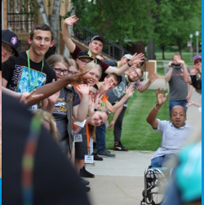
TSLP Offices
TSLP Project
Black Hills Special Services Coop
221 S. Central Ave., Suite 33
Pierre, SD 57501
Phone: (605) 494-3618
South Eastern Region
1501 S. Highline Ave. Suite 1C
Sioux Falls, SD 57110
Phone: (605) 362-4844
North Central Region
1707 4th Ave. SE
Aberdeen, SD 57401
Phone: (605) 626-2398
South Central Region
1321 N. Main St.
Mitchell, SD 57301
Phone: (605) 995-8172
Western Region
120 Industrial Dr., Suite 5
Spearfish. SD 57783
Phone: (605) 642-6989
What are Transition Services?
The supports and activities that are needed to assist a student with a disability to plan for and achieve post-school success. Transition Services are individualized and coordinated through a team approach and based on the student’s strengths, preferences, interests, and needs. Services include activities that will help a student to understand their strengths and needs and are focused on achieving post-school outcomes.
Youth Leadership Forum (YLF)
A unique career and leadership training program for high school students with disabilities to learn more about self-advocacy skills, disability awareness, and more.
Regional Transition IEP Workshops
Training for special education teachers and directors on how the transition process can guide IEP development to assist students in achieving their post-secondary goals.
Catch the College Wave
An event held on a post-secondary campus, designed specifically for high school students who have a disability and are considering post-secondary education.
Let’s Talk Work
An event designed for middle school/high school students who have a disability and want to learn more about careers, the skills it takes to get a job, and job expectations.
Technical Assistance Guide for Transition in the IEP
Designed for special educators writing a student’s IEP. This guide is free and available on our website.
Project Skills
A paid work experience program for high school students with disabilities. The work experience can last from 30 to 250 hours, with no overtime allowed. Students are paid an hourly wage.
Transition Services Prepare Students For:
Employment
Post-secondary Education
Vocational Training
Continuing and Adult Education
Adult Services
Independent Living
Community Participation

