Slide 1



Pre-ETS & Project Skills

Slide 2


Slide 3

DRS VR District Offices
Aberdeen/Pierre
Brookings/
Watertown/Huron
Rapid City/ Spearfish
Sioux Falls
Yankton/Mitchell/Chamberlain
https://dhs.sd.gov/en/rehabilitation-services/job-services-for-adults-with-disabilities
Notes:
Go to this website and get a link to referal

Slide 4
Division of Service to the Blind & Visually Impaired (SBVI) Rehabilitation Counselor Territories
Corson
McPherson
Marshall
Roberts
Mike Webb
605-626-2395
Campbell
Brown
Harding
Perkins
Walworth
Edmunds
Mike Webb
605-626-2395
Day
Dewey
Grant
Potter
Faulk
Codington
Butte
Kimberly Smith*
605-642-6901
Spink
Ziebach
Clark
Deuel
Sully
Hyde
Hamlin
Hand
Stanley
Hughes
Beadle
Kingsbury
Brookings
Lawrence
Meade
Haakon
Adam Krumwiede**
605-367-5330
Pennington*
Buffalo
Jerauld
Sanborn
Jones
Lyman
JoLynn Pichinte**
605-367-5330
Miner
Lake
Moody
Custer
Davison
McCook
Minnehaha**
Jackson
Mellette
Brule
Aurora
Hanson
Matthew Markve*
605-394-2261
Tripp
Douglas
Hutchinson
Turner
Lincoln
Bennett
Gregory
Rob Jonas**
605-367-5330
Fall River
Oglala Lakota
Todd
Charles Mix
Bon
Homme
Yankton
Union
VR Territories
June 2026
Clay
Minnehaha** and Pennington* counties served by VR Counselors as designated.
For more information contact: (605) 773-4644
Notes:
South Dakota has 2 Vocational Rehabilitation Programs. SBVI works with individuals who are blind and/or visually impaired.

Slide 5




Who is Eligible for VR services?
  Documented permanent disability
  Substantial Impediment to Employment
  Eligible for SSI/SSDI benefits
  Desire to work
  Needs supports to be successful at work
  Potentially Eligible
  504 Students

Slide 6

Individual Education Program <> Individual Plan for Employment
IEP
IPE
  CTE class for welding
  Increase competencies in Writing and Reading
  Goal to lead IEP
  Post-school goal - Attend MTI for welding
  Project Skills - Welding experience
  Assistance in Resume and Cover Letter Development using Pathful Explore
  Youth Leadership Forum
  Explore training and financial aid options
Notes:
Jen Start

Slide 7
Pre-Employment Transition Services
JOB EXPLORATION
WORK READINESS
SELF-ADVOCACY
POST-SECONDARY
WORK EXPERIENCE
  Pathful Explore
  Informational Interviews
  Career Fairs
  Exploring Local Employment Availability
  Job Analysis
  Workplace Tours
  eTrac
  Let’s Talk Work
  Soft Skills Development
  Mock Interviews
  Master Application
  Resume Development
  YLF
  Disability Disclosure
  Understanding Accommodations
  IEP Discussion
  Public Transportation Training
  Catch the Wave
  Technical College VS. University
  Campus Visits
  College Fairs
  Major Research
  18-21 Transition Program Opportunities
  Project Skills/ESP
  Project SEARCH
  Summer Employment
  Apprenticeships
  Job Shadowing
  Volunteering
*Services are individualized for every student pending their needs*
Talk with your VR Counselor to learn more!
Notes:
Bernie Start
15% or our Federal award are required to spend on PRETS
VRCs are assigned to every public and tribal school is SD as well as adults on caseloads
services provided by each VRC will look different
VRCs are not trained as teachers so might not be comfortable doing classroom presentations while others are

Slide 8

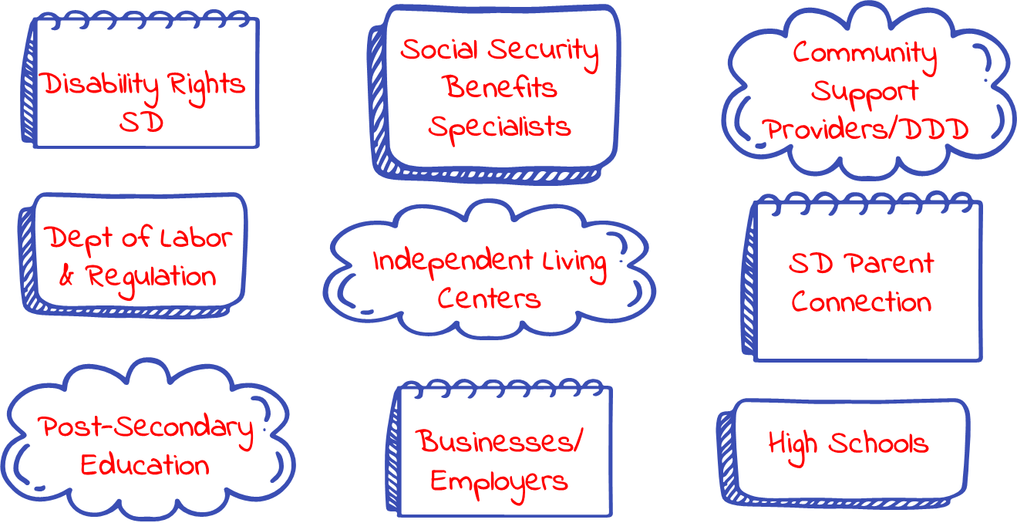
Working Relationships
Notes:
Jen Start

Slide 9
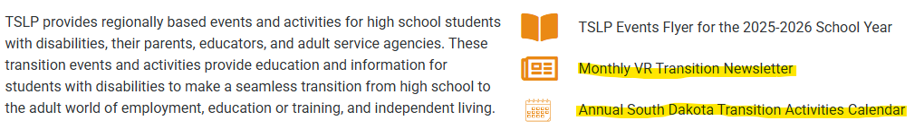
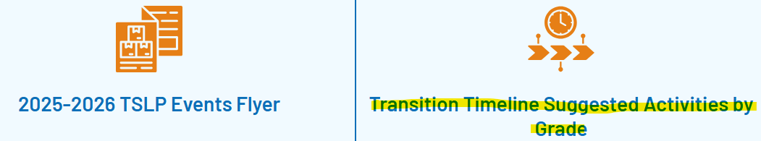

Transition Activities Calendar & Newsletters
  tslp.org/events
Transition Timeline
  tslp.org/professional
Notes:
Jen Start

Slide 10

Notes:
Jen Start

Slide 11
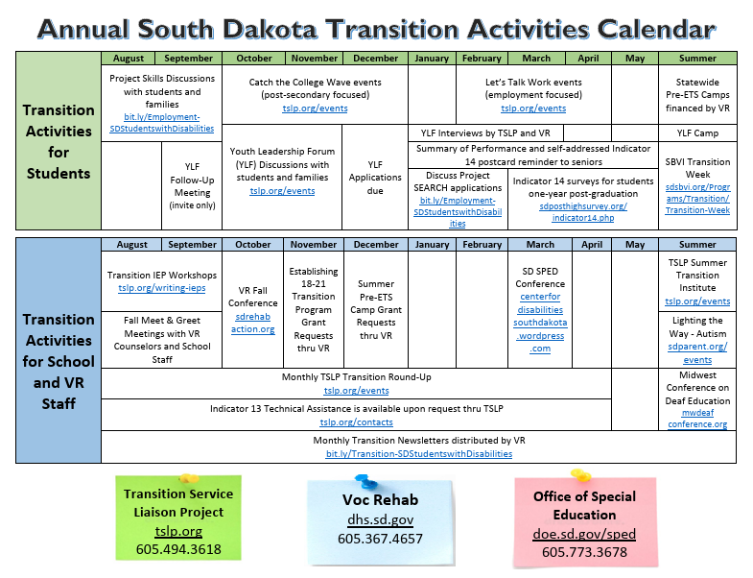
Notes:
Bernie Start

Slide 12
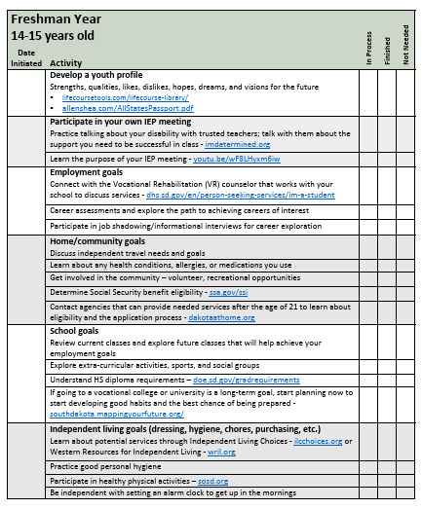
Notes:
Jen Start

Slide 13


Project
Skills
JOB DEVELOPMENT
JOB COACHING
MONITORING
  Look for a placement closely related to IEP goal
  Focus on students’ strengths
  Community business tours
  Applications and interviews
  Assisting with ADP new hire onboarding
  Work accommodations
  Encourage problem solving before helping
  Teach workplace expectations
  Encourage self-advocacy
  Ongoing conversations with onsite supervisor
  Approving timecards
  Workplace discussions
Notes:
Bernie Start
Project Skills is 31 years old this fall. It is one of the most successful transition programs available.
For students on IEP 16 years or older
It is a paid work experience where we partner with a business to provide a real work environment.
VR pays with federal funds the wages, workers comp and other payroll requirements.
School provides the match by direct services of job development, job coaching and monitoring the student. The match is documented by the quarterly assurance of match report. School can provide this directly or contract out these services.
Avoid placements within the school
think about the supports the students uses at school
Written to-do lists/checklists
visual schedules
Demonstrate then have them repeat
showing up on time
following directions
work attire
how to handle feedback
workplace language
work as a team
greeting coworkers and customers
fade your support while building natural supports

Slide 14
Work Agreement
Basic Information of Host Worksite, School District, VR Counselor, & Participant
Host Worksite Obligation: Provide safe worksite, general liability; auto insurance if the student has to drive.
Participant Obligation: follow training plan: follow policies; be to work on time, dress appropriate
Original Agreement vs Modified Agreement
Signatures.
Spend time on develop good training plan.
250 hours per year
Can do following years but not same job/tasks
Notes:
250 Hours
Employer changed to Host Business

Slide 15

PAID EVERY TWO WEEKS
NO USER ID/ NO PASSWORD
only emails and email password due to Microsoft Single-Sign-On
IPE and ONBOARDING FORM
Starts the Project Skills process and getting them into ADP
ONBOARDING PAPERWORK
Onboarding Form; I9; W4; SSA form; Wage Consent; Work Agreement
SS card and state ID/driver’s license
PS HOST SITE
Employers sign off on the PS Work Agreement & can help verify hours worked
Notes:
Last year we switched to a more real experience time keeping system with Automatic Cata Processing.

Slide 16

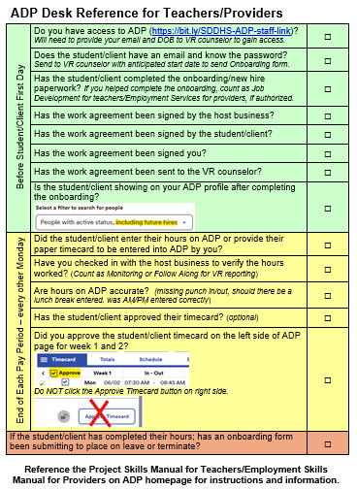
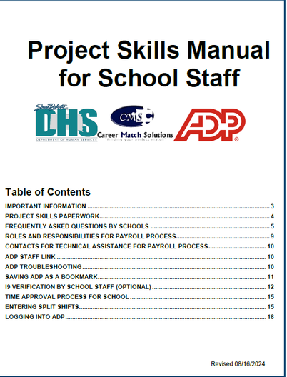

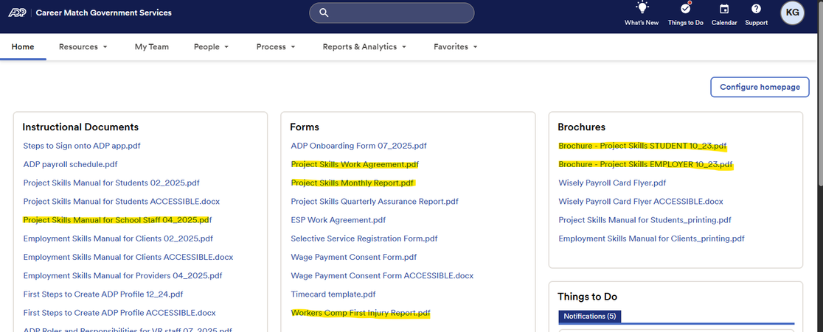
bit.ly/SDDHS-ADP-staff-link
DESK REFERENCE FOR SCHOOL STAFF
PS MANUAL FOR SCHOOL STAFF
ADP HOMEPAGE
Notes:
please take the time to review the manuals
ADP homepage
>all manuals
>monthly and quarterly
>workers comp injury report
>work agreement - recently updated

Slide 17
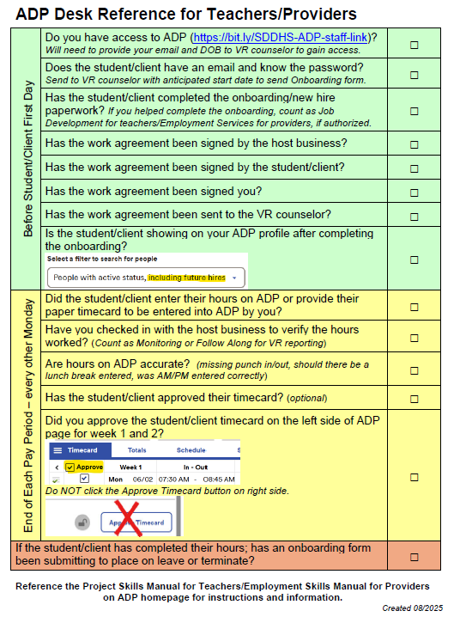

Slide 18
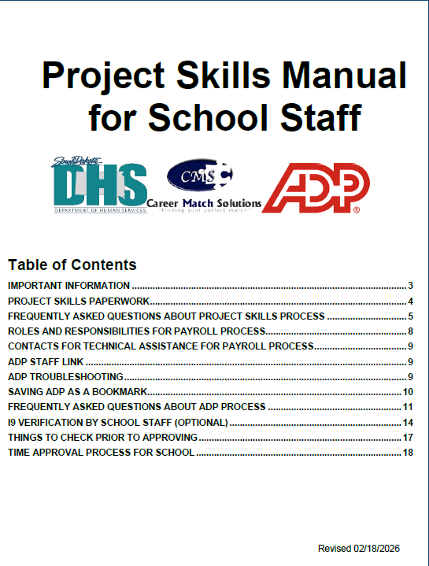

Slide 19
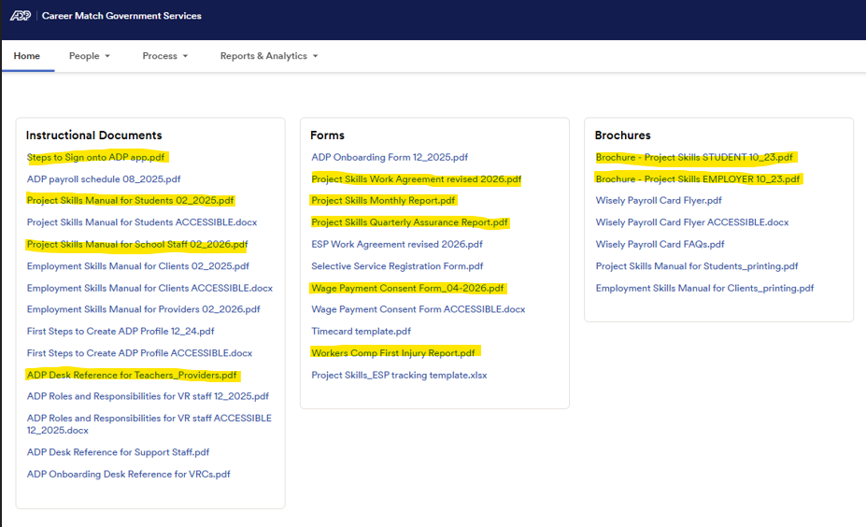

Slide 20




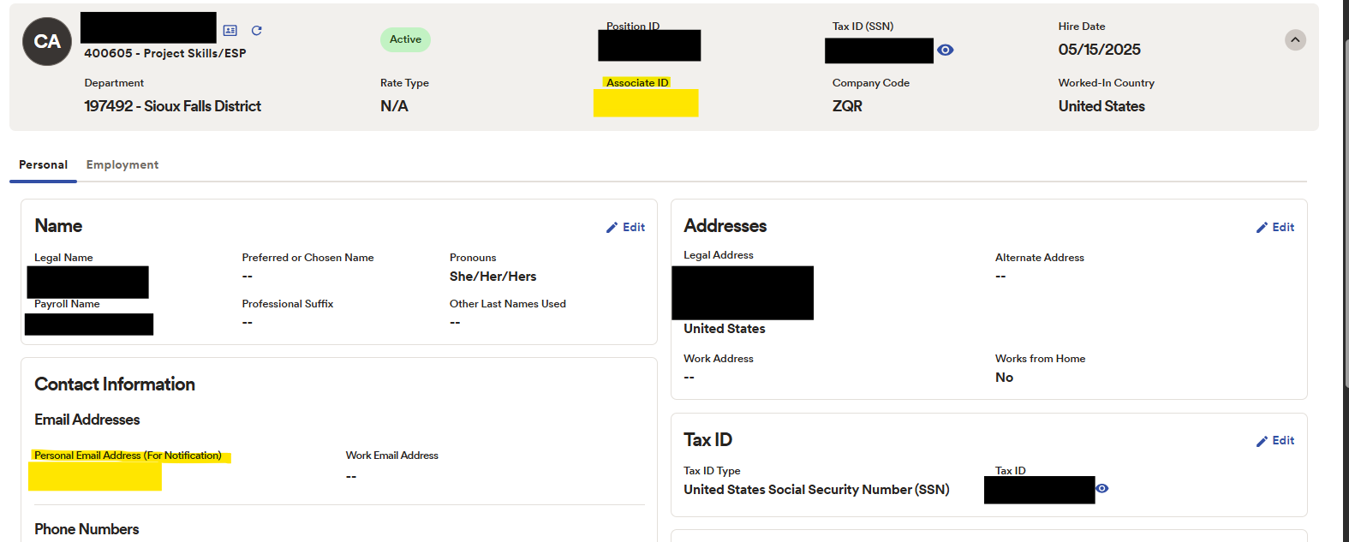
“Steps to Sign onto ADP App”
NO USER ID
NO PASSWORD
Notes:
some emails may have different verification processes
parental controls
incognito tabs if on a shared computer

Slide 21

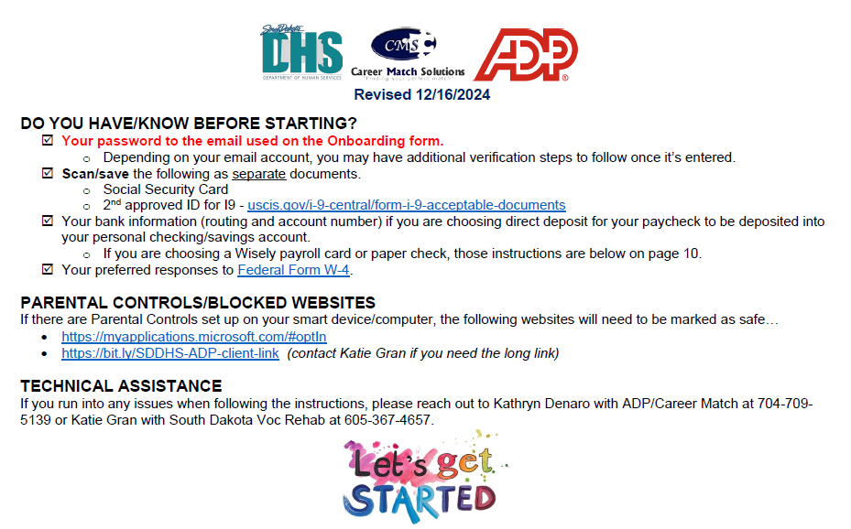
First Steps to Create ADP Profile
Notes:
some emails may have different verification processes
parental controls
incognito tabs if on a shared computer

Slide 22

Forgot User ID or Password?
  There are NONE for ADP - only their email and email password.
No email?
  Create a free professional one for future work needs
  Can use parents but they will need to assist with onboarding
Email or Phone changes?
  VR Transition Specialist needs to be notified
No phone to download app?
  Paper timecard, use website to enter hours

Slide 23
Hours per week
  Per the signed written agreement, students CANNOT work more than 20 hours/week without VR approval.
Change in paycheck delivery
  Fill out a “Wage Payment Consent Form” and change input information themselves or contact their VRC for guidance
Monthly Reports
  Onboarding help counts as job development
  Signing off on timecards counts as monitoring

Slide 24

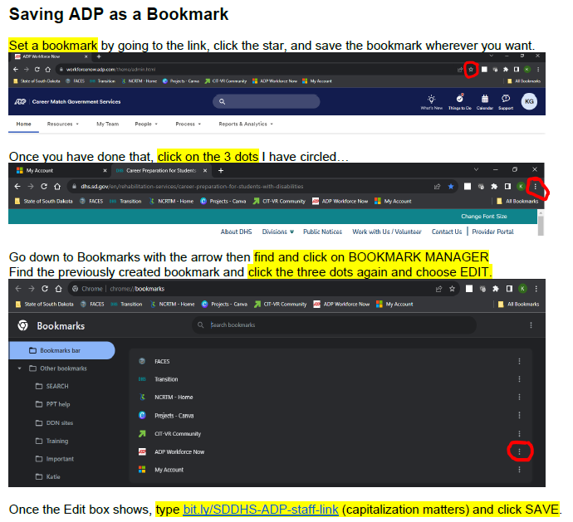

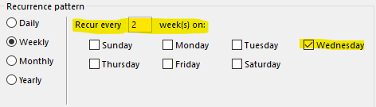
Special steps to bookmark link.
Create a biweekly reminder on calendar to approve timecards.
Notes:
instructional, Microsoft SSO, ADP with associate ID
email must be individualized to the student
phone number can be the teacher's (will get a text verification when they log into a new device)

Slide 25



Check for missing
punch in/outs ~ be sure to input AM or PM.
Review long shifts ~ Did VR agree to long shift? Missed lunch break?
Talk with business to ensure shifts were worked as scheduled.
Notes:
instructional, Microsoft SSO, ADP with associate ID
email must be individualized to the student
phone number can be the teacher's (will get a text verification when they log into a new device)

Slide 26
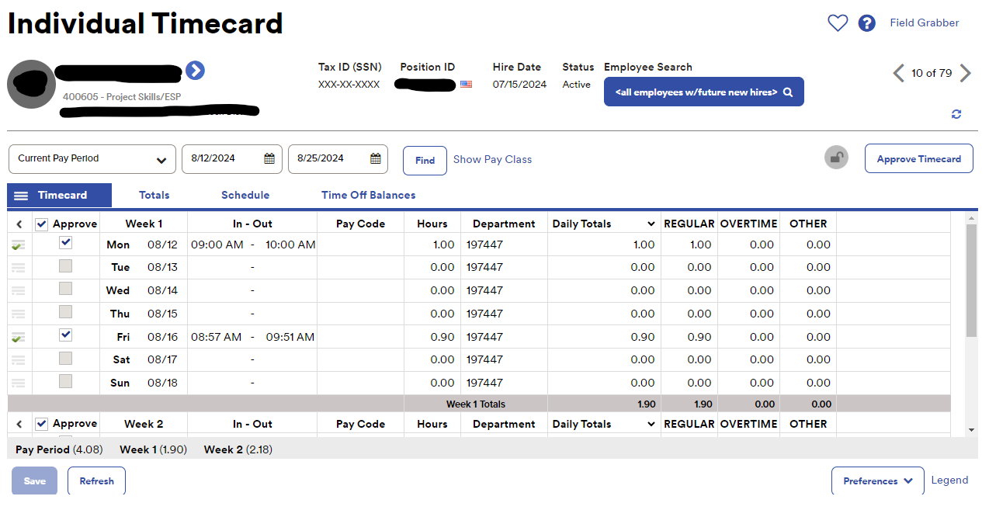



Notes:
two week email reminder on Mondays

Slide 27


Beyond High School
Services without Financial Need
  Counseling and guidance
  Job Placement, Job Coaching, & Follow Along
  Independent Living Services
  Social Security Benefits Specialist Services
  Information and Referral
  Non-FASFA Training Programs
  Interpreter Services
  Assistive Technology
Services with Financial Need
  Licenses (occupational or business)
  Tuition/Fees for FASFA programs
  Tools, Equipment, Supplies, Books
  Maintenance Services
Notes:
Bernie Start
Maintenance examples – expenses that are required to participate in VR services, travel to a training, daycare to attend services, so on

Slide 28


Thank you!
Any additional questions?

